Slide 1

NCA5 Website: https://nca2023.globalchange.gov
Chapter Website: https://nca2023.globalchange.gov/chapter/10
NCA5 Atlas: https://atlas.globalchange.gov
Figure captions can be found in the slide notes of this deck
Social media: @usgcrp, #NCA5

Slide 2
Chapter 10 | Oceans

Slide 3
1
Unprecedented Climate Impacts Threaten Ecosystems and Human Well-Being
Climate change is significantly altering US marine ecosystems at a pace, magnitude, and extent that is unprecedented over millennia (very high confidence). Changes in species locations, productivity, and seasonal timing are cascading through ecosystems, threatening critical connections between people and the ocean (high confidence), especially for Indigenous Peoples (very high confidence). Risks to marine ecosystems and the people connected to them will be greater under higher scenarios (likely, very high confidence) and will depend on the ability of ecological and social systems to adapt to the pace of climate change (very high confidence). Continued climate change, particularly under higher scenarios, is projected to push many systems toward novel conditions and critical tipping points (very high confidence), beyond which the risk of significant impacts to marine ecosystems, including collapse, is high, adaptation may be insufficient, and human well-being is threatened (high confidence).

Slide 4
2
Climate Change Is Altering Marine-Related Economic Activities
Climate change poses a substantial risk to ocean-related industries and economic activities such as fisheries, tourism, recreation, transportation, and energy (high confidence). As climate change continues, economic and cultural impacts are expected to become larger and more widespread, especially under higher scenarios and in communities that are highly dependent on ocean resources (very high confidence). A range of approaches can facilitate adaptation to some degree of climate change (medium confidence), but higher levels of climate change will limit the success of adaptation measures and markedly increase climate risk to marine-related economic activities (high confidence).

Slide 5
3
Our Future Ocean Depends on Decisions Today
Future risks to marine ecosystems, ocean resources, and people will be substantially reduced by implementing adaptation and mitigation actions now (very high confidence). Responding swiftly to climate change will improve outcomes, reduce costs, promote resilience and equity, and allow the widest possible suite of adaptation solutions (very high confidence). Impacts will continue to be uneven across communities, with more harmful outcomes in communities that are highly ocean-reliant and historically marginalized, unless equitable adaptation and mitigation efforts are implemented (high confidence).

Slide 6
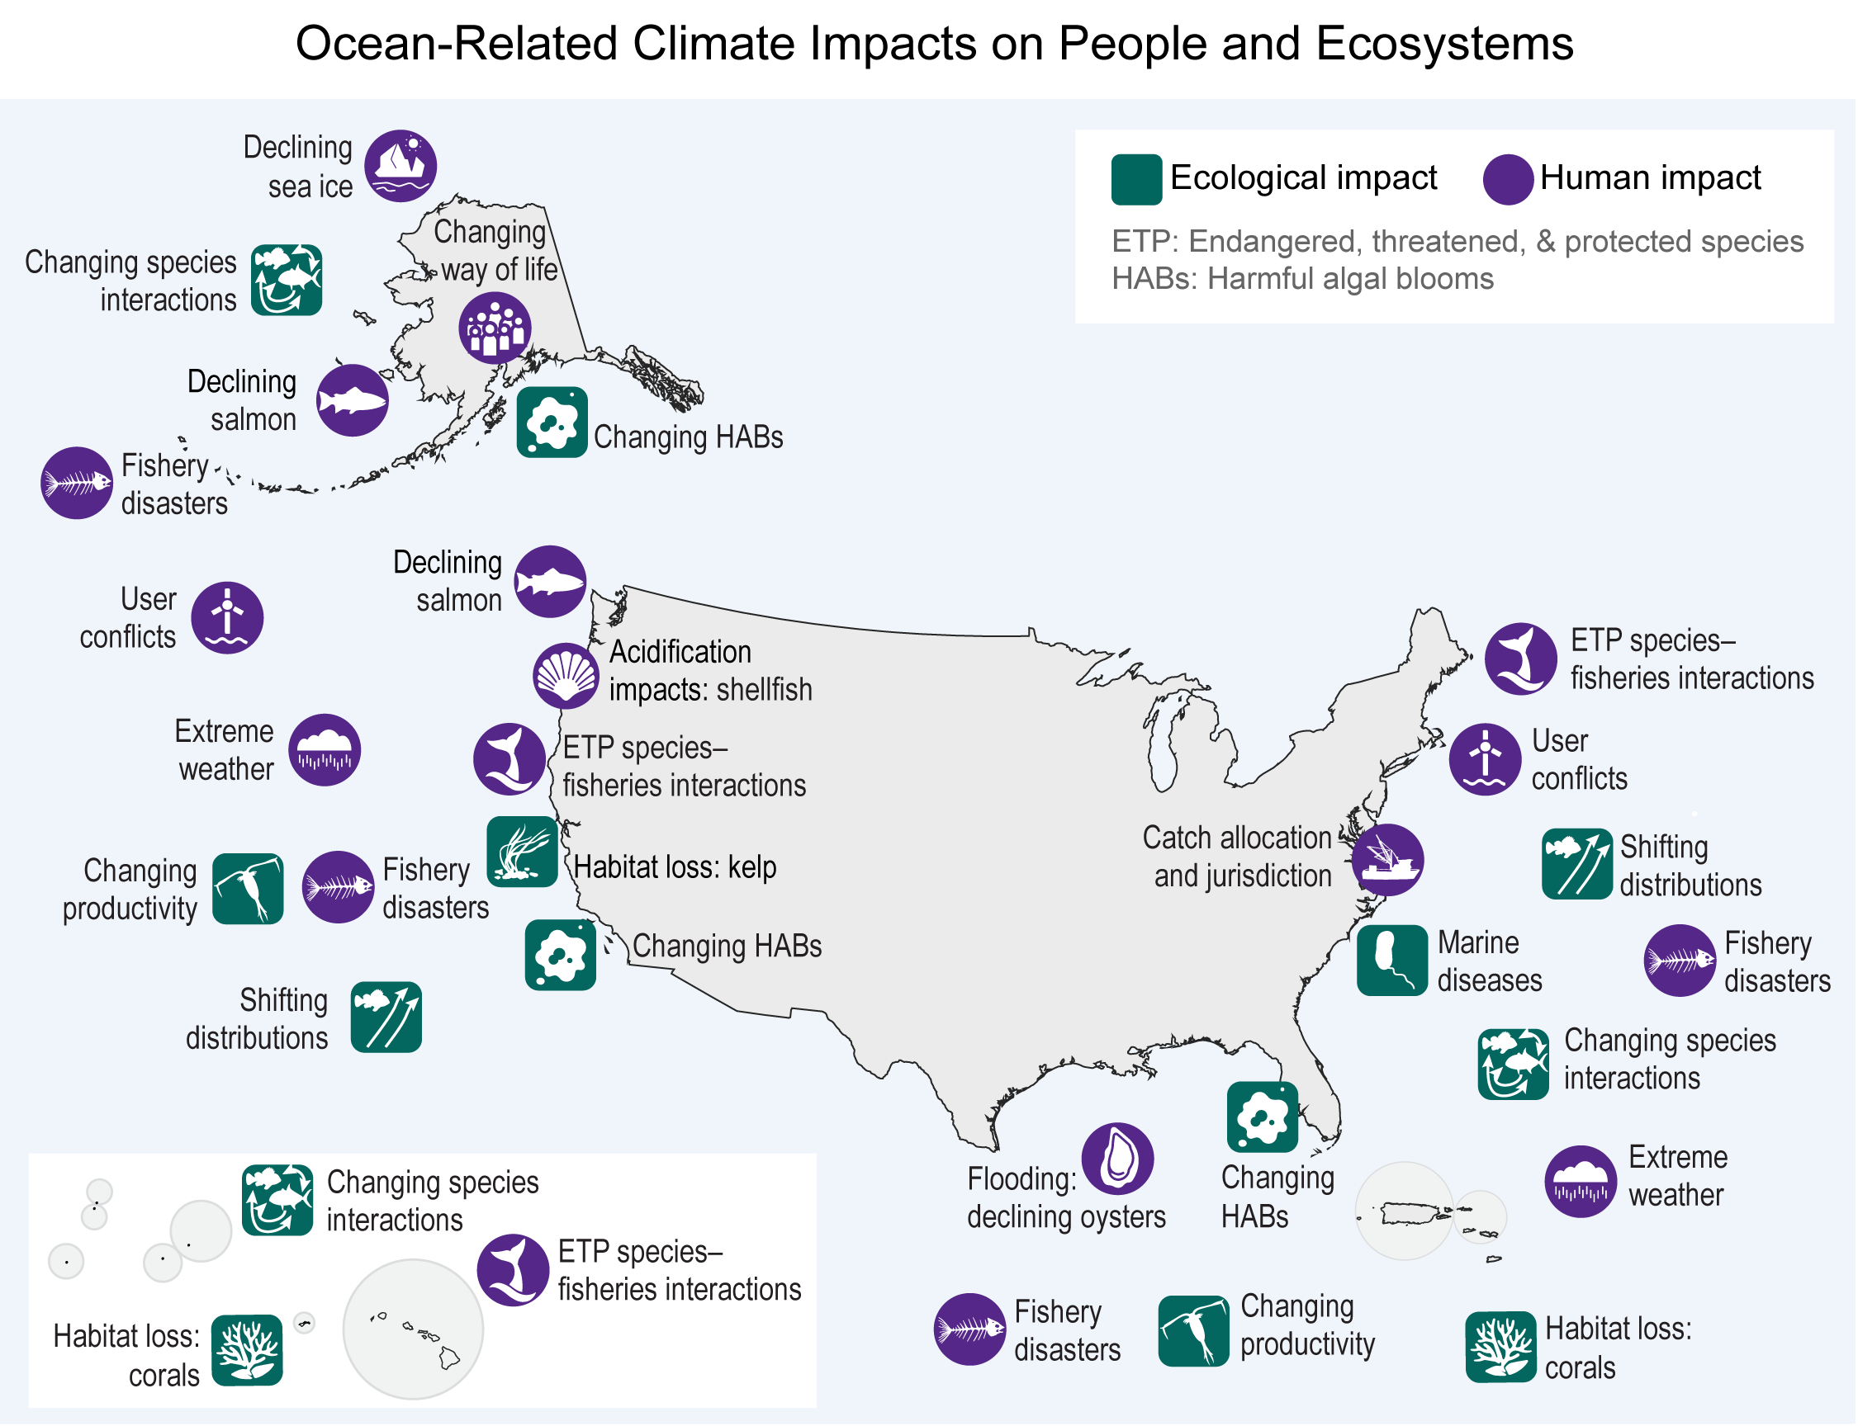
Figure 10.1. Many broad-scale climate-related ecological and human impacts are occurring in US marine areas.
Notes:
CAPTION: Climate change is affecting marine ecosystems and impacting human activities in the US ocean. The nature of ocean-based climate impacts is often unique to local areas but can cascade through social–ecological systems to affect the entire country. For example, extreme weather events impact shipping and supply chains, and harmful algal blooms (HABs) in coastal areas affect tourism. User conflicts, such as those involving the siting of offshore renewable energy in fishing areas, have created tensions in US waters. Climate impacts on physical ocean conditions are covered in Chapters 2 and 3. Figure credit: The Nature Conservancy.

Slide 7
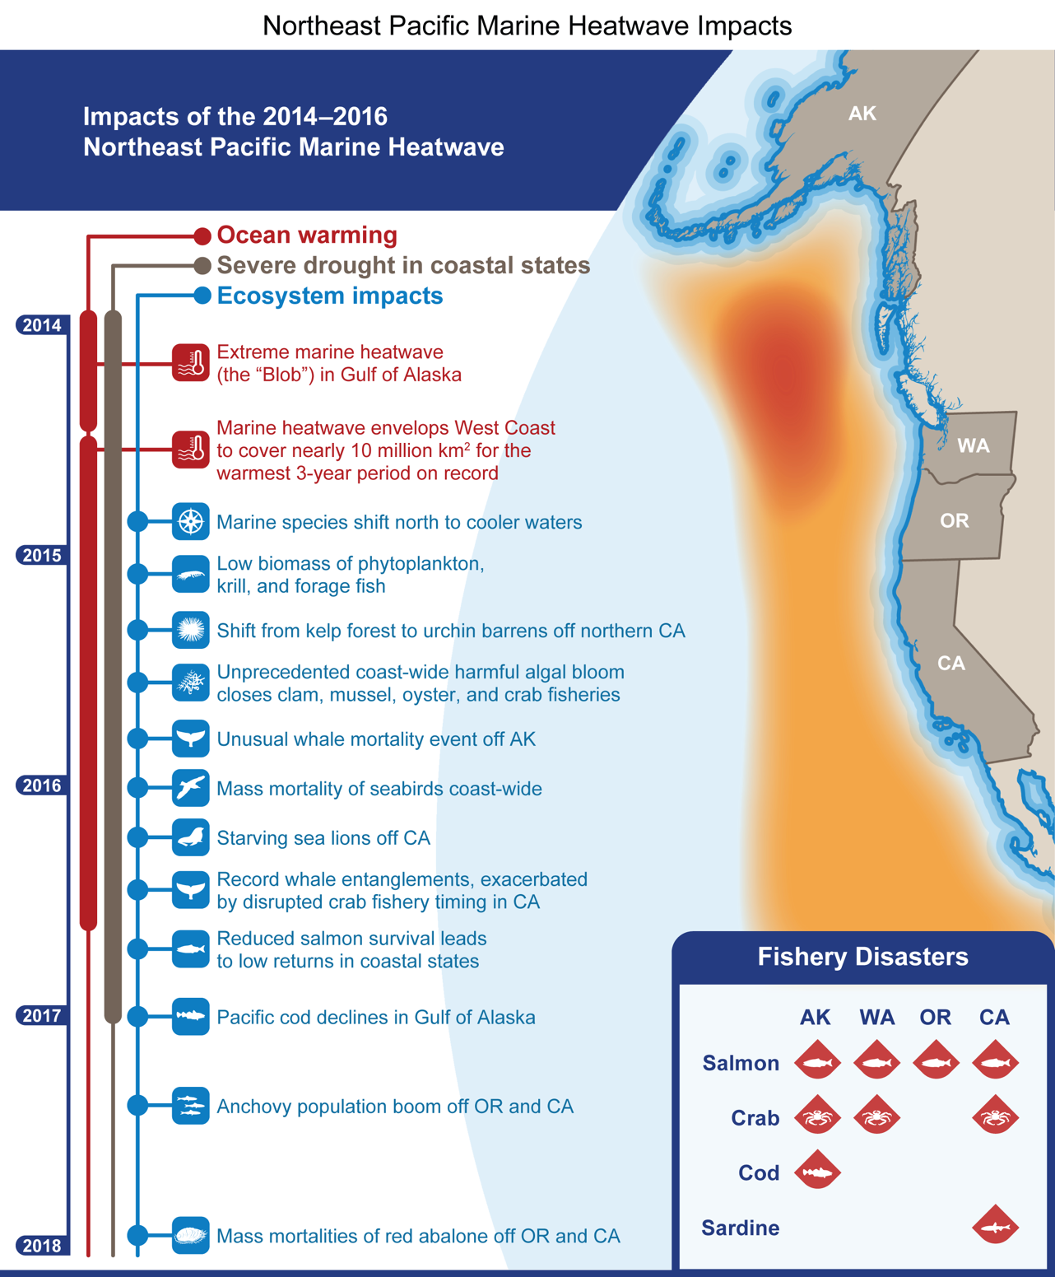
Figure 10.2. The West Coast has experienced unprecedented warm ocean temperatures and environmental disruptions from marine heatwaves.
Notes:
CAPTION: Heatwaves have caused extensive disruptions to marine ecosystems and, in turn, to human communities and economies. Shown here are the widespread impacts of a massive marine heatwave that began in the Gulf of Alaska and subsequently covered the entire West Coast, persisting for several years and coinciding with severe drought over land. Icons on the timeline indicate when impacts occurred; many impacts were sustained for months or years but, for clarity, are shown only at a representative time when they were particularly prevalent. Impacts described as coast-wide or without a specific location occurred off all West Coast states: Alaska, Washington, Oregon, and California. Fishery disasters, as determined by the US secretary of commerce, are shown for individual species (Pacific sardine, Pacific cod) or groups of species (salmon, crab). While the largest heatwave dissipated by 2017, effects of the 2014–2016 heatwave have persisted in the form of lasting ecological changes and new adaptation measures designed to mitigate negative impacts in the future. Figure credit: NOAA Southwest Fisheries Science Center.

Slide 8
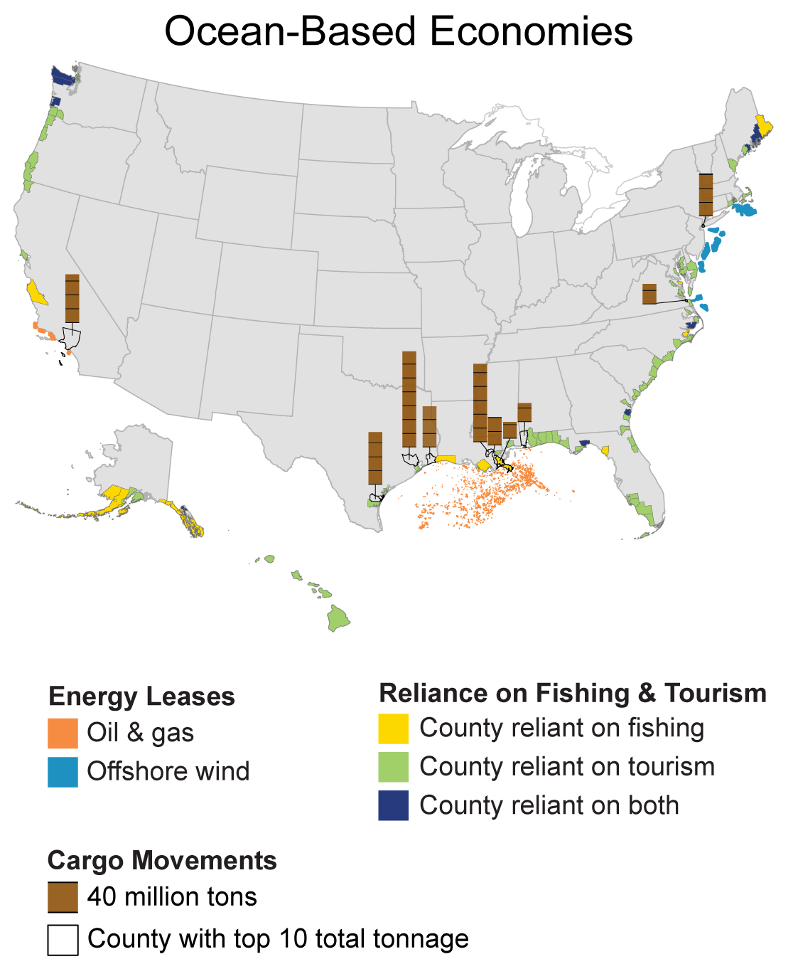
Figure 10.3. Communities throughout coastal America rely on ocean-related industries for major shares of their local economies.
Notes:
CAPTION: Ocean industries such as fishing, shipping, and tourism are important economic activities in coastal communities across the United States. The Nation’s continental shelf is a major source of energy from oil and gas, and renewable energy, particularly offshore wind, is being developed in multiple areas. The ocean-based economy is even more critical to the island commonwealths and territories in the Pacific and Caribbean, although economic data comparable to that for the 50 US states are not available. Economic dependence on ocean resources is proportionately highest in rural communities, which have fewer economic alternatives if they experience climate-related disruptions.(Bhattachan et al. 2018; Jurjonas and Seekamp 2018) Figure credit: Middlebury Institute of International Studies, NOAA NCEI, and CISESS NC.

Slide 9
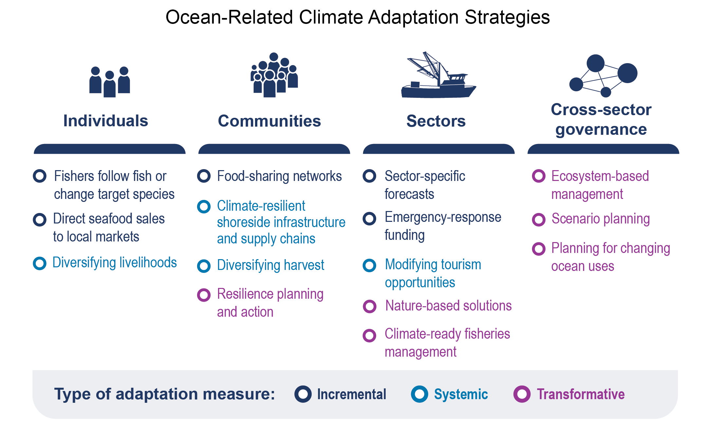
Figure 10.4. Adaptation can occur at many organizational scales—from individuals to governance systems.
Notes:
CAPTION: Many types of adaptation measures are being undertaken, or are under consideration, as ways to respond to and prepare for climate change impacts on ocean activities and economic sectors. The measures range from small adjustments (incremental) to larger actions within current socioeconomic and management systems (systemic) and substantial changes beyond existing systems (transformative). Figure credit: Gulf of Maine Research Institute.

Slide 10
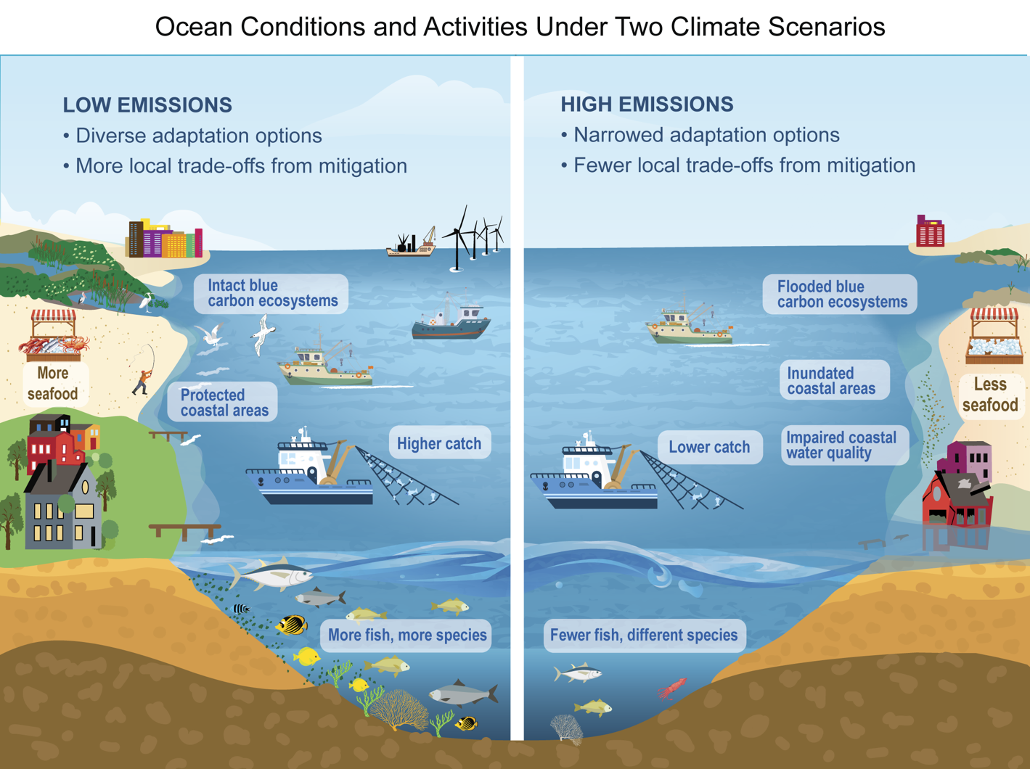
Figure 10.5. Future ocean conditions and activities will depend on emissions levels and mitigation strategies.
Notes:
CAPTION: Future marine ecosystems and human activities will differ under low versus high greenhouse gas emissions scenarios. This figure is a simplified depiction of major predicted changes as a result of climate change. Under low scenarios (left), more adaptation options remain available, and ocean services such as food provision and coastal protection are maintained, but trade-offs between ocean-based activities will escalate. Under high scenarios (right), ecosystems will be altered, fewer adaptation options will be available, and losses of services are expected across diverse sectors. Figure credit: Center for American Progress and Gulf of Maine Research Institute.

Slide 11
Federal Coordinating Lead Author
Emily B. Osborne, NOAA Oceanic and Atmospheric Research, Atlantic Oceanographic and Meteorological Laboratory
Chapter Lead
Katherine E. Mills, Gulf of Maine Research Institute
Chapter Authors
Richard J. Bell, The Nature Conservancy
Charles S. Colgan, Middlebury Institute of International Studies at Monterey, Center for the Blue Economy
Sarah R. Cooley, Ocean Conservancy
Miriam C. Goldstein, Center for American Progress (through February 2023)
Roger B. Griffis, NOAA Fisheries
Kirstin Holsman, NOAA Alaska Fisheries Science Center
Michael Jacox, NOAA Southwest Fisheries Science Center and NOAA Physical Sciences Laboratory
Fiorenza Micheli, Stanford University
Review Editor
Andrew A. Rosenberg, University of New Hampshire
USGCRP Coordinators
Fredric Lipschultz, US Global Change Research Program / USRA
Drew Story, US Global Change Research Program / ICF (through July 2022)

Slide 12
Mills, K.E., E.B. Osborne, R.J. Bell, C.S. Colgan, S.R. Cooley, M.C. Goldstein, R.B. Griffis, K. Holsman, M. Jacox, and F. Micheli, 2023: Ch. 10. Ocean ecosystems and marine resources. In: Fifth National Climate Assessment. Crimmins, A.R., C.W. Avery, D.R. Easterling, K.E. Kunkel, B.C. Stewart, and T.K. Maycock, Eds. U.S. Global Change Research Program, Washington, DC, USA. https://doi.org/10.7930/NCA5.2023.CH10
https://nca2023.globalchange.gov/chapter/10

