Slide 1

NCA5 Website: https://nca2023.globalchange.gov
Chapter Website: https://nca2023.globalchange.gov/chapter/12
NCA5 Atlas: https://atlas.globalchange.gov
Figure captions can be found in the slide notes of this deck
Social media: @usgcrp, #NCA5

Slide 2
Chapter 12 | Built Environment, Urban Systems, and Cities

Slide 3
1
Urban Areas Are Major Drivers of Climate Change
Consumption of food, energy, water, and materials is a major driver of global climate change, and these consumption activities are disproportionately concentrated in urban and suburban areas (virtually certain, very high confidence).

Slide 4
2
Attributes of the Built Environment Exacerbate Climate Impacts, Risks, and Vulnerabilities
Urban development patterns can exacerbate climate change impacts such as increases in heat and flooding (virtually certain, very high confidence). Climate change is amplifying existing loads and stressors on the built environment, and this is expected to continue (virtually certain, very high confidence). Urban areas face elevated risk as both people and the built environment are exposed to climate hazards, and these risks are distributed unevenly across the population (virtually certain, very high confidence).

Slide 5
3
Urban Environments Create Opportunities for Climate Mitigation and Adaptation
Cities across the country are working to reduce greenhouse gas emissions and adapting to adverse climate impacts (likely, high confidence). Some states and cities are integrating climate considerations into relevant codes, standards, and policies. However, the pace, scale, and scope of action are not yet sufficient to avoid the worst impacts, given the magnitude of observed and projected climate changes (virtually certain, very high confidence).

Slide 6
4
Community-Led Actions Signal a Shift Toward Equitable Climate Governance
There is varying progress in considering who benefits from, or bears the burden of, local climate actions (very likely, high confidence). The emergence of local and community-led approaches—coupled with increasing collaboration among city, Tribal, state, and federal governments—indicates a movement toward more inclusive planning and implementation of climate actions (likely, high confidence).

Slide 7
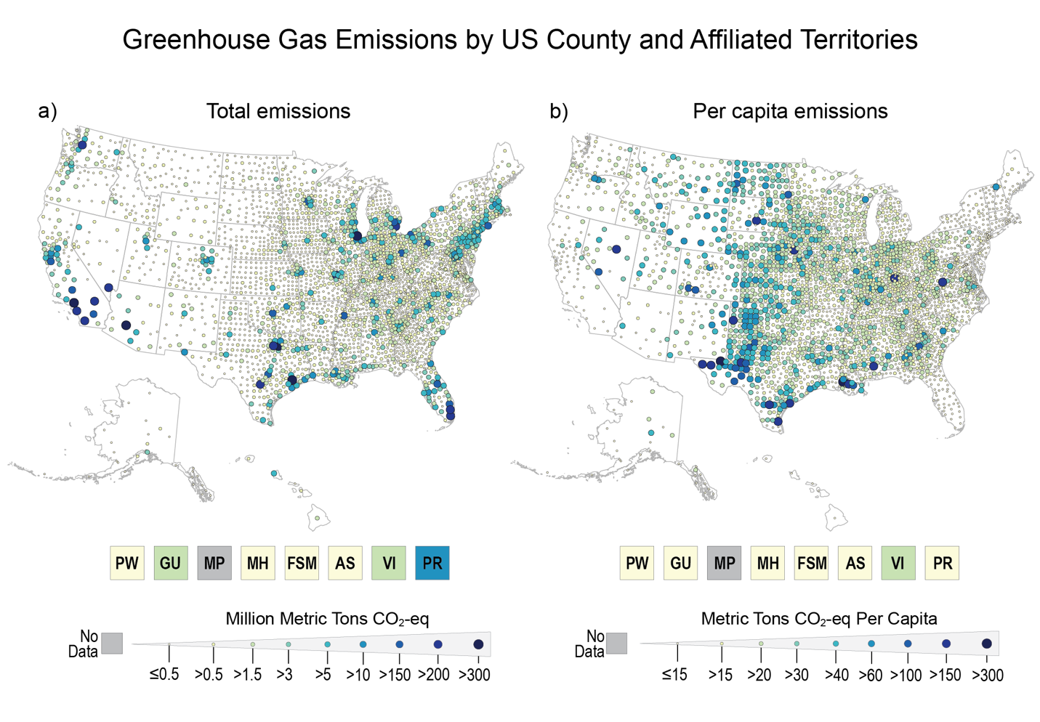
Figure 12.1. Urban and suburban areas contribute the majority of total greenhouse gas emissions through their consumption and populations.
Notes:
CAPTION: The maps show the total (a) and per capita (b) emissions, measured in millions of metric tons of carbon dioxide equivalent (CO₂-eq) and metric tons of CO₂-eq per person, respectively. Total GHG emissions across the country are concentrated in cities and suburban areas. However, per capita emissions levels of urban and suburban residents are relatively lower compared to rural areas, although measurements usually omit indirect emissions by urban residents or the variations in their consumption levels. Emissions sources included are from electricity and natural gas used by residential, commercial, and industrial buildings, together with gasoline and diesel fuel used by on-road transportation, but do not include consumption of food, water, and materials. Data for the 50 states plus DC are by county or county equivalent for the year 2016. Data for Palau (PW), Guam (GU), Republic of the Marshall Islands (MH), Federated States of Micronesia (FSM), American Sāmoa (AS), US Virgin Islands (VI), and Puerto Rico (PR) are territory-wide—all for the year 2019 except FSM, whose data is from 2017. Commensurate data for the Northern Mariana Islands (MP) is not available. Figure credit: University of California, Davis; Northern Arizona University; NOAA NCEI; and CISESS NC.

Slide 8
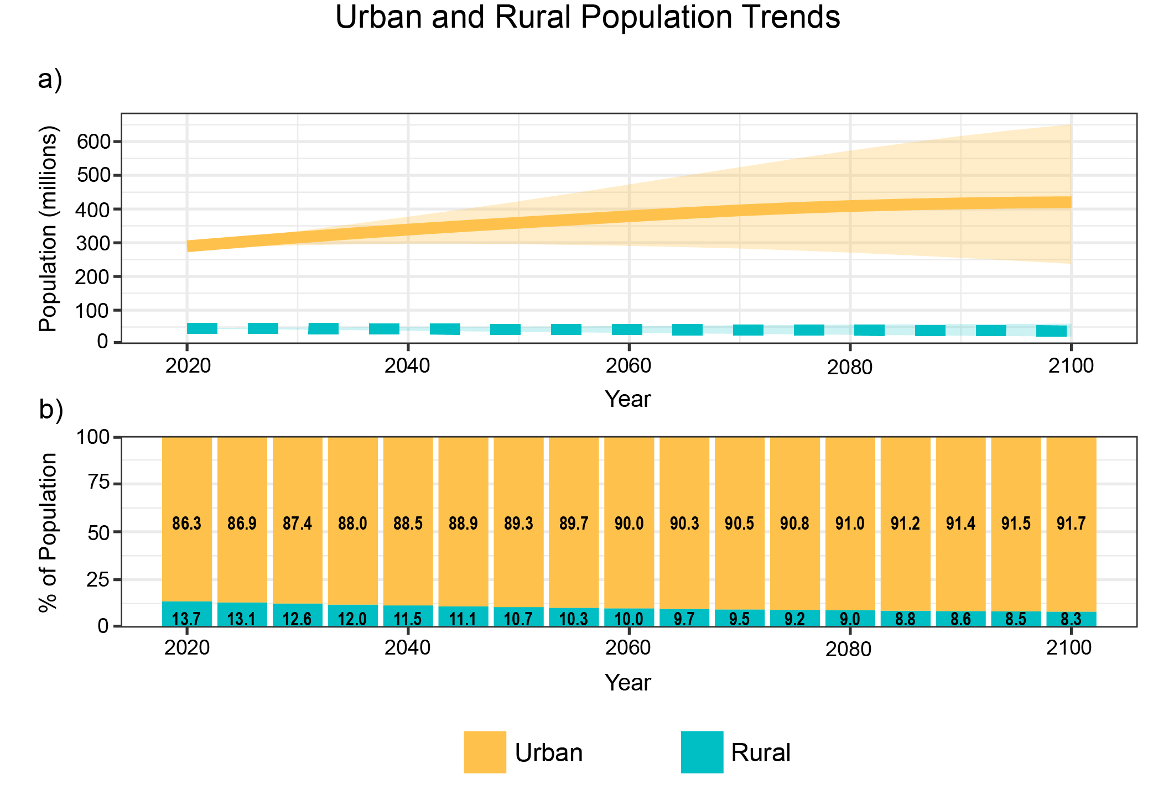
Figure 12.2. Urban areas constitute a significant majority of the total US population in all future scenarios.
Notes:
CAPTION: Panel (a) shows projected changes in urban (including suburban) and rural population in the US from 2020 to 2100 based on Shared Socioeconomic Pathways (SSPs), along with modeled scenario uncertainties in shaded areas. SSPs describe potential futures of greenhouse gas emissions and economic development, so the range of uncertainty is bounded by the overall impact of climate interventions over time. Panel (b) shows the proportional split between urban and rural populations based on an average SSP scenario. It shows that the proportion of urban population is expected to increase over time. Such a trend highlights the importance of reducing emissions in urban areas and the built infrastructure systems that concentrate in and around cities. Demographic data are available only for the 50 states plus DC and not available for the US Caribbean or US-Affiliated Pacific Islands. More extensive discussions of regional data availability constraints can be found in Chapters 23 and 30. Figure credit: University of California, Davis; Florida State University; Massachusetts Institute of Technology; NOAA NCEI; and CISESS NC.

Slide 9
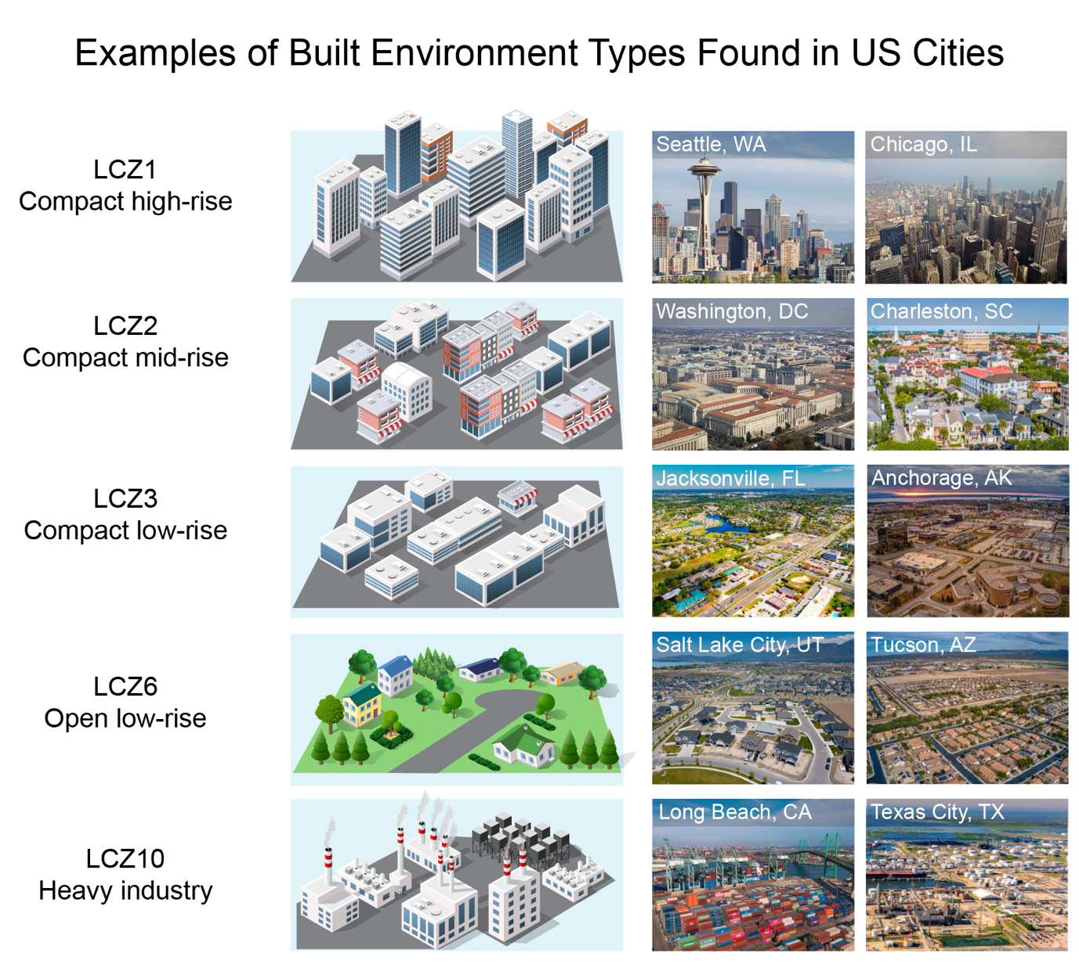
Figure 12.3. Cities across the US include multiple types of built environments, ranging from dense urban cores to much less dense suburbs.
Notes:
CAPTION: This figure illustrates five examples of a land-use and land-cover classification scheme called local climate zones (LCZs).(Stewart and Oke 2012) The scheme includes 10 classes and assumes that neighborhoods of the same LCZ are similar in their ability to modify urban climate and are different from neighborhoods of other LCZs. Residents living and working in more compact neighborhoods with a high density of mid- and high-rise buildings are more likely to experience urban heat islands, as buildings retain heat and prevent ventilation. Industrial areas also see higher temperatures because of the lack of shade from tree cover and the ways dark pavement or asphalt can trap heat. The examples shown in this figure are for illustrative purposes only. Adapted from Masson et al. 2020(Masson et al. 2020) [CC BY 4.0]. Photo credits: (Seattle) july7th/E+; (Chicago) Arial_Bold/iStock; (Washington, DC) Lingbeek/E+; (Charleston) Kruck20/iStock; (Jacksonville) Art Wager/E+; (Anchorage and Tucson) Jacob Boomsma/iStock; (Salt Lake City) olaser/iStock; (Long Beach) Jorge Villalba/iStock; (Texas City) Art Wager/iStock. All photos via Getty Images.

Slide 10
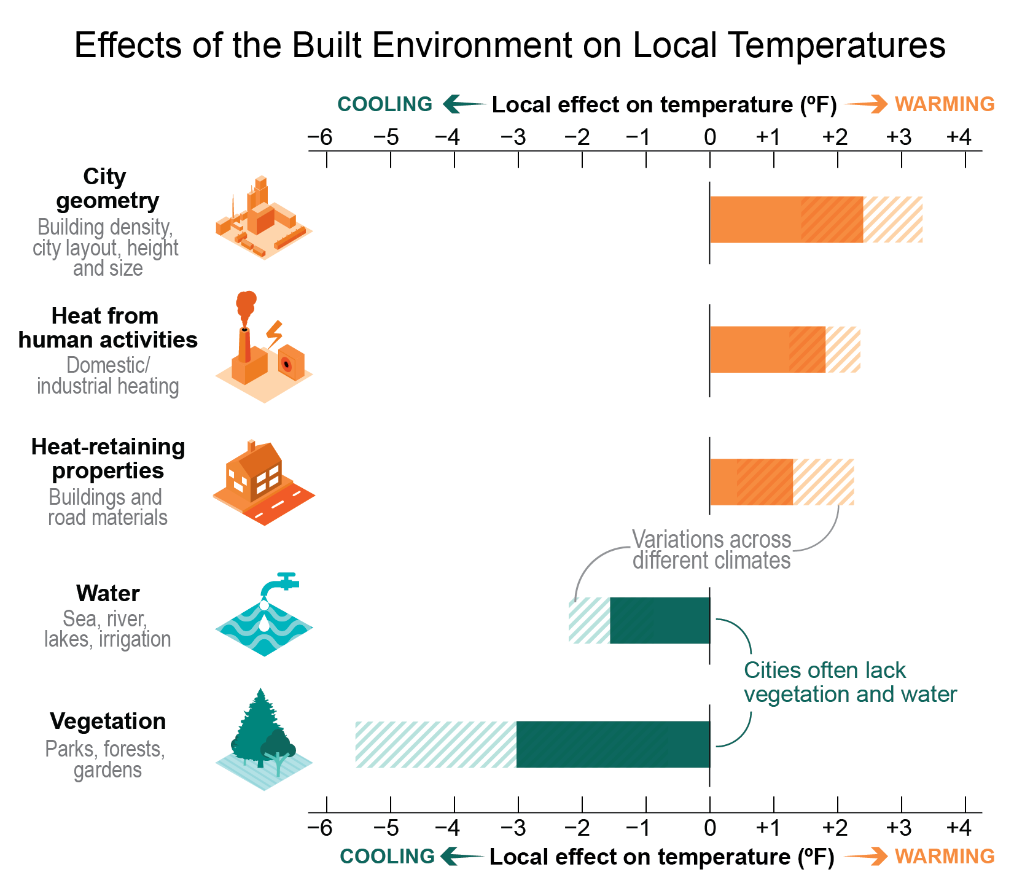
Figure 12.4. Different aspects of the built environment affect temperatures in urban areas.
Notes:
CAPTION: Cities are often warmer than their surroundings because of the urban heat island effect—the prevalence of higher air temperatures in urban areas because of the overall density of buildings, heat absorbed and emitted by buildings and asphalt, and heat from commercial, industrial, and household activities. The hatched portions of the bars show how the effects of warming or cooling of each factor vary depending on the local climate context. For example, vegetation has a stronger cooling effect in temperate and warm climates. Adapted with permission from FAQ 10.2, Figure 1 of Doblas-Reyes et al. 2021.(Doblas-Reyes et al. 2021)

Slide 11
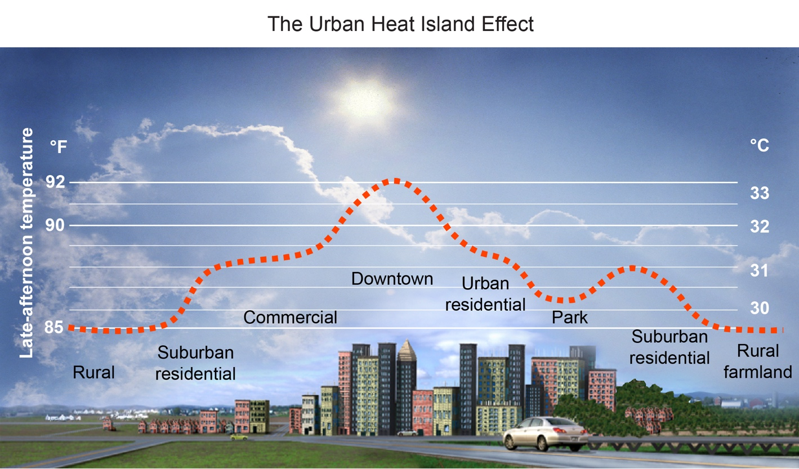
Figure 12.5. Urban heat islands are most prominent in dense downtown areas with little access to open space.
Notes:
CAPTION: The figure illustrates temperature fluctuations across natural and built environments in a typical late afternoon in the summertime. Downtown areas with dense high-rise buildings experience the heat island effect because concrete and asphalt absorb and retain heat. Waste heat from cars, air-conditioning, and other human activities also contribute to the heat island effect. Cooler temperatures are found around urban parks, green spaces, open land, and in suburbs and rural areas. The temperature lines are shown for illustrative purposes and do not represent the climate in a particular city. Figure credit: ©Heat Island Group, Lawrence Berkeley National Laboratory. Adapted with permission.

Slide 12
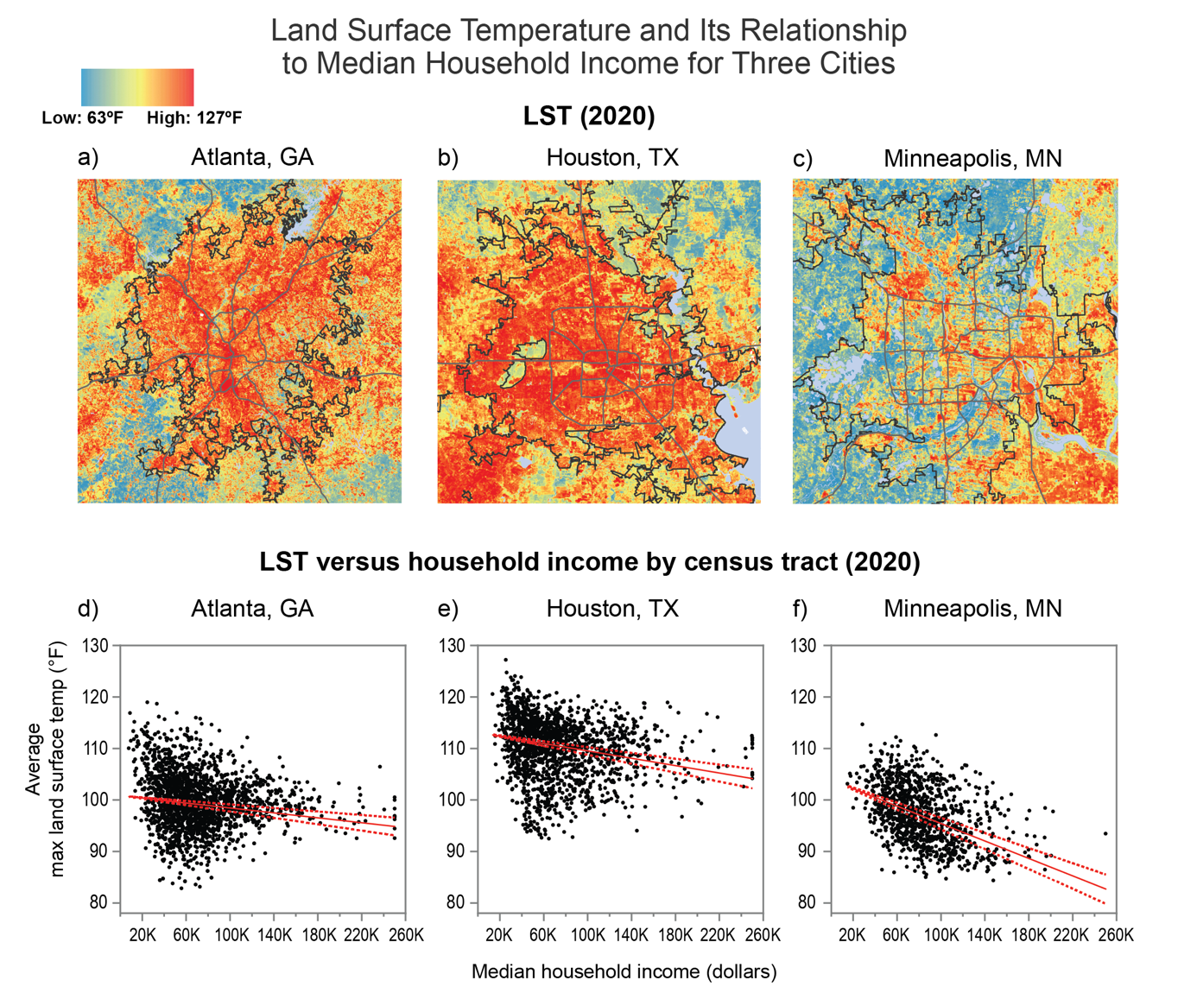
Figure 12.6. Lower-income urban neighborhoods experience higher surface temperatures.
Notes:
CAPTION: The figure shows the spatial distribution of maximum land surface temperature (LST) in 2020 for Atlanta (a), Houston (b), and Minneapolis (c). Graphs (d), (e), and (f) depict the relationship between maximum LST and median household income across census tracts in each city (see also Figure A4.4). A statistical trend analysis (the Theil-Sen estimator) returns negative values for all three cities, indicating that LST decreases as income increases (solid red line). Dashed red lines indicate the 95% confidence interval, meaning that the true slope of the trend is expected to fall within this range. Note that LST is measured at ground level and may differ from surface air temperature, which is measured at a height of 2 meters. Portions of this figure include intellectual property of Esri and its licensors and are used under license. Copyright © 2020 Esri and its licensors. All rights reserved. Figure credit: University of California, Davis; University of Texas at El Paso; Massachusetts Institute of Technology; City of Phoenix, Arizona; US Geological Survey.

Slide 13
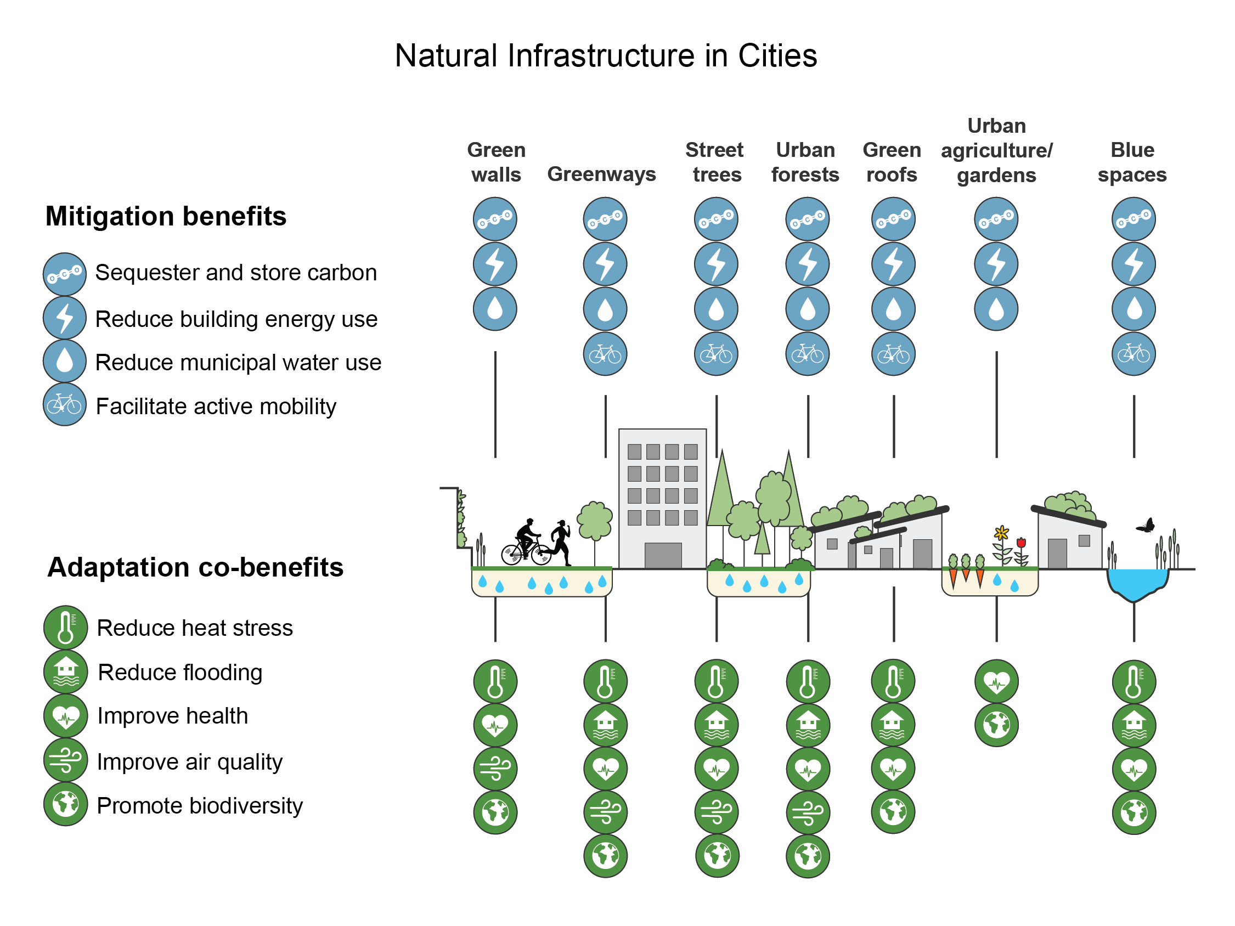
Figure 12.7. Natural infrastructure in cities provides climate mitigation and adaptation benefits.
Notes:
CAPTION: The figure illustrates the potential benefits (in no particular order) of integrating natural infrastructure strategies—also termed green, blue, or nature-based solutions—within the built environment. Nature-based, green, and blue infrastructure options are strategically planned interconnected sets of natural and constructed ecosystems, spaces with vegetation or waterscapes, and other landscape features that provide important greenhouse gas mitigation and climate adaptation functions, as well as improve human well-being, biodiversity, and ecosystem health. This figure shows examples of how urban forests and street trees can sequester and store carbon while simultaneously reducing building energy demand. Reducing municipal water use can provide a mitigation benefit by decreasing energy use in wastewater treatment plants. Adapted with permission from Figure 8.18a of Lwasa et al. 2022.(Lwasa et al. 2022)

Slide 14
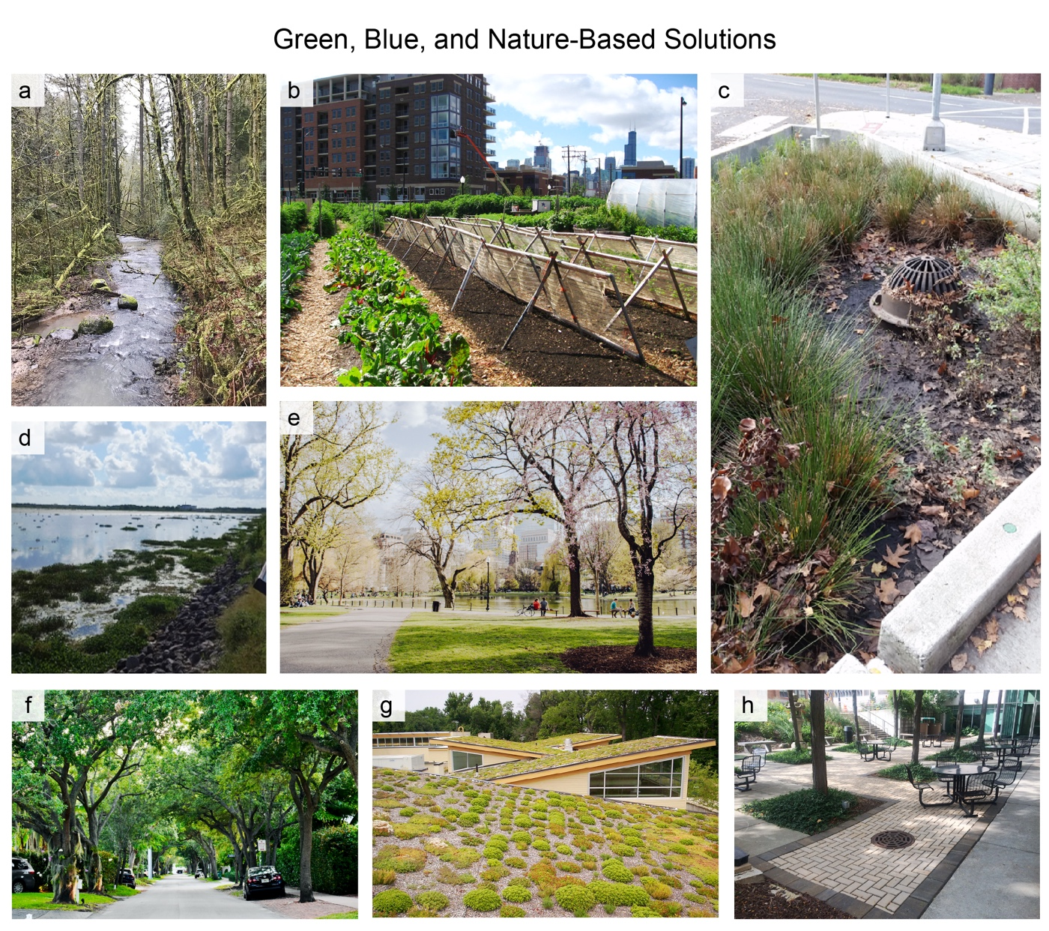
Figure 12.8. Cities have diverse options for climate adaptation and mitigation.
Notes:
CAPTION: The figure illustrates various built environment options that consist of green, blue, and nature-based components. Examples, which are for illustrative purposes only, highlight how city governments, communities, and residents can draw on diverse options to adapt to climate impacts, reduce greenhouse gas emissions, and sequester carbon in the built environment: (a) remnant forest in Forest Park, Portland, Oregon; (b) urban agriculture in Chicago; (c) bioswale in Portland, Oregon; (d) wetlands at Bayou Bienvenue Wetland Triangle, New Orleans; (e) urban park in Boston; (f) street trees in Miami; (g) green roof in Arlington, Virginia; (h) porous pavement in Milwaukee, Wisconsin. Photo credits: (a) Ari Weil via Flickr [CC BY 2.0]; (b) Linda N. via Flickr [CC BY 2.0]; (c, d) ©Annie Marissa Matsler; (e) Kelly Sikkema via Unsplash; (f) Faith Crabtree via Unsplash; (g) Arlington County via Flickr [CC BY-SA 2.0]; (h) Aaron Volkening via Flickr [CC BY 2.0].

Slide 15
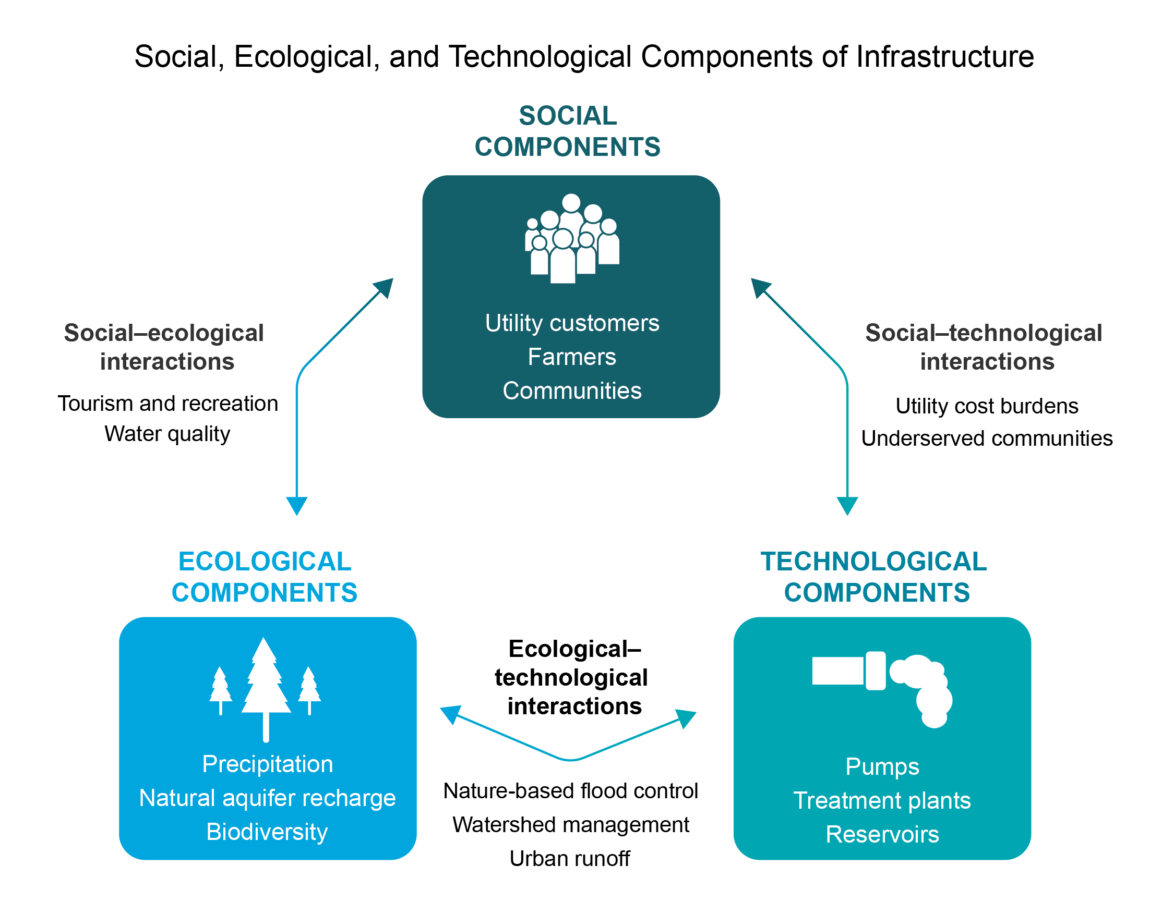
Figure 12.9. Urban infrastructure involves joint social, ecological, and technological systems. All face risks from climate change individually and in interconnected ways.
Notes:
CAPTION: This figure is an example using water and wastewater systems to highlight the social, ecological, and technological interdependencies of infrastructure. Urban ecosystems (such as waterbodies), built infrastructure (such as pipelines and pumps), and social systems (such as residents) are impacted by climate change individually. Climate change also affects the interactions between these systems, such as when flooding overwhelms pipelines and disrupts service to utilities and/or increases utility costs for consumers. Forward-looking climate actions that consider these interactions—such as how improvements in water infrastructure affect the urban ecosystem and level of access by underserved communities—can lead to more effective and equitable outcomes. Adapted with permission from Markolf et al. 2018.(Markolf et al. 2018)

Slide 16
Federal Coordinating Lead Author
Meridith M. Fry, US Environmental Protection Agency
Chapter Lead
Eric K. Chu, University of California, Davis
Chapter Authors
Jayajit Chakraborty, University of Texas at El Paso
So-Min Cheong, Texas A&M University
Christopher Clavin, National Institute of Standards and Technology (until October 2022)
Makena Coffman, University of Hawai‘i at Mānoa, Department of Urban and Regional Planning
David M. Hondula, City of Phoenix, Arizona
David Hsu, Massachusetts Institute of Technology
Viniece L. Jennings, Agnes Scott College
Jesse M. Keenan, Tulane University
Ann Kosmal, US General Services Administration
Tischa A. Muñoz-Erickson, USDA Forest Service, International Institute of Tropical Forestry
Na’Taki Osborne Jelks, Spelman College
Technical Contributors
Kristin Baja, Urban Sustainability Directors Network
Michele Barbato, University of California, Davis
Joyce Coffee, Climate Resilience Consulting
Juan F. Fung, National Institute of Standards and Technology
Adrienne I. Greve, California Polytechnic State University
Kevin R. Gurney, Northern Arizona University
Mathew Hauer, Florida State University
Joe Krolak, US Department of Transportation, Federal Highway Administration
Victoria L. Ludwig, US Environmental Protection Agency
A. Marissa Matsler, US Environmental Protection Agency, Oak Ridge Institute for Science and Education
Sara Meerow, Arizona State University
Chandana Mitra, Auburn University
Kimberly L. Mueller, National Institute of Standards and Technology
Christopher J. Narducci, ICF
Daniel S. Sharar-Salgado, US Department of Transportation
Hua Shi, US Geological Survey, Earth Resources Observation and Science Center/ASRC Federal Data Solutions
Yating Zhang, National Institute of Standards and Technology
Review Editor
Austin N. Glass, University of Michigan
USGCRP Coordinators
Aaron M. Grade, US Global Change Research Program / ICF
Allyza R. Lustig, US Global Change Research Program / ICF

Slide 17
Chu, E.K., M.M. Fry, J. Chakraborty, S.-M. Cheong, C. Clavin, M. Coffman, D.M. Hondula, D. Hsu, V.L. Jennings, J.M. Keenan, A. Kosmal, T.A. Muñoz-Erickson, and N.T.O. Jelks, 2023: Ch. 12. Built environment, urban systems, and cities. In: Fifth National Climate Assessment. Crimmins, A.R., C.W. Avery, D.R. Easterling, K.E. Kunkel, B.C. Stewart, and T.K. Maycock, Eds. U.S. Global Change Research Program, Washington, DC, USA. https://doi.org/10.7930/NCA5.2023.CH12
https://nca2023.globalchange.gov/chapter/12

