Slide 1

NCA5 Website: https://nca2023.globalchange.gov
Chapter Website: https://nca2023.globalchange.gov/chapter/20
NCA5 Atlas: https://atlas.globalchange.gov
Figure captions can be found in the slide notes of this deck
Social media: @usgcrp, #NCA5

Slide 2
Chapter 20 | Social Systems and Justice

Slide 3
1
Social Systems Are Changing the Climate and Distributing Its Impacts Inequitably
Social systems are changing the climate (very high confidence). Societal characteristics and processes shape greenhouse gas (GHG) emissions, primarily through the burning of fossil fuels (very high confidence). Social systems also inequitably distribute the benefits of energy consumption and the impacts of GHG emissions and climate change (high confidence). Governance is a critical process that distributes these impacts (very high confidence) and provides access to adaptation (medium confidence).

Slide 4
2
Social Systems Structure How People Know and Communicate About Climate Change
People’s histories, educations, cultures, and ethics determine how they understand and experience climate change (high confidence). These knowledges take multiple forms (high confidence) and generate diverse approaches to climate adaptation and mitigation (medium confidence). Engagement across communities that builds clear objectives and benchmarks has been shown to produce more desired outcomes (medium confidence). Effective engagement is challenging due in part to the complexity and uncertainty associated with climate science and politics (high confidence). Including community perspectives and multiple forms of knowledge in climate discussions and decision-making helps promote justice (medium confidence).

Slide 5
3
Climate Justice Is Possible If Processes Like Migration and Energy Transitions Are Equitable
Climate justice—the recognition of diverse values and past harms, equitable distribution of benefits and risks, and the procedural inclusion of affected communities in decision-making processes—is possible (medium confidence). Complex social processes such as human migration affect climate inequities (medium confidence). Climate justice is also closely related to just transitions (high confidence), which involve equitably adapting societies, economies, and energy systems to climate change mitigation strategies and climate impacts (high confidence).

Slide 6
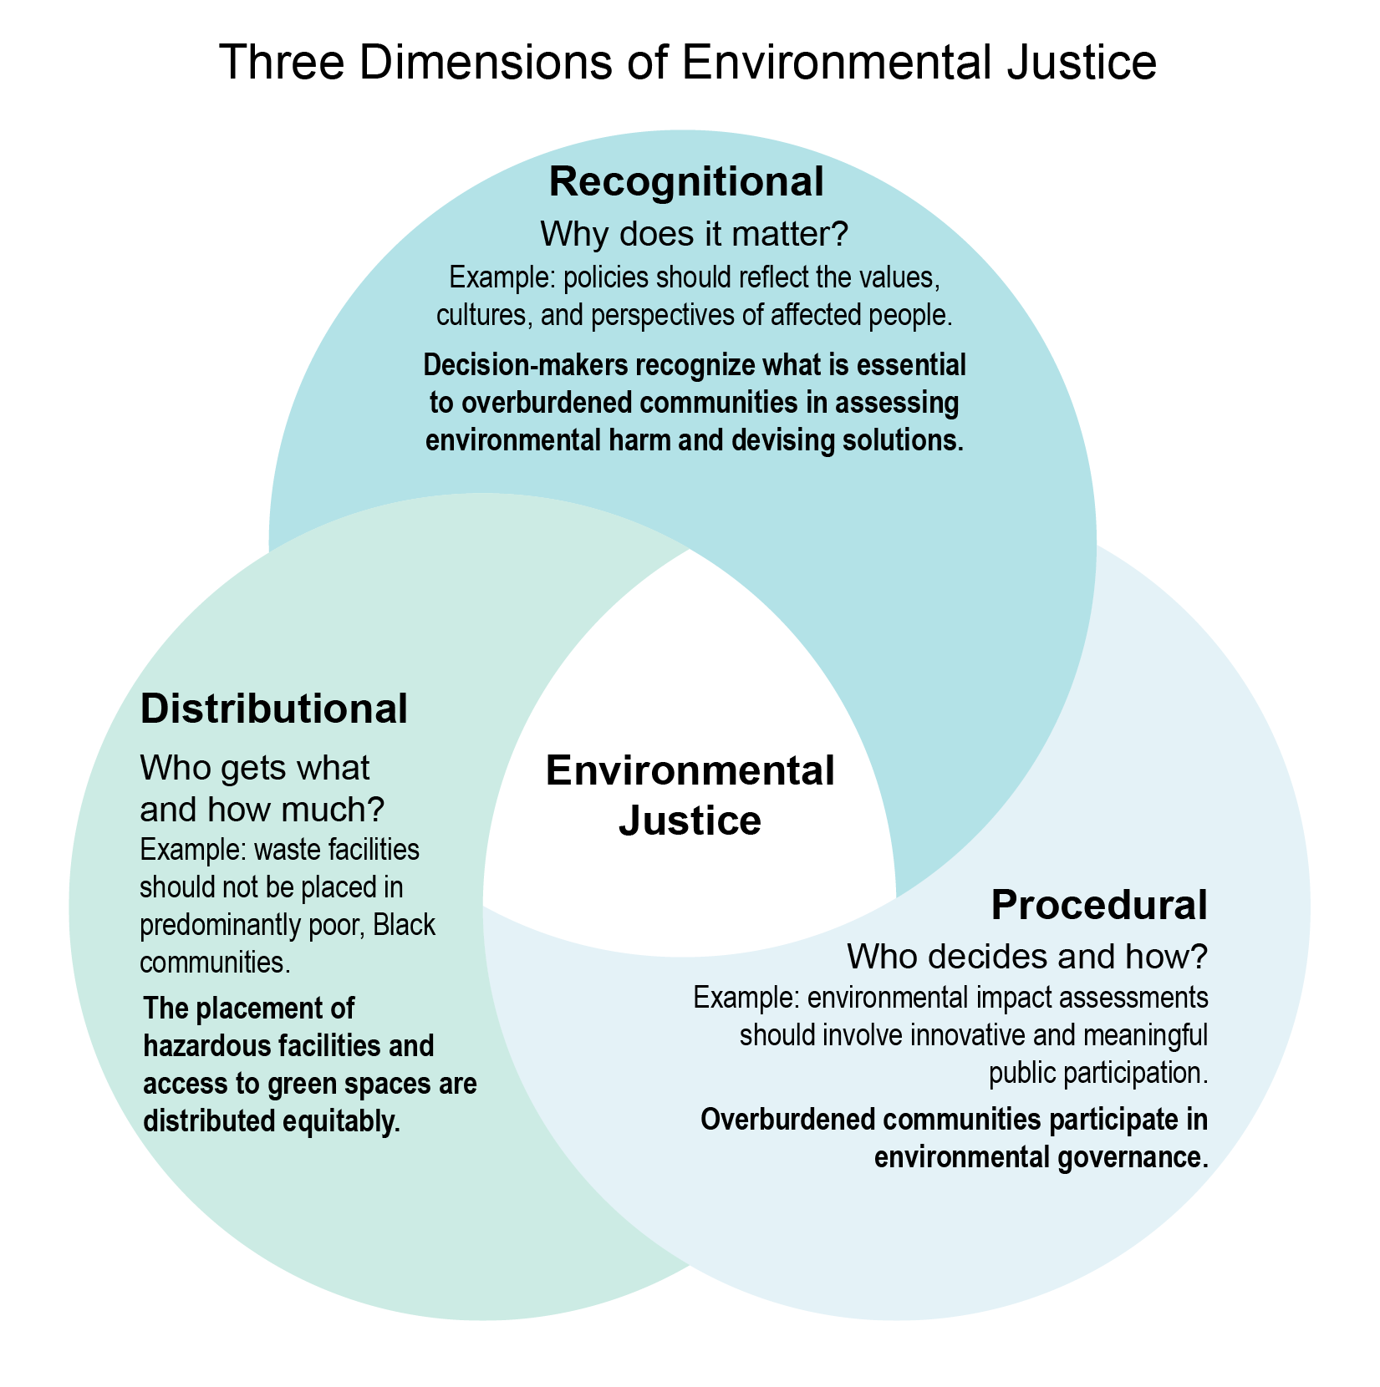
Figure 20.1. Environmental justice requires three dimensions: recognitional, distributional, and procedural justice.
Notes:
CAPTION: These three dimensions of justice are based on a framework originally summarized by the “father of environmental justice,” Robert Bullard,(Bullard 1994) who pointed to the “ethical and political questions of ‘who gets what, why, and in what amounts?’” Commitments to each dimension are essential to achieving environmental justice, and each dimension can influence the others.(Foster 1998; Whyte 2011; Yakubu 2018) Figure credit: Puget Sound Partnership, Citizen Potawatomi Nation, and University of Michigan.

Slide 7
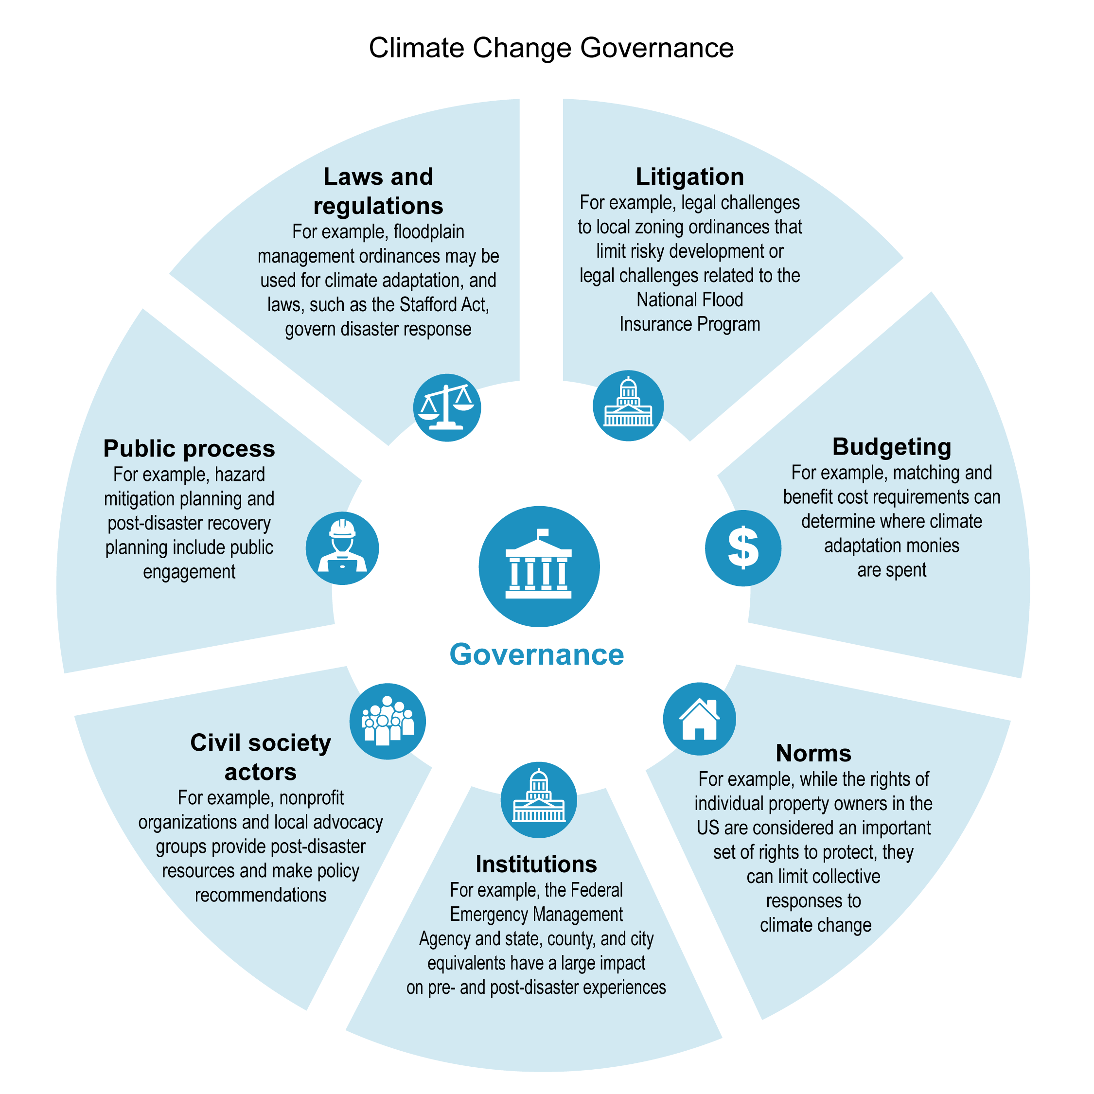
Figure 20.2. Climate change governance is complex and multifaceted.
Notes:
CAPTION: This figure recognizes the complex interaction of multiple social systems that give rise to governance. Climate change impacts, and the impacts of adaptation and mitigation strategies, will all be mediated by governance decisions and actions. Understanding this complex interplay allows the social scientists who study climate change to make predictions regarding climate impacts and to assess where governance systems are expected to produce climate justice or injustice. Figure credit: Jacksonville State University.

Slide 8
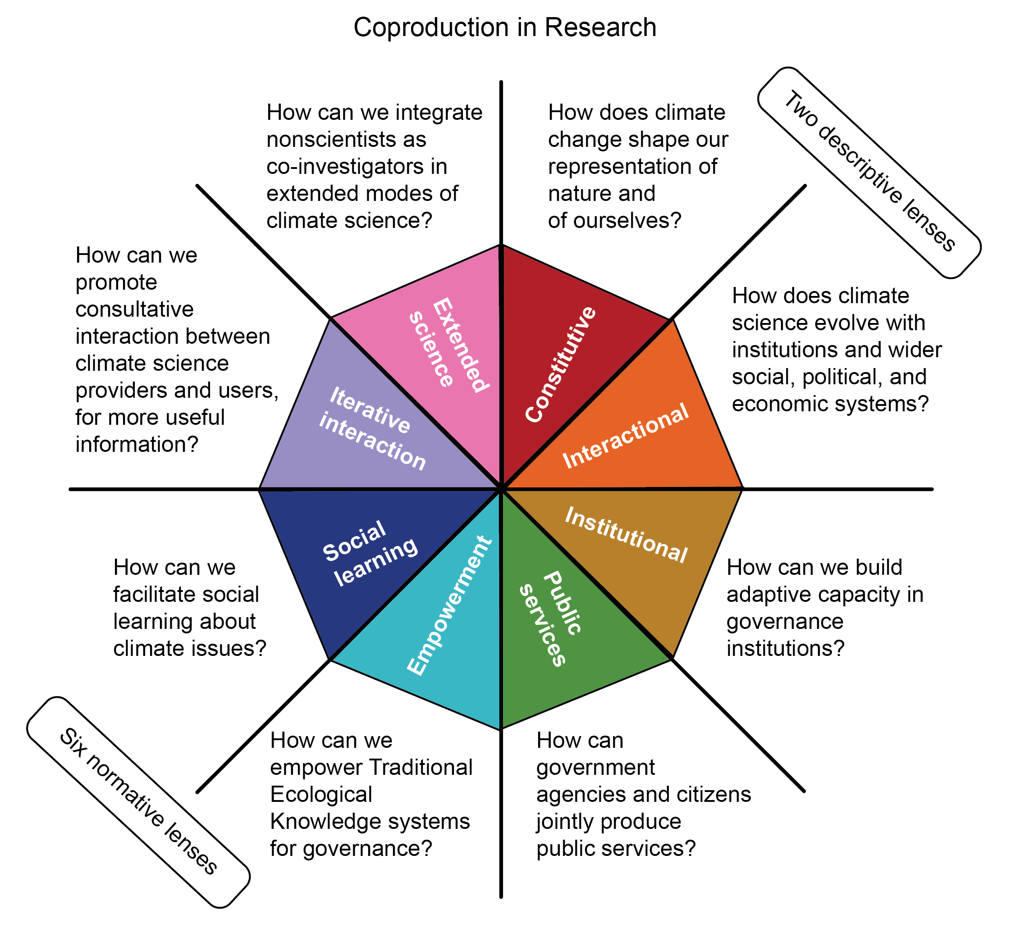
Figure 20.3. Coproduction is a way forward to include multiple epistemologies, or knowledge traditions, but must be defined to be productive.
Notes:
CAPTION: This figure demonstrates the diverse approaches to coproduction and focuses on the need to define what a research team means when seeking to do a coproduced research project. The two items in the top right quadrant are descriptive lenses, while the other six are normative lenses. Adapted with permission from Bremer and Meisch 2017.(Bremer and Meisch 2017)

Slide 9
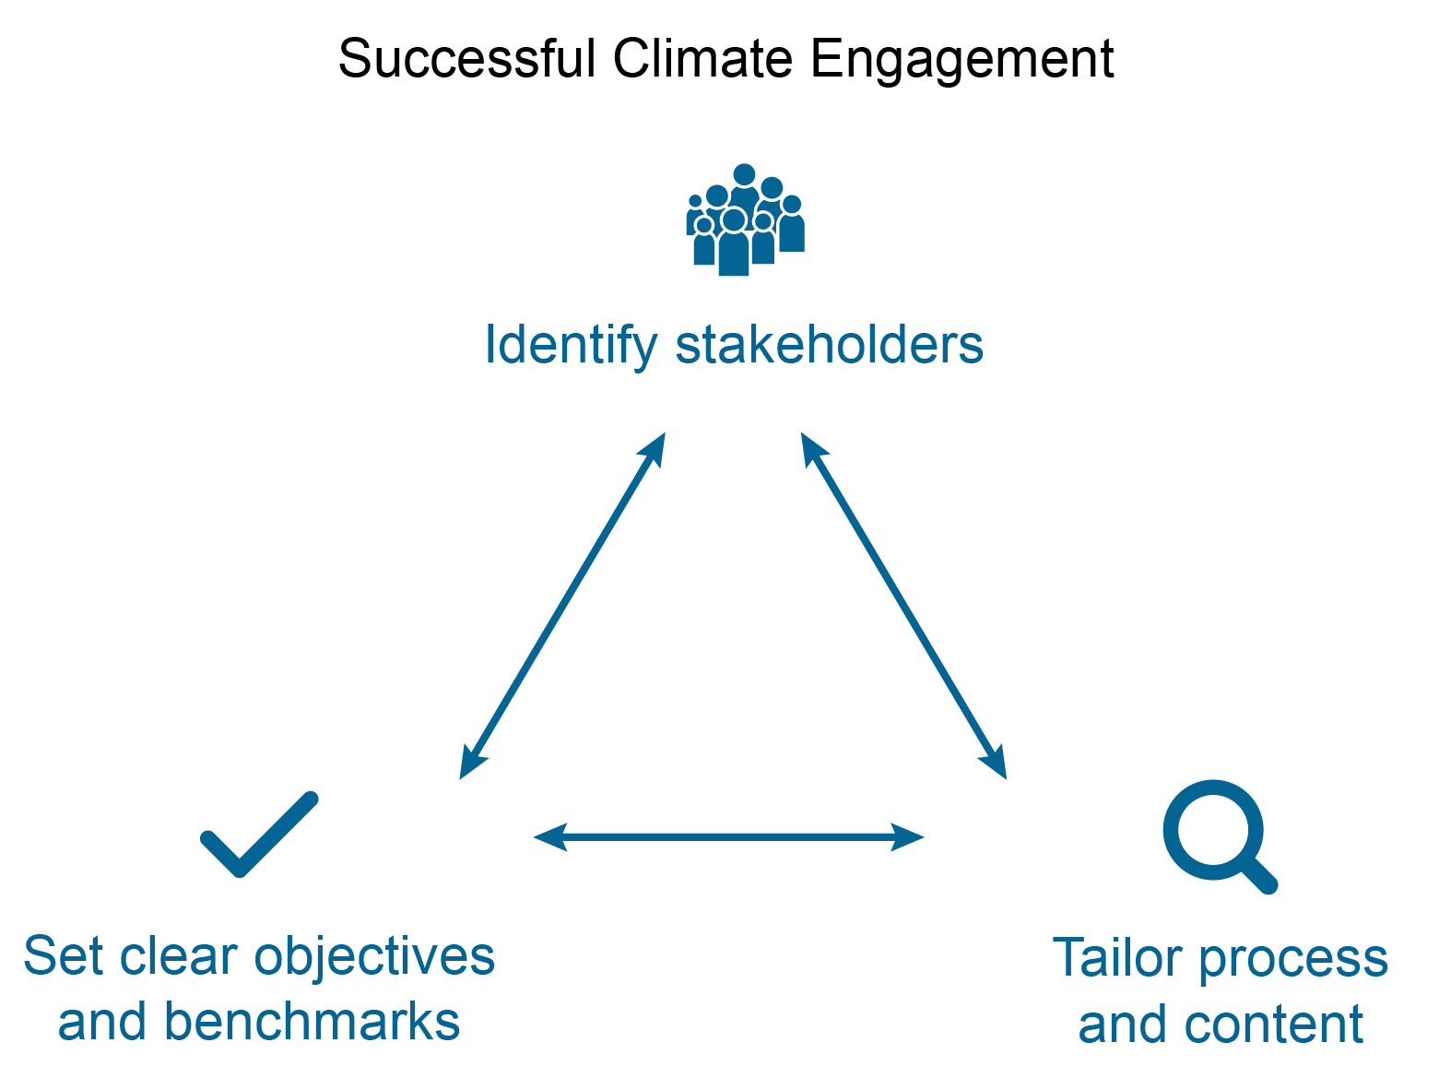
Figure 20.4. A simple three-step process of communication can improve climate change engagement with diverse stakeholders.
Notes:
CAPTION: Simple changes can help facilitate communication about climate change. Identifying the stakeholders, tailoring the process of communication and knowledge creation, and setting clear objectives for everyone involved has been shown to be an effective process. Figure credit: Rutgers University, University of Massachusetts Amherst, and Oregon State University–Cascades.

Slide 10
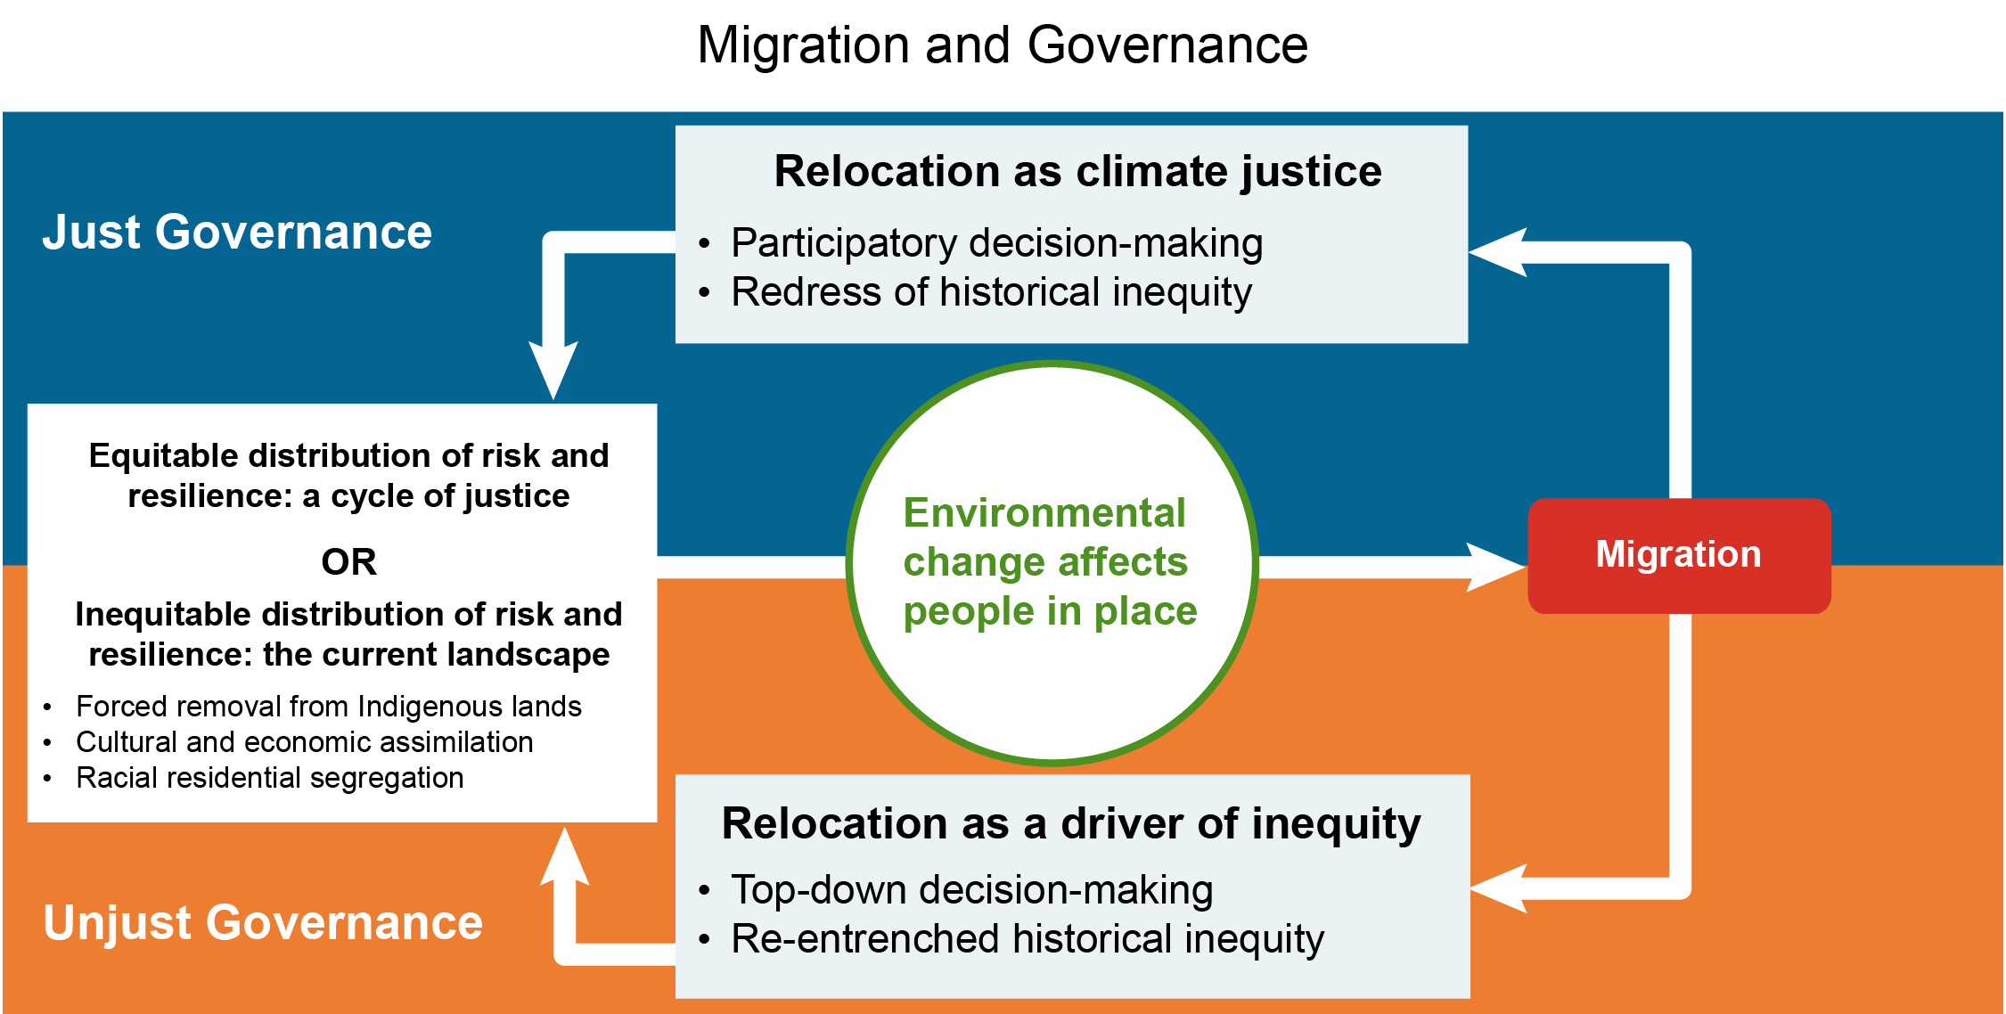
Figure 20.5. Social systems create just or unjust conditions that influence migration outcomes.
Notes:
CAPTION: Research shows that social systems exert influence on migration. Historically, forced migration has exacerbated inequities and caused social harm. It is not yet understood how these dynamics will play out under conditions of climate change and whether climate-inflected migration can be a pathway toward climate justice. This figure captures, conceptually, how migration may exacerbate inequity or be a remedy. Figure credit: Oregon State University–Cascades, Brown University, Jacksonville State University, and Puget Sound Partnership.

Slide 11
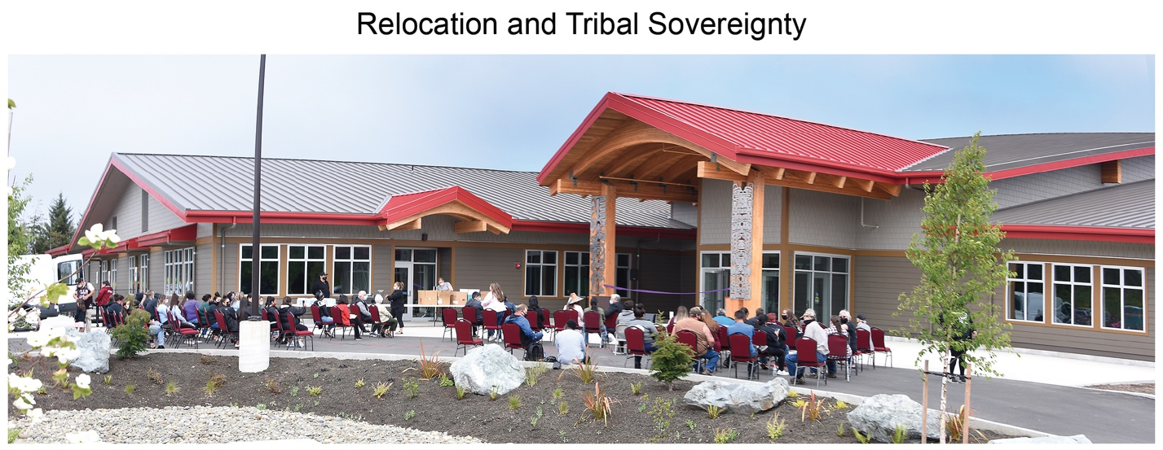
Figure 20.6. Quinault Indian Nation engaged the full community in its village relocation plan.
Notes:
CAPTION: Community members gather for a ribbon cutting for Quinault Indian Nation’s New Generations Building in Taholah, Washington. In March 2014, the Quinault Indian Reservation hired planners to work with the community to develop a plan for the relocation of the village. The master plan resulting from this effort directs the development of a new village beyond the tsunami zone and flooding inundation areas. The new village will replicate the uses in the lower village and will include single and multifamily residential, commercial, public, and institutional land uses. The plan also includes new streets and provides for open spaces, parks, and other recreational facilities. Photo credit: ©Larry Workman, Quinault Indian Nation.

Slide 12
Federal Coordinating Lead Author
Keely Maxwell, US Environmental Protection Agency
Chapter Lead
Elizabeth K. Marino, Oregon State University–Cascades
Agency Chapter Lead Authors
Emily Eisenhauer, US Environmental Protection Agency
Ariela Zycherman, NOAA Climate Program Office
Chapter Authors
Candis Callison, University of British Columbia
Elizabeth Fussell, Brown University
Marccus D. Hendricks, University of Maryland, College Park (through January 2023)
Fayola H. Jacobs, University of Minnesota
Alessandra Jerolleman, Jacksonville State University
Andrew K. Jorgenson, University of British Columbia
Ezra M. Markowitz, University of Massachusetts Amherst
Sandra T. Marquart-Pyatt, Michigan State University
Melissa Schutten, Puget Sound Partnership
Rachael L. Shwom, Rutgers University
Kyle Whyte, Citizen Potawatomi Nation and University of Michigan
Review Editor
Benjamin P. Warner, University of New Mexico
USGCRP Coordinators
Austin A. Scheetz, US Global Change Research Program / ICF
Allyza R. Lustig, US Global Change Research Program / ICF

Slide 13
Marino, E.K., K. Maxwell, E. Eisenhauer, A. Zycherman, C. Callison, E. Fussell, M.D. Hendricks, F.H. Jacobs, A. Jerolleman, A.K. Jorgenson, E.M. Markowitz, S.T. Marquart-Pyatt, M. Schutten, R.L. Shwom, and K. Whyte, 2023: Ch. 20. Social systems and justice. In: Fifth National Climate Assessment. Crimmins, A.R., C.W. Avery, D.R. Easterling, K.E. Kunkel, B.C. Stewart, and T.K. Maycock, Eds. U.S. Global Change Research Program, Washington, DC, USA. https://doi.org/10.7930/NCA5.2023.CH20
https://nca2023.globalchange.gov/chapter/20

