Slide 1

NCA5 Website: https://nca2023.globalchange.gov
Chapter Website: https://nca2023.globalchange.gov/chapter/24
NCA5 Atlas: https://atlas.globalchange.gov
Figure captions can be found in the slide notes of this deck
Social media: @usgcrp, #NCA5

Slide 2
Chapter 24 | Midwest

Slide 3
1
Climate-Smart Practices May Offset Complex Climate Interactions in Agriculture
Crop production is projected to change in complex ways (likely, medium confidence) due to increasing extreme precipitation events and transitions between wet and dry conditions (likely, medium confidence), as well as intensification of crop water loss (likely, low confidence). Changes in precipitation extremes, timing of snowmelt, and early-spring rainfall are expected to pose greater challenges for crop and animal agriculture, including increased pest and disease transmission, muddier pastures, and further degradation of water quality (likely, high confidence). Climate-smart agriculture and other adaptation techniques provide a potential path toward environmental and economic sustainability (medium confidence).

Slide 4
2
Adaptation May Ease Disruptions to Ecosystems and Their Services
Ecosystems are already being affected by changes in extreme weather and other climate-related changes, with negative impacts on a wide range of species (likely, high confidence). Increasing incidence of flooding and drought is expected to further alter aquatic ecosystems (likely, medium confidence), while terrestrial ecosystems are being reshaped by rising temperatures and decreasing snow and ice cover (very likely, high confidence). Loss of ecosystem services is undermining human well-being, causing the loss of economic, cultural, and health benefits (medium confidence). In response, communities are adapting their cultural practices and the ways they manage the landscape, preserving and protecting ecosystems and the services they provide (low confidence).

Slide 5
3
Climate Adaptation and Mitigation Strategies Improve Individual and Community Health
Climate change has wide-ranging effects on lives and livelihoods (very likely, very high confidence), healthcare systems (high confidence), and community cohesion (high confidence). These diverse impacts will require integrated, innovative response from collaborations between public health and other sectors, such as emergency management, agriculture, and urban planning. Because of historical and systemic biases, communities of color are especially vulnerable to these negative impacts (very likely, very high confidence). Mitigation and adaptation strategies, such as expanded use of green infrastructure, heat-health early warning systems, and improved stormwater management systems, when developed in collaboration with affected communities, have the potential to improve individual and community health (high confidence).

Slide 6
4
Green Infrastructure and Investment Solutions Can Address Costly Climate Change Impacts
Increases in temperatures and extreme precipitation events are already challenging aging infrastructure and are expected to impair surface transportation, water navigation, and the electrical grid (likely, medium confidence). Shifts in the timing and intensity of rainfall are expected to disrupt transportation along major rivers and increase chronic flooding (likely, high confidence). Green infrastructure and public and private investments may mitigate losses, provide relief from heat, and offer other ways to adapt the built environment to a changing climate (medium confidence).

Slide 7
5
Managing Extremes Is Necessary to Minimize Impacts on Water Quality and Quantity
Climate-related changes to water quantity and quality are increasing the risks to ecosystem health, adequate food production, surface water and groundwater uses, and recreation (high confidence). Projected increases in droughts, floods, and runoff events across the Mississippi River basin and the Great Lakes will adversely impact ecosystems through increased erosion, harmful algal blooms, and expansion of invasive species (likely, high confidence). Federal and state agencies and nongovernmental organizations are cooperating on adaptation efforts related to streamflow, water quality, and other water issues (high confidence).

Slide 8
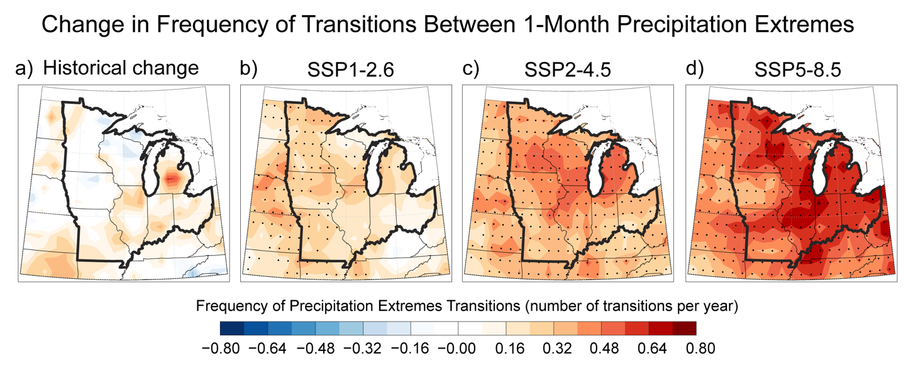
Figure 24.1. The frequency of wet–dry and dry-wet transitions across the Midwest is projected to increase by late century (2071–2100).
Notes:
CAPTION: Transitions between wet and dry periods are expected to become more frequent across the Midwest. Observed changes in transition frequency (from wet to dry or dry to wet) are based on the Standardized Precipitation Index (SPI), represented by the difference between the periods 1951–1980 and 1981–2010 (historical change, panel a). SPI is a common statistical index that quantifies the relative intensity of drought or wetness, and monthly SPI values are utilized to show transitions over short periods. Projected changes in transition frequency under low (SSP1-2.6; b), intermediate (SSP2-4.5; c), and very high (SSP5-8.5; d) scenarios are represented by the difference between the periods 2071–2100 and 1981–2010. The black boundary outlines the Midwest region. Black dots indicate grid cells where the model-projected transition frequency is significantly different from the historical climatology. Adapted from Chen and Ford 2023(Chen and Ford 2023) [CC BY 4.0].

Slide 9
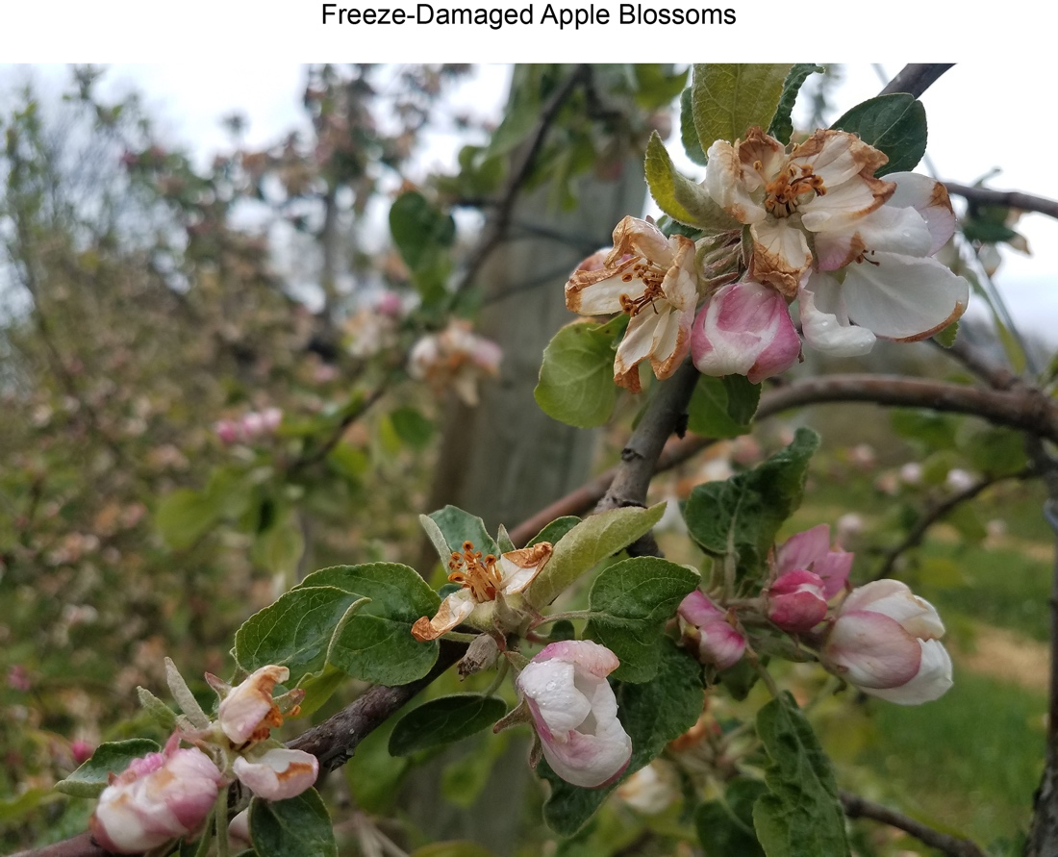
Figure 24.2. Early warmth and flowering followed by freezing temperatures in the spring poses risks to perennial and annual crops.
Notes:
CAPTION: Apple blossoms are damaged by a freeze event on May 9, 2020, in Berrien County, Michigan. Photo credit: ©Dr. Mike Reinke, Michigan State University.

Slide 10
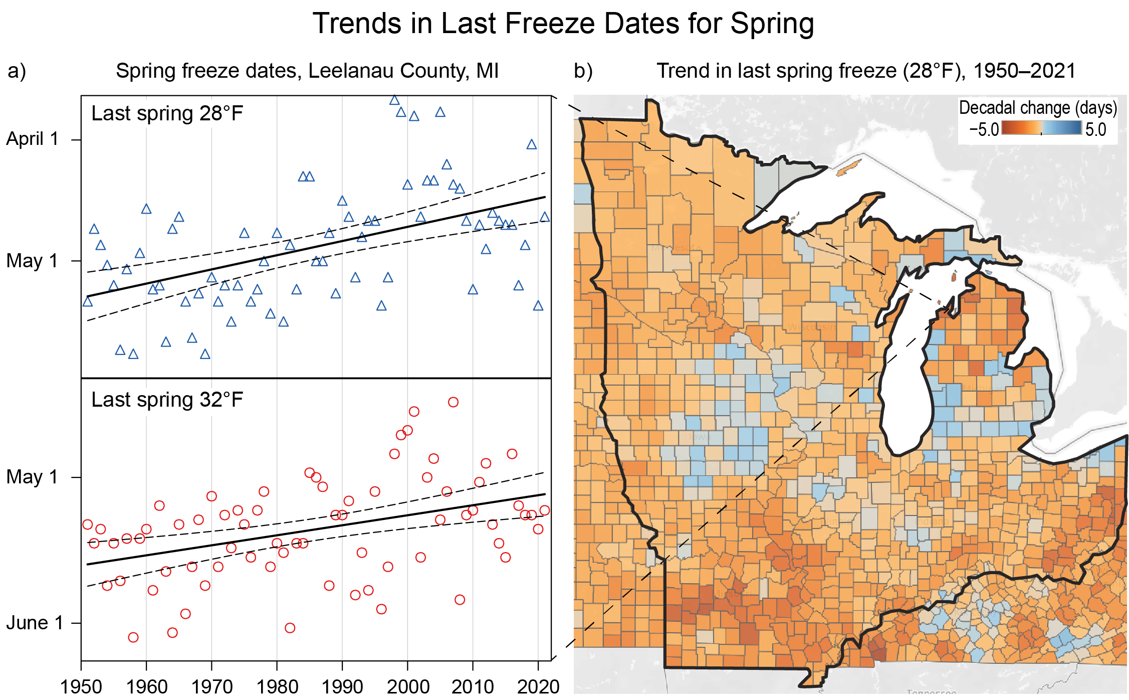
Figure 24.3. Last spring freezes are occurring earlier over most of the Midwest region.
Notes:
CAPTION: (a) Trends (solid black lines) show that the last date in spring when minimum temperatures fall to either 28°F or 32°F in Leelanau County, Michigan, are occurring earlier in the year. For example, the last 28°F temperature commonly occurred after May 1 during the 1950s–1970s, with earlier dates noted since the 1980s. Note the large variability in dates. The statistical significance of the trends (dashed black lines; based on a 95% confidence interval) shows the range of values of the trend line based on the observed dates. In all cases, these confirm there is a trend toward earlier last freeze dates. Panel (b) shows change in the number of days per decade of the last spring freeze (28°F) over the period 1950–2021. The black boundary outlines the Midwest region. Orange shading indicates trends toward earlier last spring freeze dates, blue shading indicates trends towards later last spring freeze dates, and gray shading indicates no trend. Adapted with permission from the Midwestern Regional Climate Center’s Freeze Date Tool (https://mrcc.purdue.edu/freeze/freezedatetool). Map base layer on right is ©Mapbox ©OpenStreetMap.

Slide 11
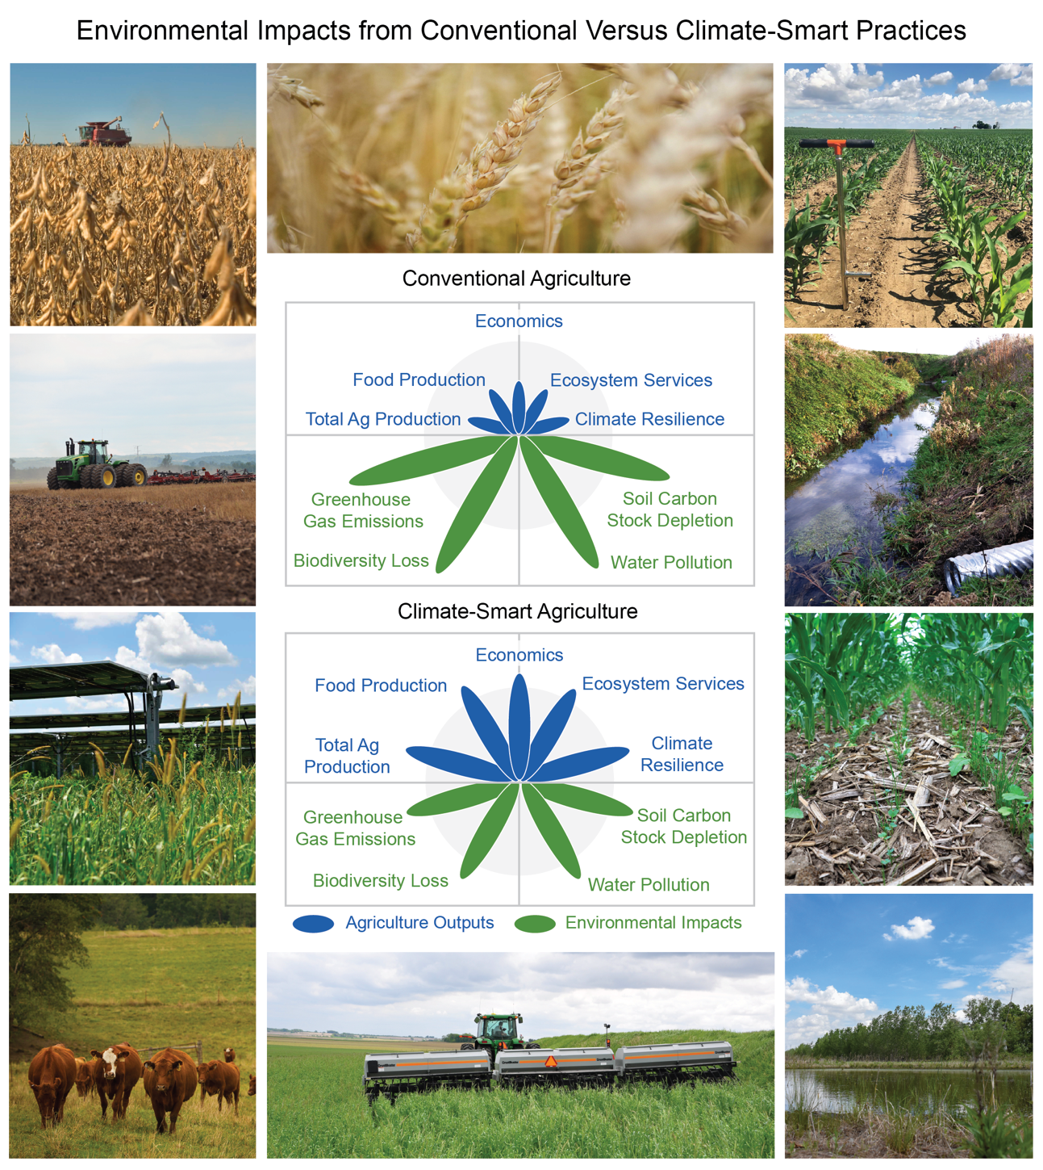
Figure 24.4. Climate-smart agricultural strategies may have adaptation and mitigation advantages that balance agricultural needs and environmental impacts.
Notes:
CAPTION: The figure shows examples of conventional and climate-smart production methods: (clockwise from top center) wheat field in Brownsburg, Indiana; spring corn under fair skies in southwest Ohio with infield soil sampling probe; outlet from water control structure to agricultural drainage ditch; inter-seeded annual ryegrass, clovers, and radishes growing in young corn in Carroll County, Iowa; macrotopograhic feature (ridge and swale) on a wetland restoration easement in Starke County, Indiana; planting green: no-till drilling soybeans into standing cereal rye in Washington County, Iowa; Forage Systems Research Center in Missouri works to improve the quality of forage grass, promotes management-intensive grazing, rotational grazing, cattle management, and the economics of beef and forage; an example of agrivoltaics—combining solar energy production on agricultural production lands; farmer tilling fields: traditional practice to break up soil in preparation for planting; farmer harvesting soybean with combine. The center diagrams compare the agricultural needs (blue ovals and text) with environmental impacts (green ovals and text) for both conventional and climate-smart agriculture. As shown, there is an imbalance between the agricultural needs and environmental impacts of conventional agriculture (represented by the blue and green ovals); whereas climate-smart agriculture may provide more balance between the two. Adapted with permission from Foley et al. 2011.(Foley et al. 2011) Photo credits: (top left; left, second from top) United Soybean Board [CC BY 2.0]; (top center) Carly Whitmore, NRCS; (top right) ©Elizabeth Hawkins; (right, second and third from top; bottom left) NRCS/SWCS photo by Lynn Betts [CC BY 2.0]; (bottom right) Carly Whitmore, NRCS; (bottom center) Kyle Spradley [CC BY 2.0]; (left, third from top) ©Tony Mancuso.

Slide 12
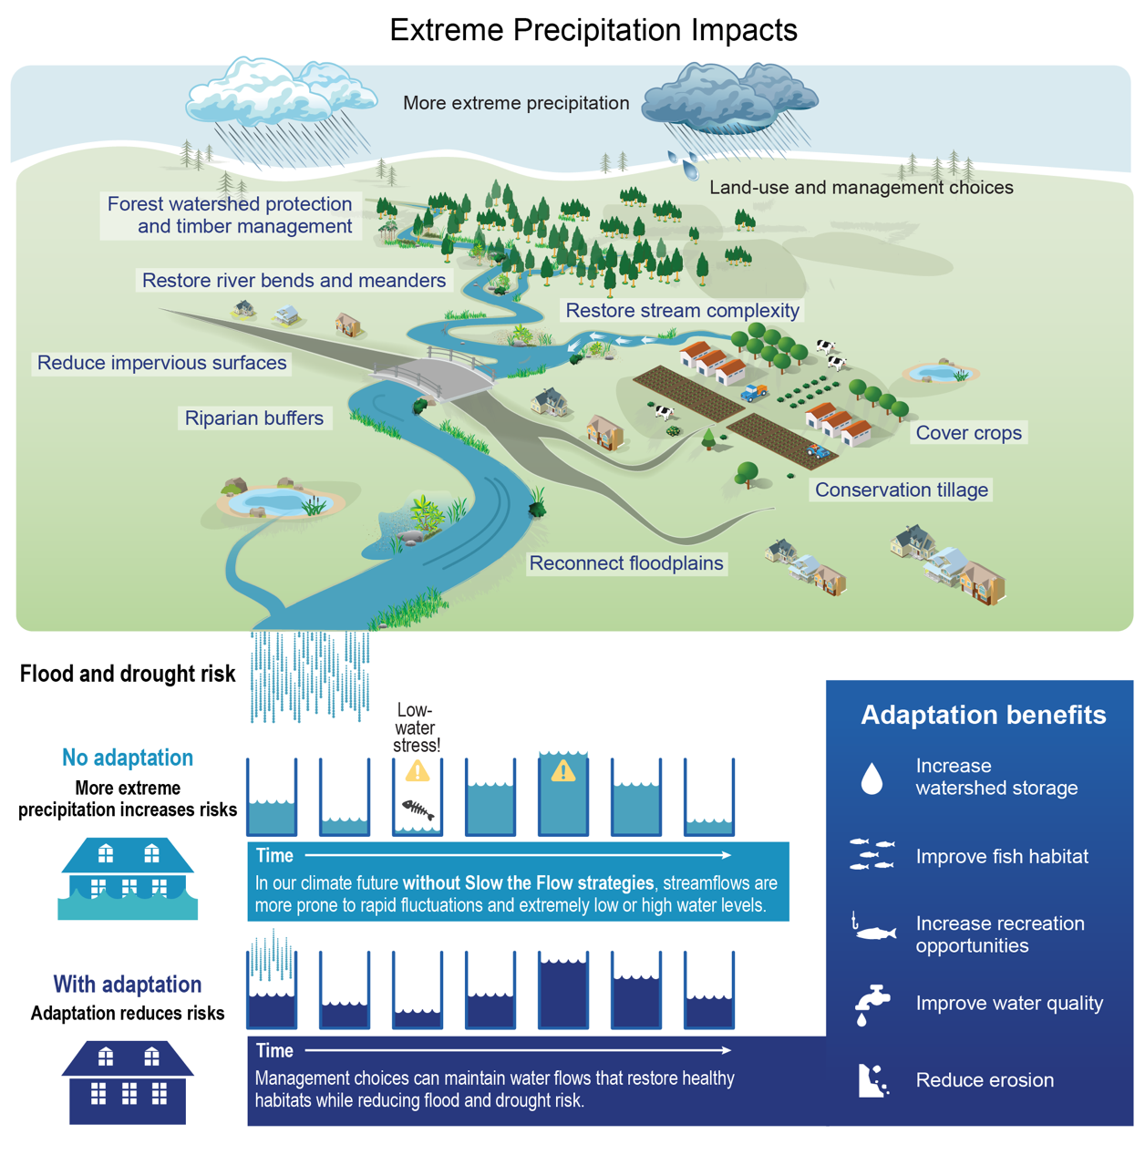
Figure 24.5. Extreme precipitation events have adverse impacts on aquatic and terrestrial ecosystems, human health, infrastructure, and economies. Conservation and management strategies can help moderate these impacts.
Notes:
CAPTION: Extreme precipitation events can degrade aquatic ecosystems, threaten human health and safety, damage infrastructure and communities, and yield billions of dollars in economic damage. The conservation and management of natural lands can reduce these negative effects—reducing erosion and flood risk, improving water quality, increasing carbon sequestration, and reducing the economic cost of flooding. This conceptual drawing, showing a Midwestern landscape with an extreme storm on the horizon and water flowing into streams and rivers, illustrates how land management choices affect downstream flooding, infrastructure, and ecosystem services. Landscape features and land management practices that slow the flow of water across the surface can improve habitat and water quality, reduce flood and drought risks, and have a variety of other benefits. Adapted with permission from Palmer et al. 2020.(Palmer et al. 2020)

Slide 13
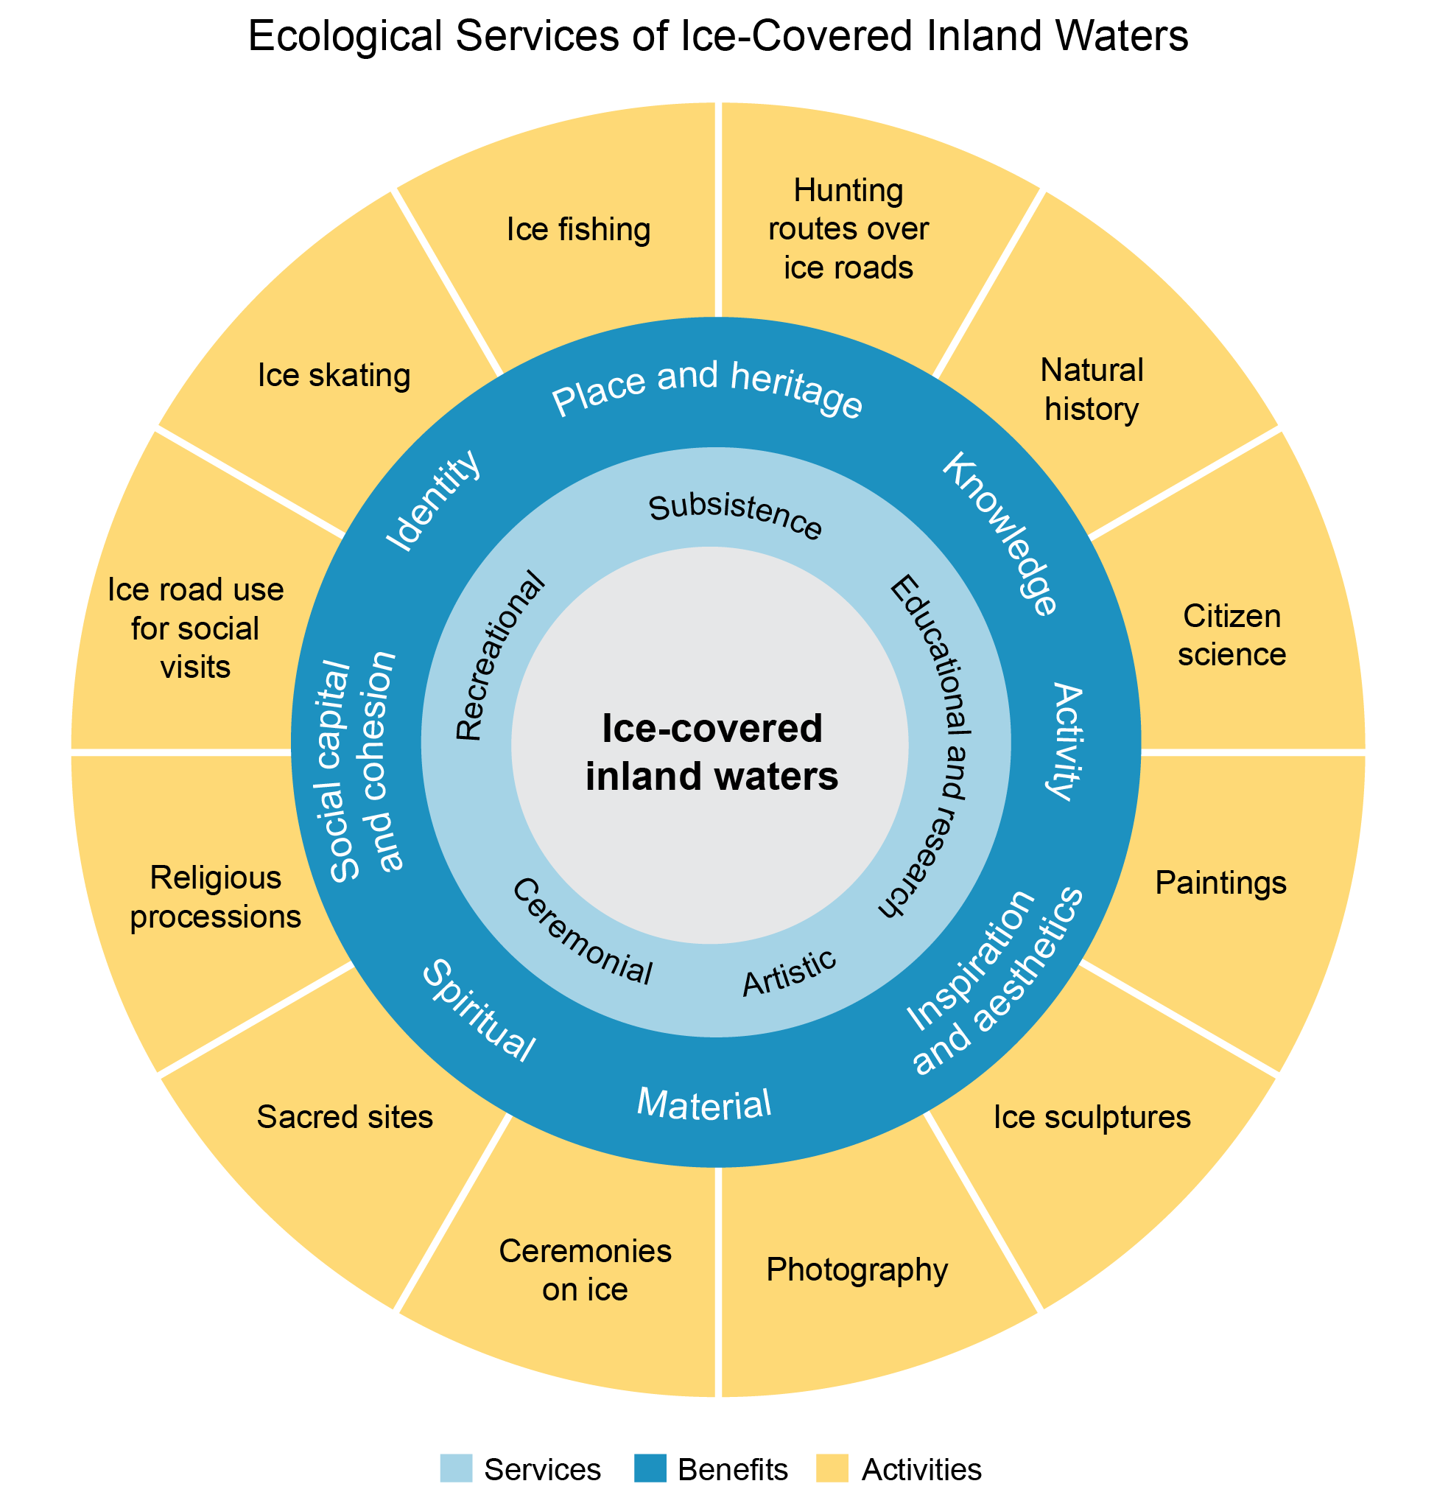
Figure 24.6. Rising winter temperatures are decreasing inland lake ice cover and the associated ecosystem services, benefits, and activities it provides.
Notes:
CAPTION: Ice-covered inland waters provide humans with important cultural ecosystem services (light blue ring), benefits (dark blue ring), and activities (yellow ring) that are central to people’s well-being, culture, and identity across the Midwest. Adapted from Knoll et al. 2019(Knoll et al. 2019) [CC BY 4.0].

Slide 14
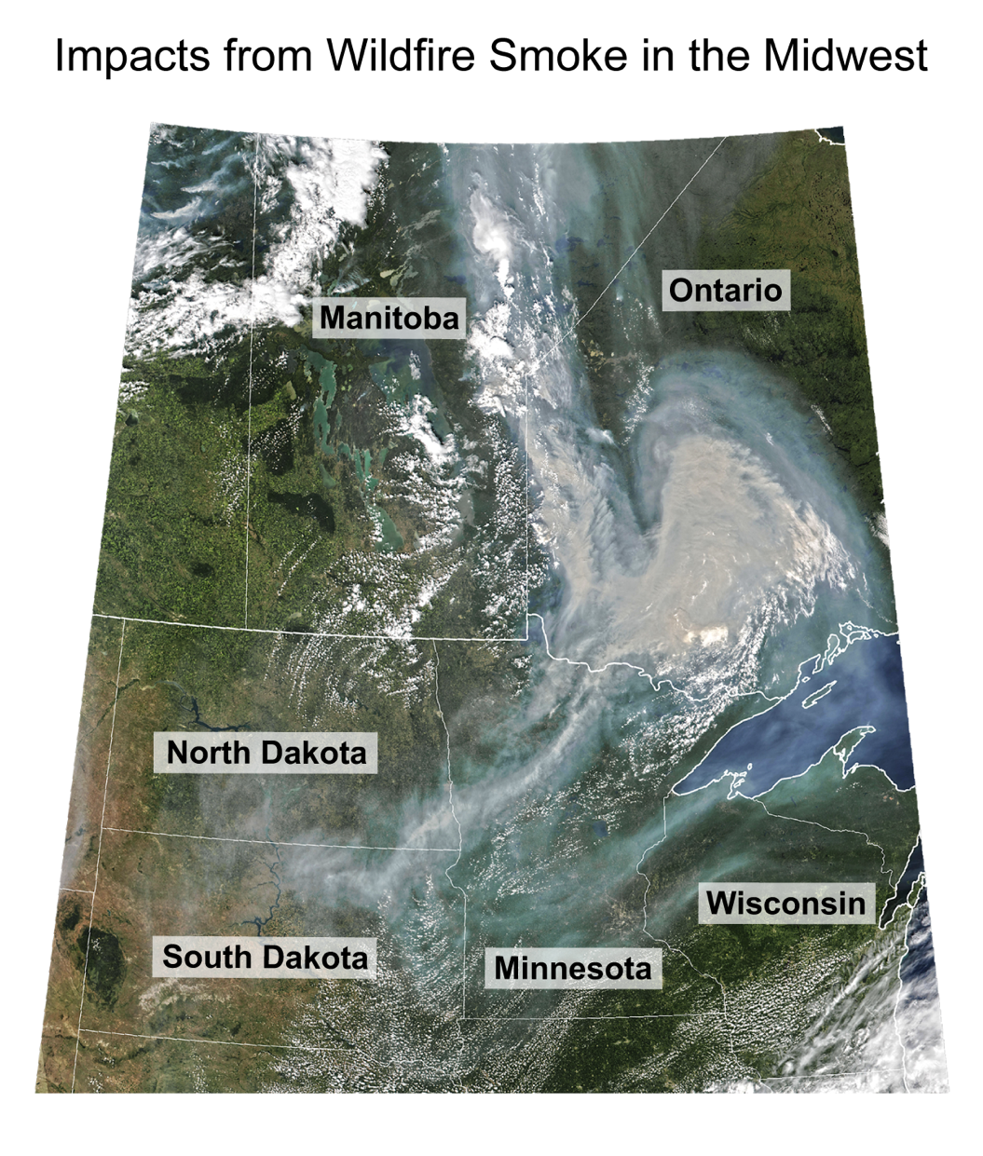
Figure 24.7. Wildfire smoke from both local and distant sources threatens human health.
Notes:
CAPTION: This satellite image shows wildfire smoke from Canada moving down over the northern Midwest on July 11, 2021. Satellite image credit: Joshua Stevens, NASA Earth Observatory, using VIIRS data from NASA EOSDIS LANCE, GIBS/Worldview, and the Joint Polar Satellite System (JPSS).

Slide 15
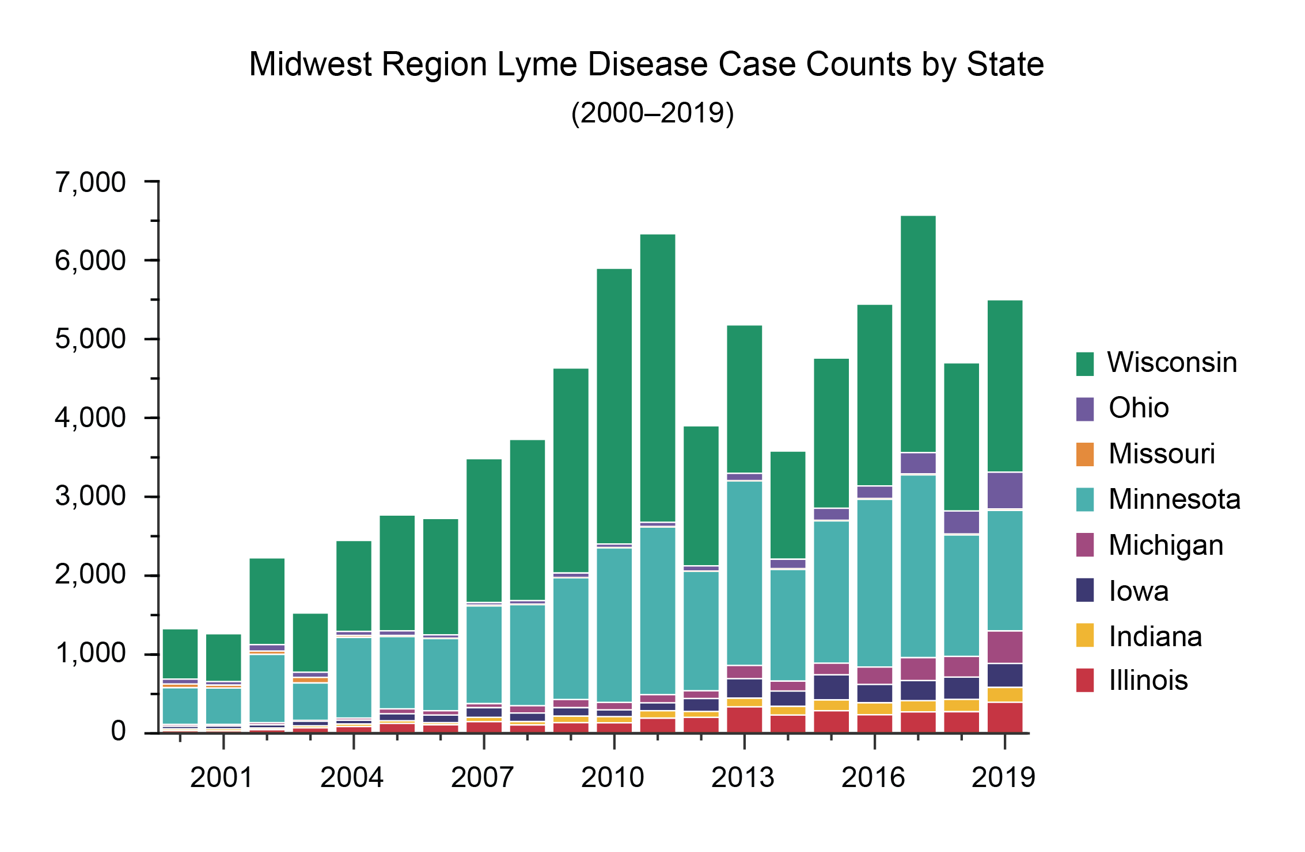
Figure 24.8. Lyme disease incidence has increased across the Midwest.
Notes:
CAPTION: The graph shows annual reports of Lyme disease incidence across the Midwest between 2000 and 2019. Factors such as rising temperatures, increased precipitation, warmer winters and land-use change have contributed to an increase in the incidence of Lyme disease across the region. Figure credit: University of Minnesota Climate Adaptation Partnership, NOAA NCEI, and CISESS NC.

Slide 16
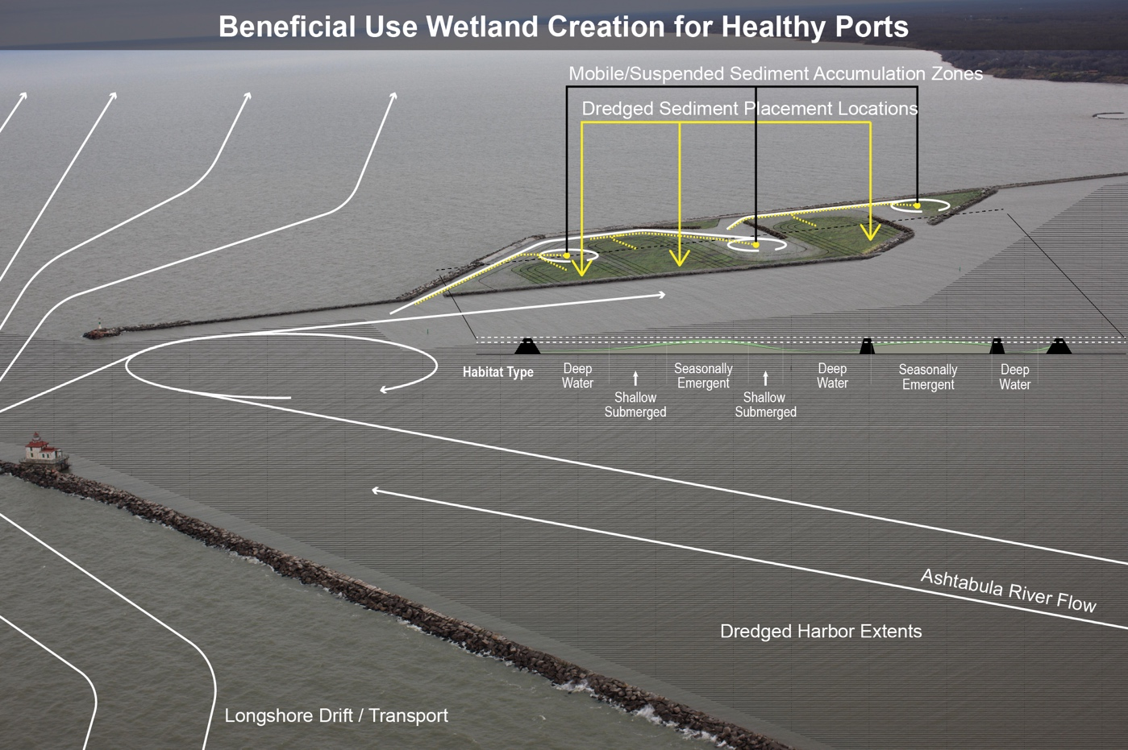
Figure 24.9. Innovative design of coastal infrastructure, such as the Ashtabula Port, allows the built environment to deliver social and environmental services.
Notes:
CAPTION: The image shows an overview of the harbor in Ashtabula, Ohio, the site of a wetland creation project by the US Army Corps of Engineers with support from Healthy Port Futures. This project, which works with the flow on the Ashtabula River into Lake Erie, was one of the first attempts in the Great Lakes to establish a partially open wetland system with reused dredge material. This design permits an occasional, ecologically necessary disturbance that will promote wetland complexity while also allowing for an important hydrological connection to the nearshore. The figure highlights areas of material placement (solid yellow lines) and sediment movement and accumulation (solid white lines, including sediment transported naturally along the shore). Sediment that accumulates in the wetland channels is placed in the dredged sediment placement locations (dashed yellow lines) every two to three years. This way, the project can employ an adaptive management approach and respond to successes and challenges that may arise. The project will create diverse habitat types including deep water, shallow submerged areas, seasonally emergent areas, and the adjacent open water areas (habits indicated by the light beige and green shading). The built project differs slightly from what is shown here. Adapted from Burkholder et al. 2022.(Burkholder et al. 2022)

Slide 17
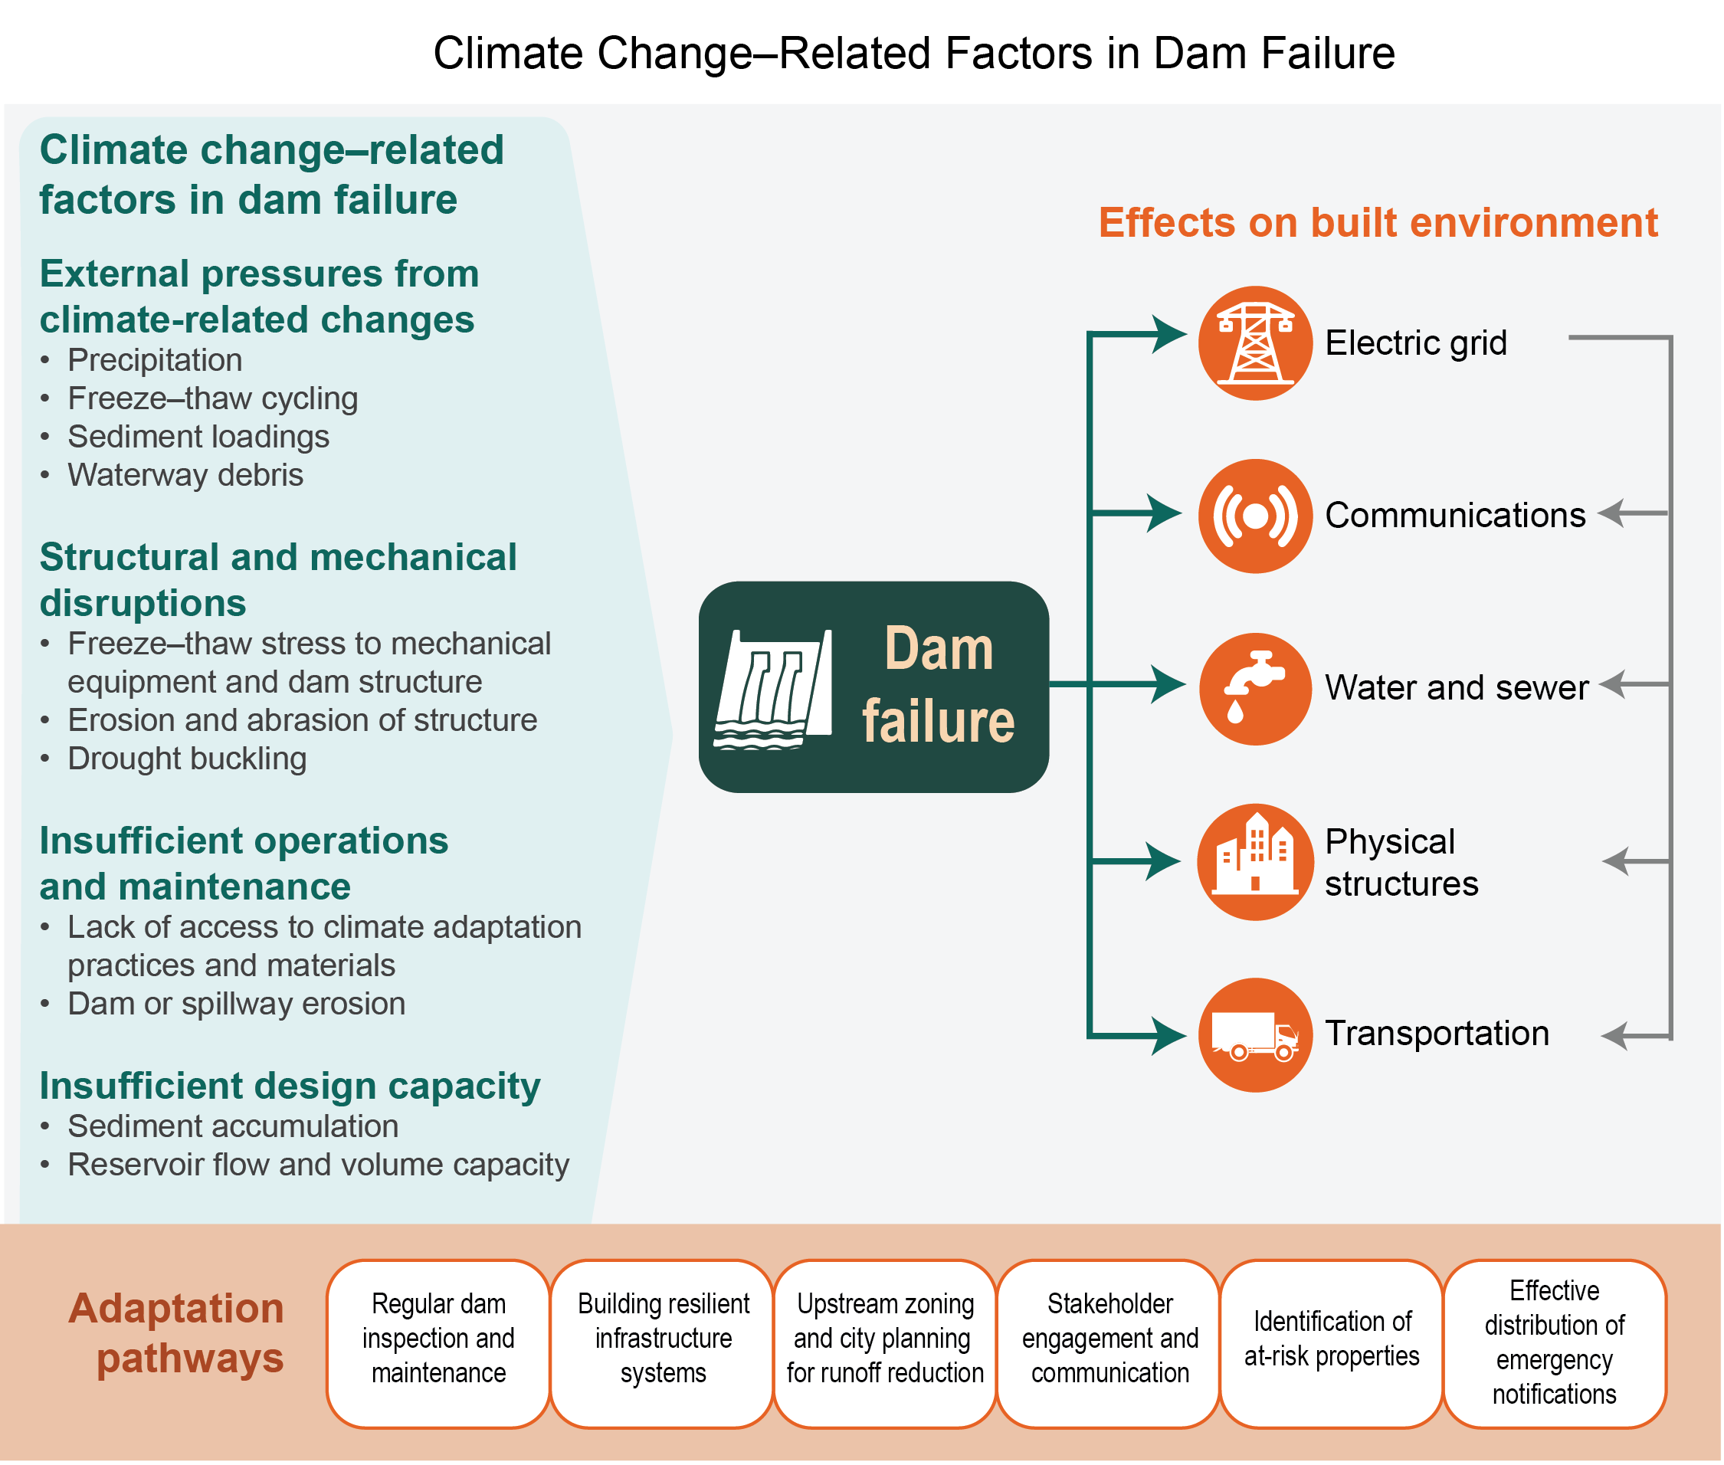
Figure 24.10. Climate change–related factors contribute to dam failure, with cascading impacts on the built environment.
Notes:
CAPTION: The graphic shows contributing causes for dam failure related to climate change, first-order effects of dam failure on the built environment, and adaptation pathways. Dam systems may experience climate change–related impacts independently or in parallel, and these impacts can have cascading effects. Damage to transportation, power, water, and communication infrastructure can limit a community’s ability to access health services. Damage to infrastructure, land, and the built environment can negatively impact local businesses and the economy. Adaptation pathways provide a basis for communities to address dam risk from a variety of system viewpoints. Figure credit: MITRE, University of Pennsylvania, American Society of Adaptation Professionals, and The Ohio State University.

Slide 18
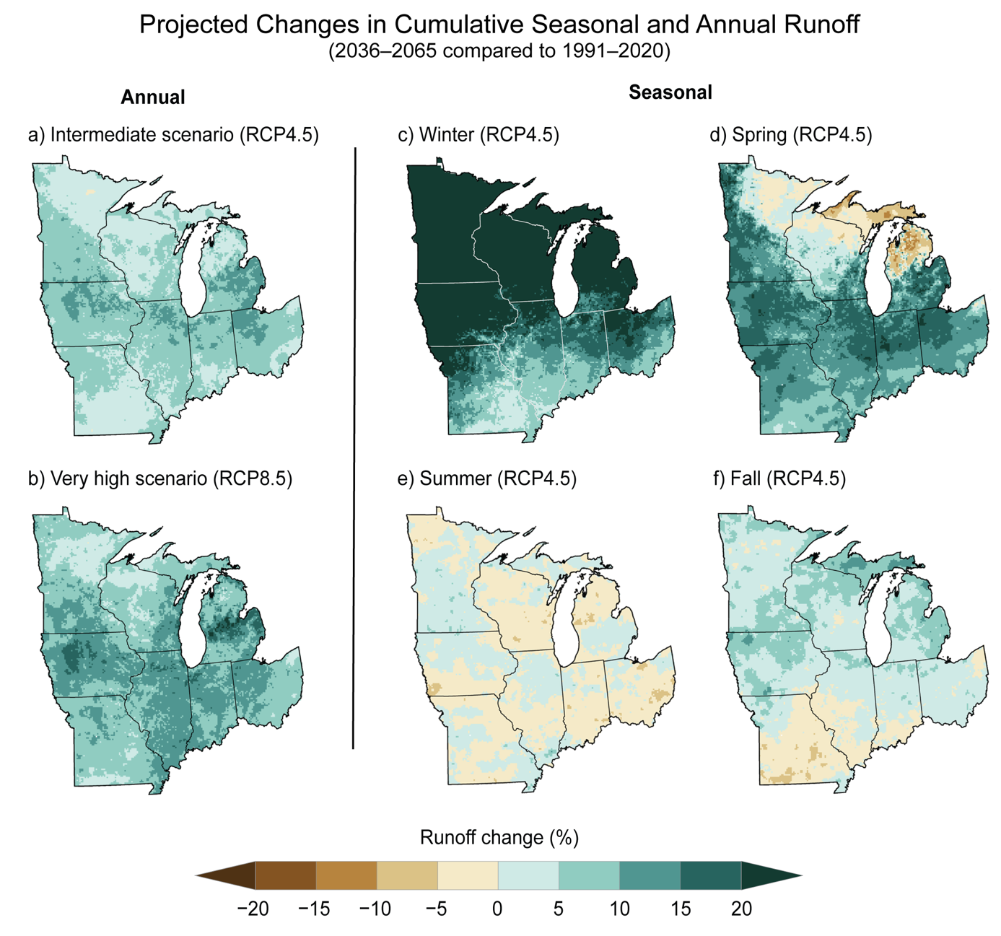
Figure 24.11. Projected changes in cumulative local runoff will lead to increased flooding susceptibility in winter and spring with, increased flash drought potential in summer.
Notes:
CAPTION: The maps show projected changes in the annual approximate cumulative gridded local runoff generation (referred to as cumulative runoff) for intermediate (RCP4.5) and very high (RCP8.5) scenarios (a, b) and seasonal approximate cumulative runoff for an intermediate (RCP4.5) scenario (c–f). The cumulative runoff is defined as the gridded cell-by-cell ability of the landscape to generate excess water for potential downstream river runoff using the Variable Infiltration Capacity (VIC) land-surface model. The cumulative runoff was developed using Coupled Model Intercomparison Project Phase 5–modeled scenarios and the VIC hydrology model. Cumulative runoff is projected to increase annually across the Midwest between 2036 and 2065 compared to 1991–2020 (shown in percent changes). Cumulative runoff increases are expected throughout the region in winter and across all but the northern Great Lakes in spring and southern Midwest in fall. Summer cumulative runoff is projected to be more variable. The result of the projected increases (and in summer, both increases and decreases) in cumulative runoff will be increased stresses to ecosystems, the built environment, natural and water resources, and agriculture. Figure credit: NOAA NWS, NOAA NCEI, and CISESS NC.

Slide 19
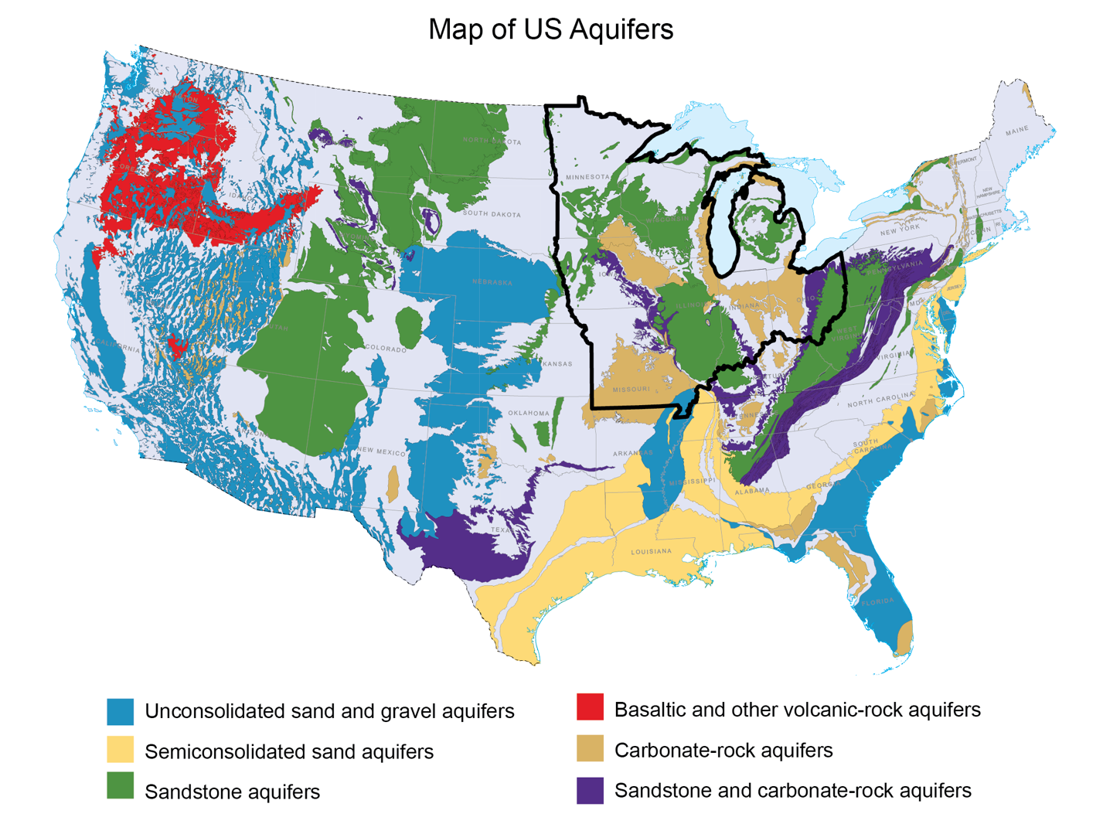
Figure 24.12. Vulnerability to disruptions in water quality and quantity varies by location, depending on the primary source of water for drinking and other uses.
Notes:
CAPTION: The USGS Ground Water Atlas of the United States provides a complete summary of the Nation’s groundwater resources and includes the location, geography, geology, and hydrologic characteristics of the major US aquifers. Surface water and groundwater (aquifers) are the primary sources of water in the Midwest and Great Lakes. The areas highlighted in color represent groundwater aquifers, while areas in gray represent surface water as the main source. The black boundary outlines the Midwest region. Changes in rainfall and runoff patterns impact water availability and water tables differently across the Midwest, depending on whether the main source of water is surface- or aquifer-based. For more information on aquifers outside the contiguous US, visit the USGS Ground Water Atlas of the United States and Principal Aquifers of the United States. Adapted from USGS 2021.(USGS 2021)

Slide 20
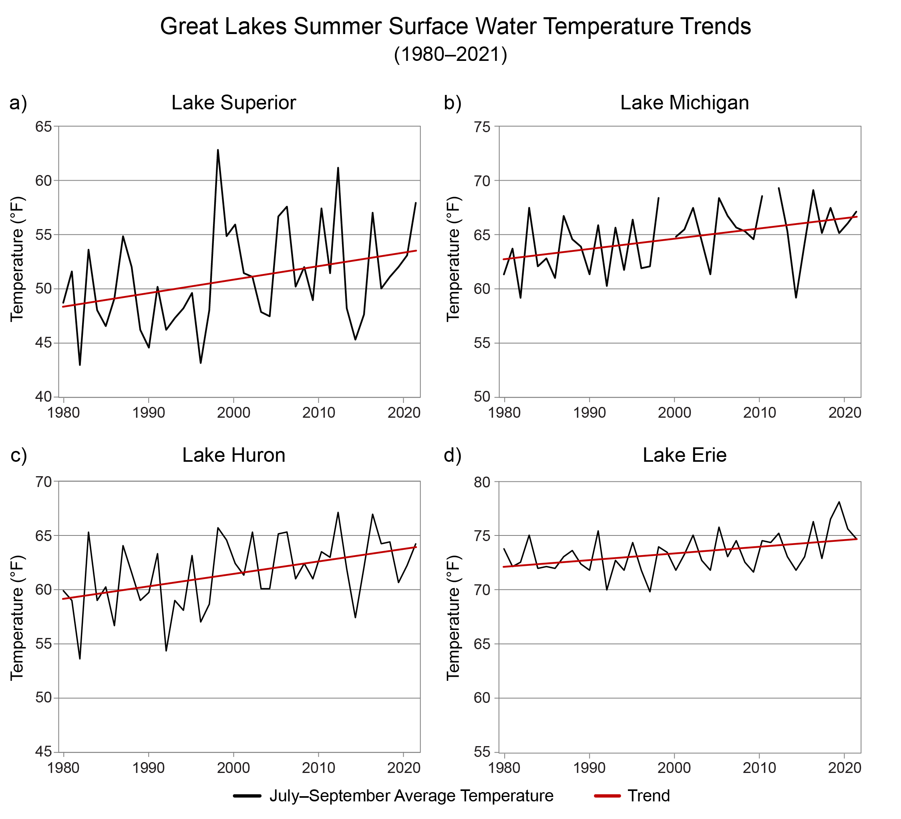
Figure 24.13. Summer surface water temperatures have been increasing for Lakes Superior, Michigan, Huron, and Erie since the late 1970s.
Notes:
CAPTION: The graphs show summer (July–September) surface water temperatures for the period 1980–2021 observed from buoys in the offshore waters of Lakes Superior, Michigan, Huron, and Erie. The upper lakes (Superior, Michigan, and Huron; a–c) show similar trends toward warmer temperatures against a background of strong interannual variability, while Lake Erie (d) shows a weaker but still positive trend. To facilitate comparison of trends, a temperature range of 25°F is used for the vertical axis on all four charts, with actual temperatures varying across the different lakes. Figure credit: University of Minnesota Duluth, NOAA NCEI, and CISESS NC

Slide 21
Federal Coordinating Lead Author
John M. Baker, USDA Agricultural Research Service
Chapter Lead
Aaron B. Wilson, The Ohio State University, Byrd Polar and Climate Research Center
Chapter Authors
Elizabeth A. Ainsworth, USDA Agricultural Research Service
Jeffrey Andresen, Michigan State University
Jay A. Austin, University of Minnesota Duluth
Jeffrey S. Dukes, Carnegie Institution for Science
Elizabeth Gibbons, Farallon Strategies LLC
Brendalynn O. Hoppe, University of Minnesota Climate Adaptation Partnership
Olivia E. LeDee, US Geological Survey
James Noel, NOAA National Weather Service, Ohio River Forecast Center
Heidi A. Roop, University of Minnesota Climate Adaptation Partnership
Sara A. Smith, Oneida Nation and College of Menominee Nation
Dennis P. Todey, USDA Agricultural Research Service, National Laboratory for Agriculture and the Environment
Ray Wolf, NOAA National Weather Service (retired)
Jeffrey D. Wood, University of Missouri, School of Natural Resources
Technical Contributors
Sean Burkholder, University of Pennsylvania
Sean Cavanaugh, MITRE Corporation
Trent W. Ford, University of Illinois, Prairie Research Institute
Jennifer Richkus, MITRE Corporation
Review Editor
Thomas W. Bonnot, US Fish and Wildlife Service
USGCRP Coordinators
Samantha Basile, US Global Change Research Program / ICF
Joshua Hernandez, US Global Change Research Program / ICF

Slide 22
Wilson, A.B., J.M. Baker, E.A. Ainsworth, J. Andresen, J.A. Austin, J.S. Dukes, E. Gibbons, B.O. Hoppe, O.E. LeDee, J. Noel, H.A. Roop, S.A. Smith, D.P. Todey, R. Wolf, and J.D. Wood, 2023: Ch. 24. Midwest. In: Fifth National Climate Assessment. Crimmins, A.R., C.W. Avery, D.R. Easterling, K.E. Kunkel, B.C. Stewart, and T.K. Maycock, Eds. U.S. Global Change Research Program, Washington, DC, USA. https://doi.org/10.7930/NCA5.2023.CH24
https://nca2023.globalchange.gov/chapter/24

