Slide 1

NCA5 Website: https://nca2023.globalchange.gov
Chapter Website: https://nca2023.globalchange.gov/chapter/28
NCA5 Atlas: https://atlas.globalchange.gov
Figure captions can be found in the slide notes of this deck
Social media: @usgcrp, #NCA5

Slide 2
Chapter 28 | Southwest

Slide 3
1
Drought and Increasing Aridity Threaten Water Resources
Climate change has reduced surface water and groundwater availability for people and nature in the Southwest (very high confidence), and there are inequities in how these impacts are experienced (high confidence). Higher temperatures have intensified drought and will lead to a more arid future (very likely, high confidence); without adaptation, these changes will exacerbate existing water supply–demand imbalances (likely, high confidence). At the same time, the region is experiencing more intense precipitation events, including atmospheric rivers, which contribute to increased flooding (high confidence). Flexible and adaptive approaches to water management have the potential to mitigate the impacts of these changes on people, the environment, and the economy (medium confidence).

Slide 4
2
Adaptation Efforts Increase to Address Accelerating Impacts to the Region’s Coast and Ocean
Large-scale marine heatwaves and harmful algal blooms have caused profound and cascading impacts on marine coastal ecosystems and economies (high confidence). Without implementation of adaptation or emissions-reductions measures, human-caused warming will drive more frequent and longer marine heatwaves (very likely, very high confidence), amplifying negative coastal effects (medium confidence). Sea level rise, along with associated impacts such as flooding and saltwater intrusion, will have severe and disproportionate effects on infrastructure, communities, and natural resources (likely, very high confidence). The California State Government has applied climate science to planning and decision-making for sea level rise, and multiple regions are moving toward climate-informed and adaptive strategies for fisheries (high confidence). However, climate planning and adaptation solutions for aquaculture are less clear (high confidence).

Slide 5
3
Increasing Challenges Confront Food and Fiber Production in the Southwest
Continuing drought and water scarcity will make it more difficult to raise food and fiber in the Southwest without major shifts to new strategies and technologies (high confidence). Extreme heat events will increase animal stress and reduce crop quality and yield, thereby resulting in widespread economic impacts (likely, high confidence). Because people in the Southwest have adapted to drought impacts for millennia, incorporating Indigenous Knowledge with technological innovation can offer solutions to protect food security and sovereignty (medium confidence).

Slide 6
4
Climate Change Compromises Human Health and Reshapes Demographics
Increases in extreme heat, drought, flooding, and wildfire activity are negatively impacting the physical health of Southwest residents (high confidence). Climate change is also shaping the demographics of the region by spurring the migration of people from Central America to the Southwest (medium confidence). Individuals particularly vulnerable to increasing climate change impacts include older adults, outdoor workers, and people with low income (high confidence). Local, state, and federal adaptation initiatives are working to respond to these impacts (high confidence).

Slide 7
5
Changes in Wildfire Patterns Pose Challenges for Southwest Residents and Ecosystems
In recent years, the Southwest has experienced unprecedented wildfire events, driven in part by climate change (high confidence). Fires in the region have become larger and more severe (high confidence). High-severity wildfires are expected to continue in coming years, placing the people, economies, ecosystems, and water resources of the region at considerable risk (very likely, high confidence). Opportunities for adaptation include pre- and postfire actions that reduce wildfire risk and facilitate ecosystem restoration and include traditional land stewardship practices (high confidence) and the application of Indigenous cultural fire (medium confidence).

Slide 8
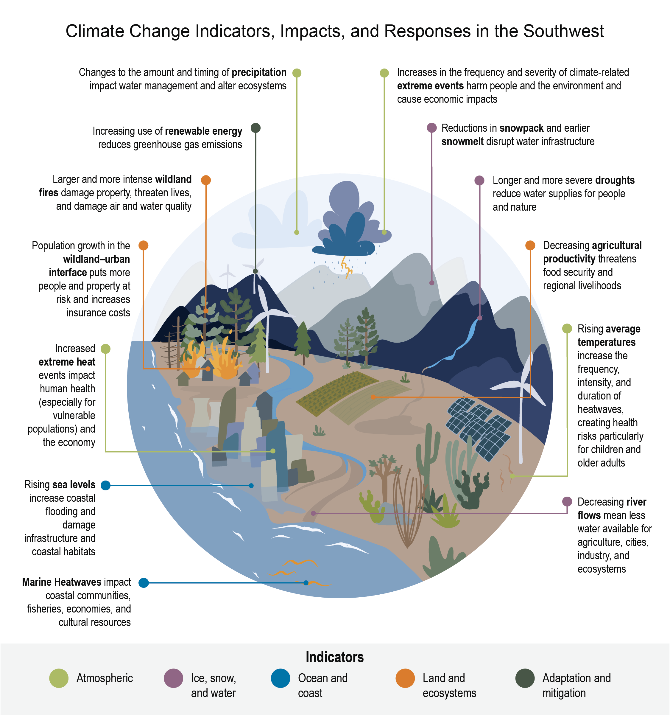
Figure 28.1. Indicators highlight important climate impacts and adaptation and mitigation efforts.
Notes:
CAPTION: Indicators track the impacts of climate change on the atmosphere; ice, snow, and water; ocean and coast; and land and ecosystems, as well as adaptation and mitigation efforts. Monitoring these indicators helps us understand how impacts are experienced and how to adapt to risks. See Appendix 4 for more Indicators. Figure credit: Arizona State University. See figure metadata for additional contributors.

Slide 9
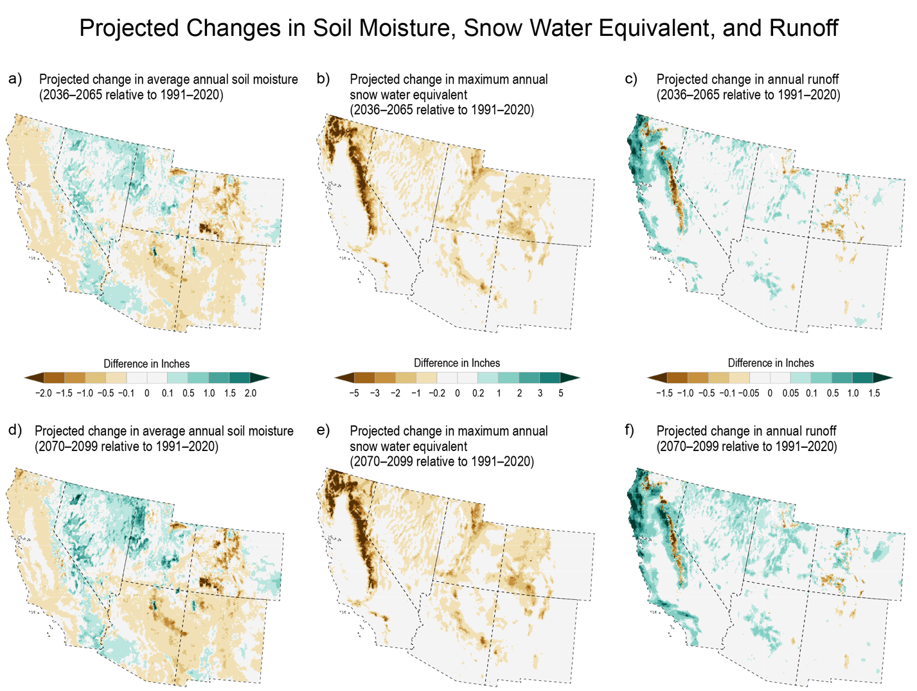
Figure 28.2. Climate change is projected to reduce snow water equivalent and alter trends in soil moisture and annual runoff.
Notes:
CAPTION: These maps show projected average mid-21st-century (2036–2065; top row) and late-21st-century (2070–2099; bottom row) differences in annual soil moisture, snow water equivalent (the amount of water contained within the snowpack), and runoff over the Southwest region relative to the baseline period, 1991–2020. The data in these maps come from a land-surface hydrological model that simulates different parts of the water and energy balance. The model takes temperature and precipitation data from an ensemble of downscaled Coupled Model Intercomparison Project, Phase 5 (CMIP5) global climate models using an intermediate scenario (RCP4.5)(Pierce 2023) to create future projections of soil moisture, snow water equivalent, and runoff.(Vano et al. 2020) Warming temperatures and precipitation variability are expected to reduce snow water equivalent and alter trends in soil moisture and annual runoff (KM 4.1). The historical record shows that the climatology of 1991–2020 was substantially warmer than the climatology of preceding 30-year periods. Thus, the areas of projected lower soil moisture, snow water equivalent, and runoff in this figure, especially at higher elevations, present marked deficits in comparison to 30-year periods in the 20th century. There are also areas of projected increases in soil moisture and runoff. Some CMIP5 global climate models project increased precipitation over parts of the Southwest, and when these are included in calculating average soil moisture or runoff, the result indicates wetter conditions in some locations, predominantly in Nevada, Utah, southwest Arizona, and southeast California. For more detail on variability, Figures 4.5, 4.6, and 4.7 show data from the same source that illustrate the wet to dry range of projections for the mid-21st century. Figure credit: New Mexico State University; Arizona State University; University of Nevada, Reno; NOAA NCEI; and CISESS NC.

Slide 10
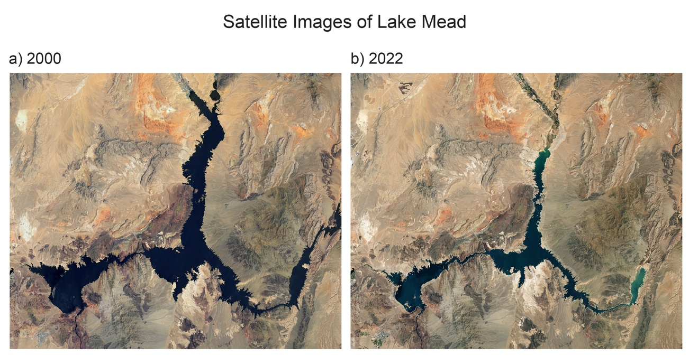
Figure 28.3. Lake Mead water levels have declined, with potential water supply implications for millions of people.
Notes:
CAPTION: Lake Mead, the largest reservoir in the US, supplies water to tens of millions of people across the Southwest; irrigates millions of acres of agricultural land; supports biodiversity, cultural heritage, ecosystems, and ecosystem services; and provides recreational opportunities. From 2000 (a) to 2022 (b), the water levels in Lake Mead declined from 98% to just 27% of its capacity, as shown in these satellite images. Satellite images: NASA Earth Observatory.

Slide 11
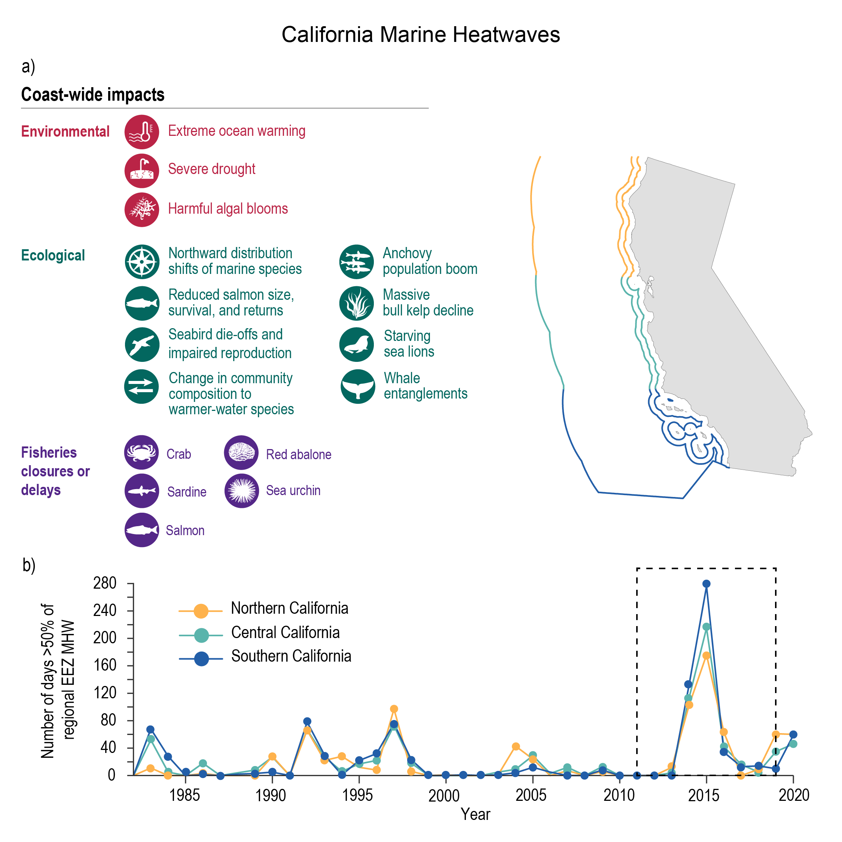
Figure 28.4. Pacific marine heatwaves have had coast-wide impacts on ecosystems and fisheries.
Notes:
CAPTION: The 2014–2016 Pacific marine heatwave (MHW) was unusually long and resulted in a variety of impacts for the southwest California coast (a). This MHW was followed by less extensive events in 2018 and 2019–2020 (b). While impacts like this can be expected to continue, they demonstrate the need and potential for adaptive management and mitigation through an integrated ecosystem approach to managing marine habitats and fisheries. EEZ refers to exclusive economic zone. Figure credit: University of California, Santa Barbara; California Department of Transportation; NOAA NCEI; and CISESS NC.

Slide 12
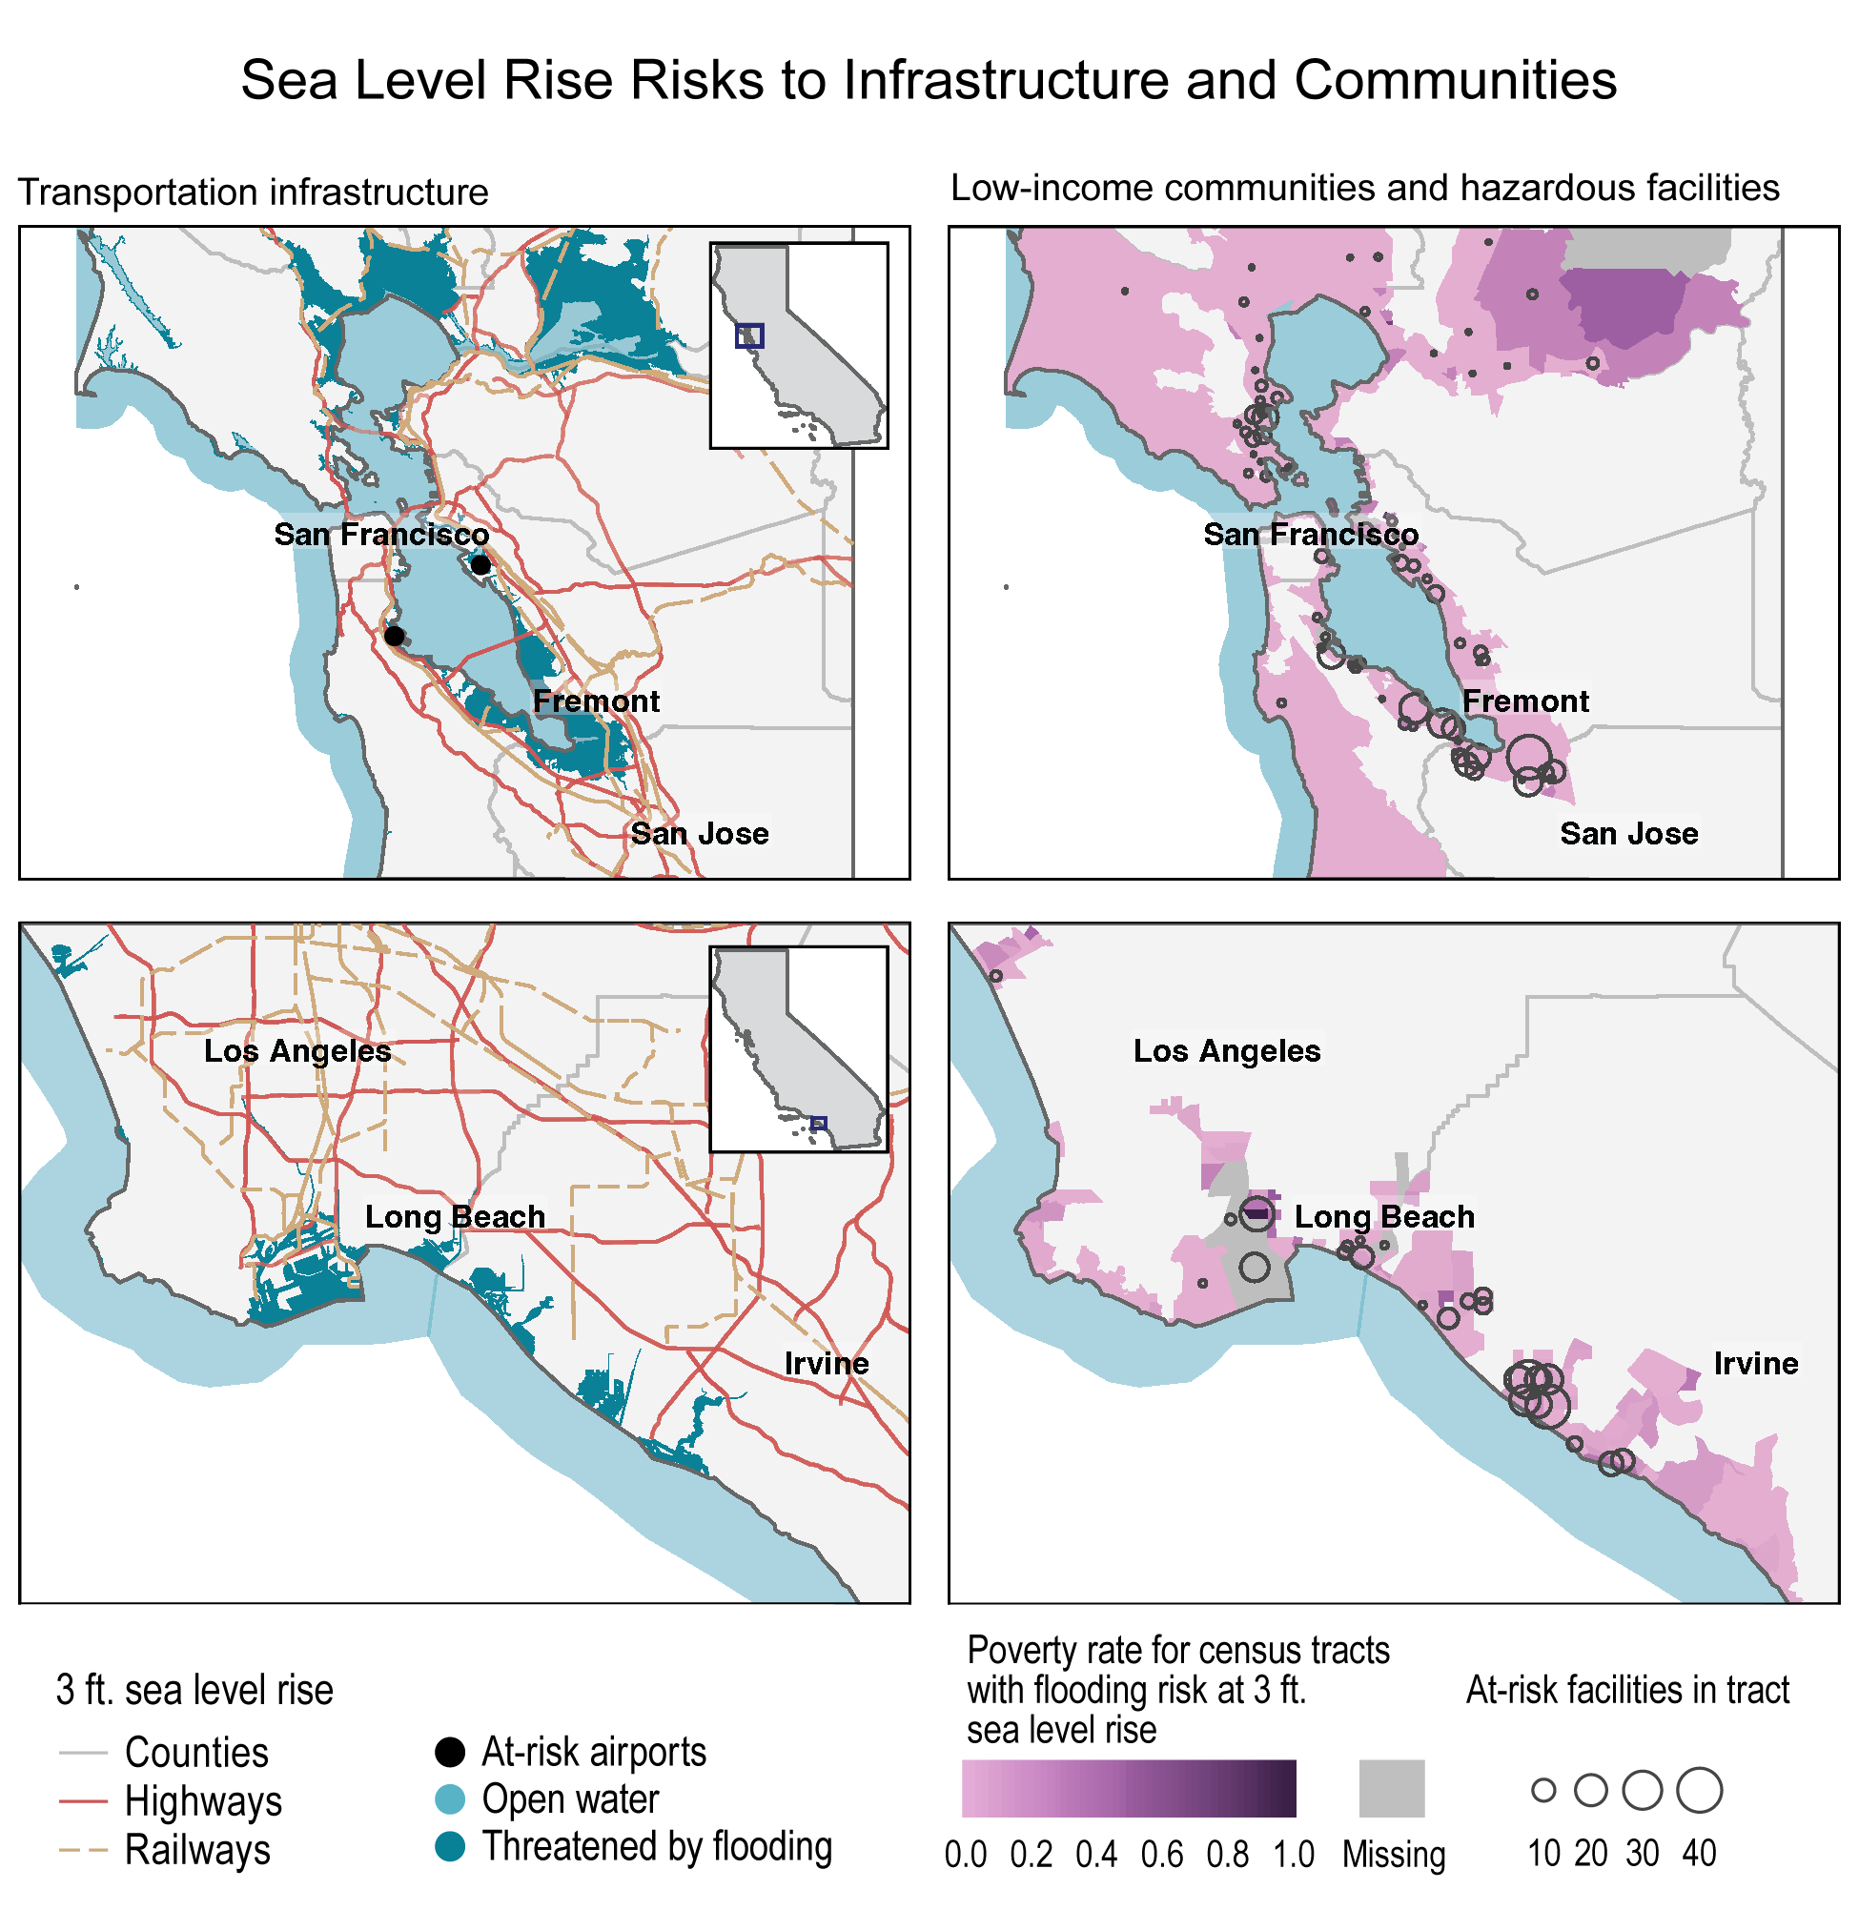
Figure 28.5. Flooding from sea level rise is expected to affect transportation infrastructure and communities along the California coast, with disproportionate impacts on lower-income communities.
Notes:
CAPTION: These maps show the projected flood risk from 3 feet of sea level rise (SLR), as well as risks to critical infrastructure and surrounding communities, for the San Francisco Bay Area (top row) and the coastline from Los Angeles to San Diego (bottom row). Panels in the left column show transportation infrastructure threatened by flooding with 3 feet of SLR, while those in the right column show the number of hazardous facilities (indicated by circles) and census tracts at risk of flooding, with purple shading indicating the fraction of population in each census tract with income below the poverty level. Flooding from SLR will impact major transportation infrastructure along the coast; given the locations of hazardous facilities and their overlap with lower-income communities, this flooding will have disproportionate impacts on these communities. Flood risk from SLR is consistent with an Intermediate scenario in the year 2100.(Sweet et al. 2022) Transportation infrastructure includes major airports, highways, and railways. Hazardous facility categories defined by EPA include manufacturing plants, power transmission plants and substations, natural gas pipelines, refineries and oil and gas wells, waste management facilities, landfills and incinerators, and animal operations. Figure credit: Eagle Rock Analytics.

Slide 13
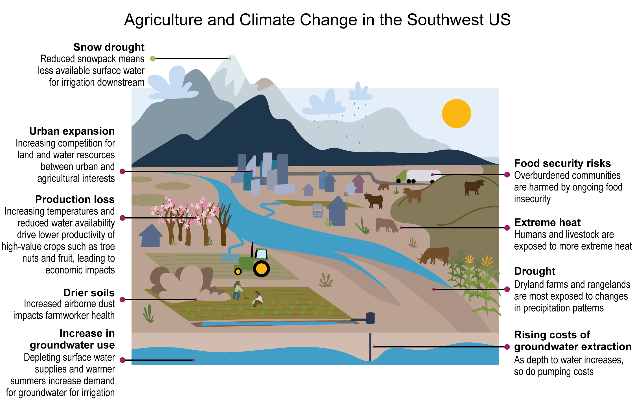
Figure 28.6. Monitoring indicators of climate impacts on agriculture can improve understanding and help with adaptation efforts.
Notes:
CAPTION: Climate change impacts to the Southwest’s agriculture include longer growing seasons, a northward shift in plant hardiness zones, expanded areas of heat stress, and higher rates of evapotranspiration, increasing demand for fresh water for irrigation. Monitoring the indicators helps us understand how impacts are experienced and how to adapt to risks. Figure credit: New Mexico State University and Utah State University. See figure metadata for additional contributors.

Slide 14
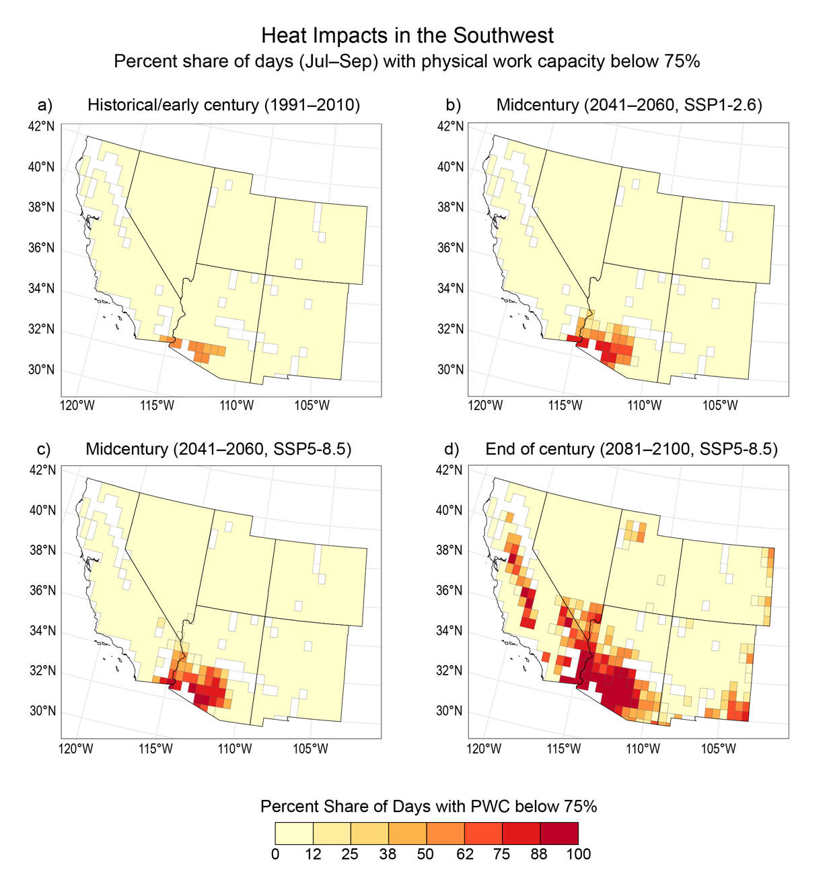
Figure 28.7. With extreme heat events expected to increase in frequency and severity, the ability to perform work outside is projected to decline across parts of the Southwest.
Notes:
CAPTION: The ability to perform work outside—as measured by physical work capacity (PWC)—will decline across large swaths of the Southwest due to heat exposure throughout the century, with the greatest declines expected in southwest Arizona, southeast California, and California’s Central Valley. These impacts on outdoor work will affect agricultural output, as well as earning ability for workers. PWC has a range of 100% (no loss of work capacity) to 0% (complete loss). The maps display the proportion of days in the third quarter (July to September) in which PWC is less than 75%. In historical conditions (a), a few locations in southern Arizona had PWC values less than 75% for half of the quarter. (d) Under a very high scenario (SSP5-8.5) by end of century, most of southern Arizona, southeast California, and some of California’s Central Valley are projected to have less than 75% work capacity for all days in the third quarter. This daily labor loss is calculated based on a given heat load (temperature, humidity, and solar radiation) compared to temperate conditions where there is no thermal effect on work output. To provide a full range of potential impacts, maps are based on representative years for (a) historical/early century (1991–2010); (b) midcentury (2041–2060, SSP1-2.6 [low scenario]); (c) midcentury (2041–2060, SSP5-8.5 [very high scenario]); and (d) end of century (2081–2100, SSP5-8.5). Estimates are based on an individual performing moderate to heavy agricultural work outdoors over a daytime shift (about 7 hours). The PWC is an empirical estimate based on human physiological chamber studies quantifying how PWC changes with the environment heat load based on the wet-bulb globe temperature.(Foster et al. 2022; Foster et al. 2021, 2022; Smallcombe et al. 2022) Land areas in white had no crops in the early 21st century. Figure credit: University of Illinois–Urbana Champaign and Arizona State University.

Slide 15
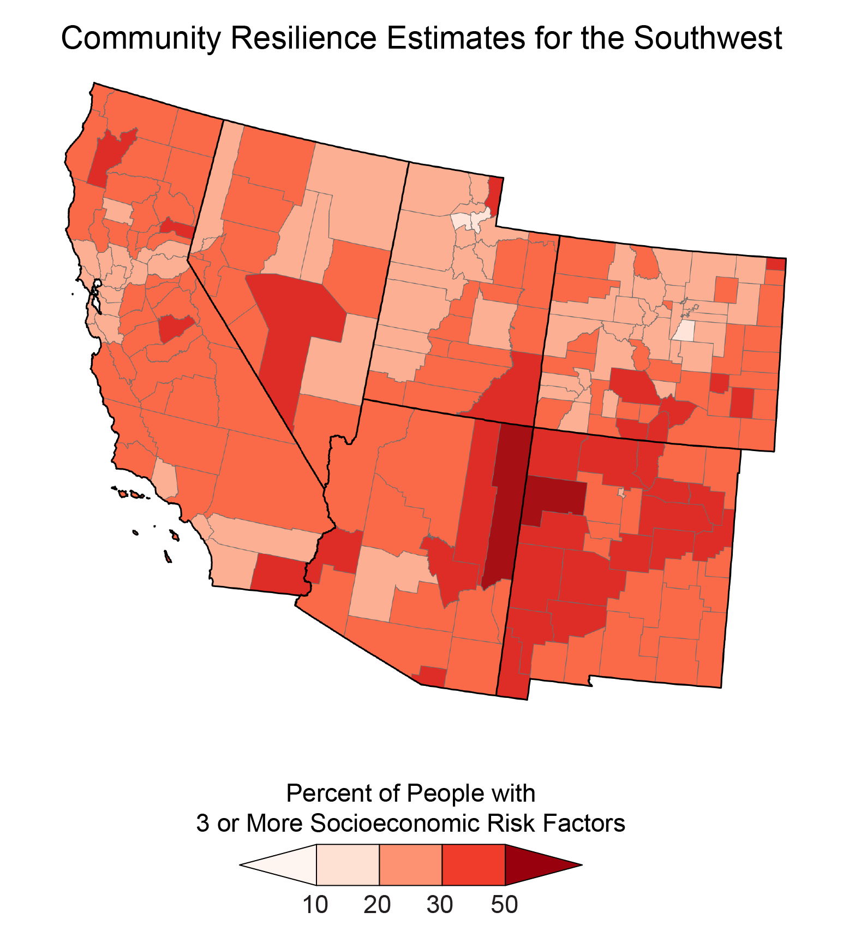
Figure 28.8. Communities with higher socioeconomic risk factors are expected to be less resilient in the event of climate and weather disasters.
Notes:
CAPTION: The map shows community resilience estimates (CREs) for the Southwest. Community resilience is the capacity of individuals and households to absorb, endure, and recover from the health, social, and economic impacts of a disaster. Individual and household characteristics from the 2019 American Community Survey were modeled, in combination with data from the Population Estimates Program, to create the CREs at the county level. Darker shading indicates a higher proportion of the population at risk. Adapted from US Census Bureau 2021.(U.S. Census Bureau 2021)

Slide 16
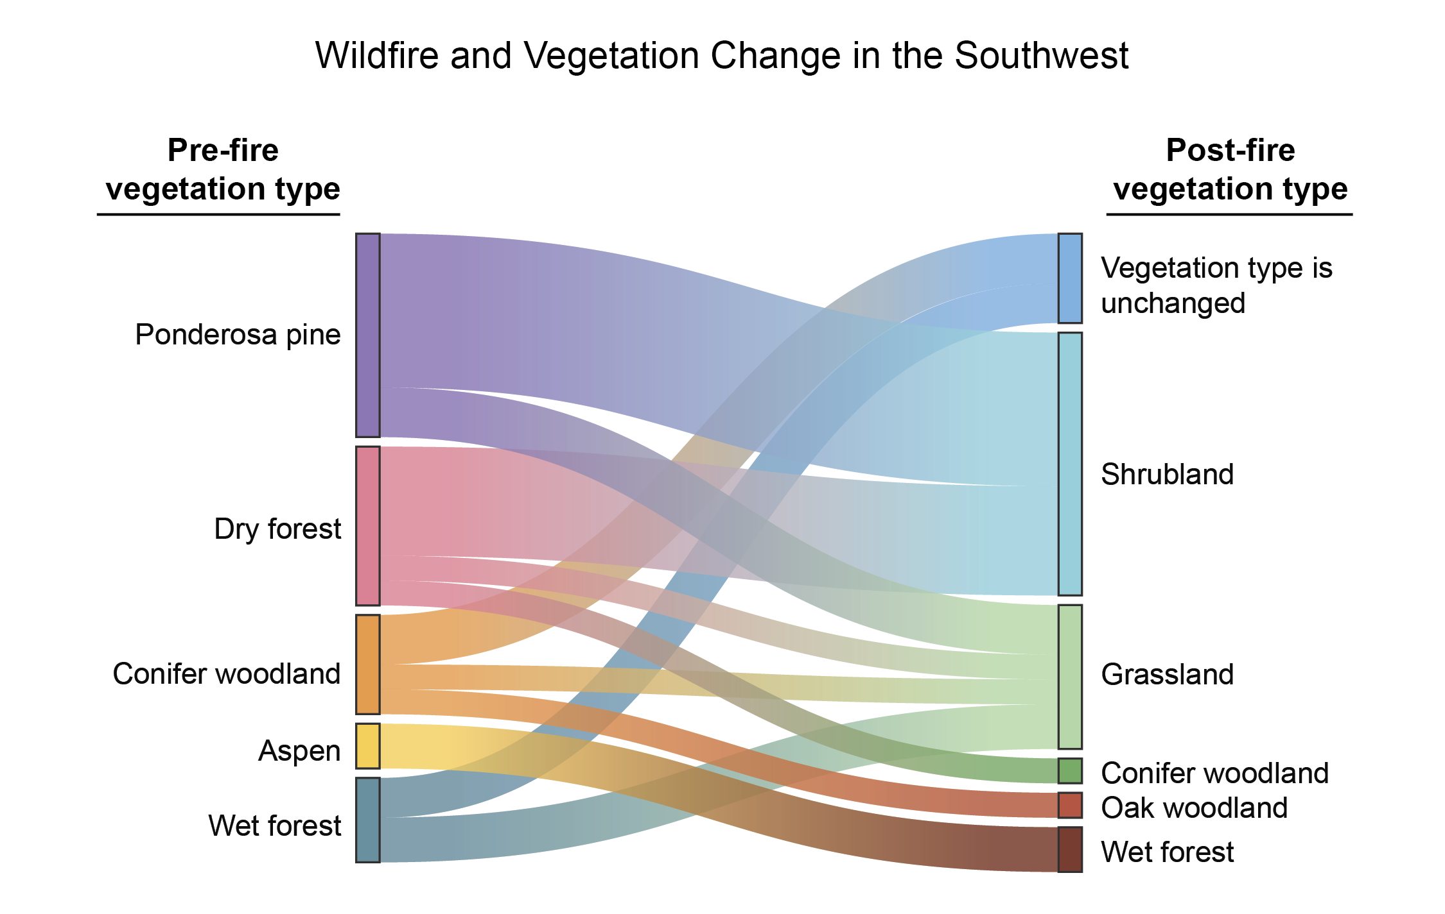
Figure 28.9. Climate change is leading to larger and hotter fires and resulting in shifts in vegetation.
Notes:
CAPTION: Data from the states of California, Arizona, Colorado, and New Mexico show that approximately half (about 50%) of vegetation type change (e.g., forests transiting to shrublands or grasslands) is a function of high-severity fire. Adapted from Guiterman et al. 2022(Guiterman et al. 2022) [CC BY 4.0].

Slide 17
Federal Coordinating Lead Author
Emile H. Elias, USDA Agricultural Research Service, Southwest Climate Hub
Chapter Lead
Dave D. White, Arizona State University
Agency Chapter Lead Author
Kathryn A. Thomas, US Geological Survey, Southwest Biological Science Center
Chapter Authors
Cristina E. Bradatan, US Census Bureau, International Programs Center
Mark W. Brunson, Utah State University, Department of Environment and Society
Ann Marie Chischilly, Northern Arizona University, Institute for Tribal Environmental Professionals
Carolyn A.F. Enquist, US Geological Survey, Southwest Climate Adaptation Science Center
Leah R. Fisher, California Department of Transportation
Halley E. Froehlich, University of California, Santa Barbara
Elizabeth A. Koebele, University of Nevada, Reno
Michael Méndez, University of California, Irvine
Steven M. Ostoja, USDA Agricultural Research Service, California Climate Hub
Caitriana Steele, New Mexico State University
Jennifer K. Vanos, Arizona State University
Technical Contributors
Grace Di Cecco, Eagle Rock Analytics
Owen M. Doherty, Eagle Rock Analytics
Victoria L. Ford, Eagle Rock Analytics
Gerald C. Nelson, University of Illinois at Urbana–Champaign
Ashley Quay, unaffiliated
Scott Stephens, University of California, Berkeley, Department of Environmental Science, Policy, and Management
Review Editor
Olivia T. Yip, San Jose State University
USGCRP Coordinators
Fredric Lipschultz, US Global Change Research Program / USRA
Christopher W. Avery, US Global Change Research Program / ICF

Slide 18
White, D.D., E.H. Elias, K.A. Thomas, C.E. Bradatan, M.W. Brunson, A.M. Chischilly, C.A.F. Enquist, L.R. Fisher, H.E. Froehlich, E.A. Koebele, M. Méndez, S.M. Ostoja, C. Steele, and J.K. Vanos, 2023: Ch. 28. Southwest. In: Fifth National Climate Assessment. Crimmins, A.R., C.W. Avery, D.R. Easterling, K.E. Kunkel, B.C. Stewart, and T.K. Maycock, Eds. U.S. Global Change Research Program, Washington, DC, USA. https://doi.org/10.7930/NCA5.2023.CH28
https://nca2023.globalchange.gov/chapter/28

