Slide 1

NCA5 Website: https://nca2023.globalchange.gov
Chapter Website: https://nca2023.globalchange.gov/chapter/23
NCA5 Atlas: https://atlas.globalchange.gov
Figure captions: Captions can be found in the slide notes of this deck
Social media: @usgcrp, #NCA5

Slide 2
Chapter 23 | US Caribbean

Slide 3
1
Climate-Driven Extreme Events Exacerbate Inequities and Impact Human Health and Well-Being
Traditionally underserved and disadvantaged communities suffer disproportionate impacts from climate change because they have been systematically excluded from social services, secure livelihoods, quality education, and other social benefits that help sustain health and well-being (high confidence). Hurricanes and other climate-related extreme events have been associated with higher rates of disease, mental illness, and overall mortality, as well as loss of cultural heritage that is central to community identity (high confidence). As extreme weather events become more intense and more frequent, residents will continue experiencing increasing levels of noncommunicable diseases, excess mortality, behavioral health challenges, and loss of quality of life (high confidence). The frequency of heat episodes and the severity of hurricanes are both expected to increase in the region due to human-induced climate change, which will affect public health unless adaptation measures are taken (high confidence).

Slide 4
2
Ecology and Biodiversity Are Unique and Vulnerable
Coastal and terrestrial ecosystems provide a large number of goods and services that are vital to the islands’ economies and to the health and well-being of their residents (high confidence). These essential systems are degraded by human actions and climate change, thereby reducing the benefits they provide to people, as well as their functionality as habitats for protecting biological diversity (high confidence). Climate change is expected to exacerbate the degradation of ecosystems (very likely, high confidence). The success of climate adaptation strategies will depend on reducing all sources of stress on ecological systems (medium confidence).

Slide 5
3
Climate Change Threatens Water and Food Security
US Caribbean food and water systems are becoming increasingly vulnerable to the escalation of climate change, including stronger hurricanes, more severe drought, warmer air temperatures, and other extreme weather (likely, high confidence). Because the territories are heavily reliant on imported foods, they are affected by climate changes occurring both within and outside of the region (high confidence). Reductions in average annual rainfall, increasing air temperatures, and rising sea levels will adversely affect freshwater availability in the future (medium confidence). Improved adaptation efforts would benefit from a better understanding of the ways food and water systems interrelate and of the cascading impacts generated by climate change (medium confidence).

Slide 6
4
Infrastructure and Energy Are Vulnerable, but Decentralization Could Improve Resilience
Climate change has created profound risks for the US Caribbean’s critical infrastructure, already weakened from years of disinvestment and deferred maintenance (high confidence). Increasingly powerful storms, along with rising sea levels, are severely impairing infrastructure systems, with increasing damage projected in future years (likely, high confidence). Dependence on fossil fuel imports increases energy insecurity (high confidence). Infrastructure improvements, coupled with a new paradigm focused on decentralization, adoption of distributed solar, and shared governance, could help limit residents’ vulnerability to health and other risks associated with loss of essential services (likely, medium confidence).

Slide 7
5
Adaptation Effectiveness Increases When Coupled with Strategic Governance and Planning
Climate adaptation in the US Caribbean is challenging because of multiple interacting factors, including high risk exposure, limited or misaligned funding, insufficient institutional and organizational capacity, and siloed approaches to risk reduction and resilience (high confidence). Effective adaptation to support resilience in the US Caribbean could be enhanced through co-development and integration of robust global, regional, and local climate science and risk-based knowledge into planning and implementation, as well as improved governance arrangements (high confidence). US Caribbean capabilities in planning and adaptation could be enhanced by strengthening partnerships across the wider Caribbean region and the US mainland (medium confidence).

Slide 8
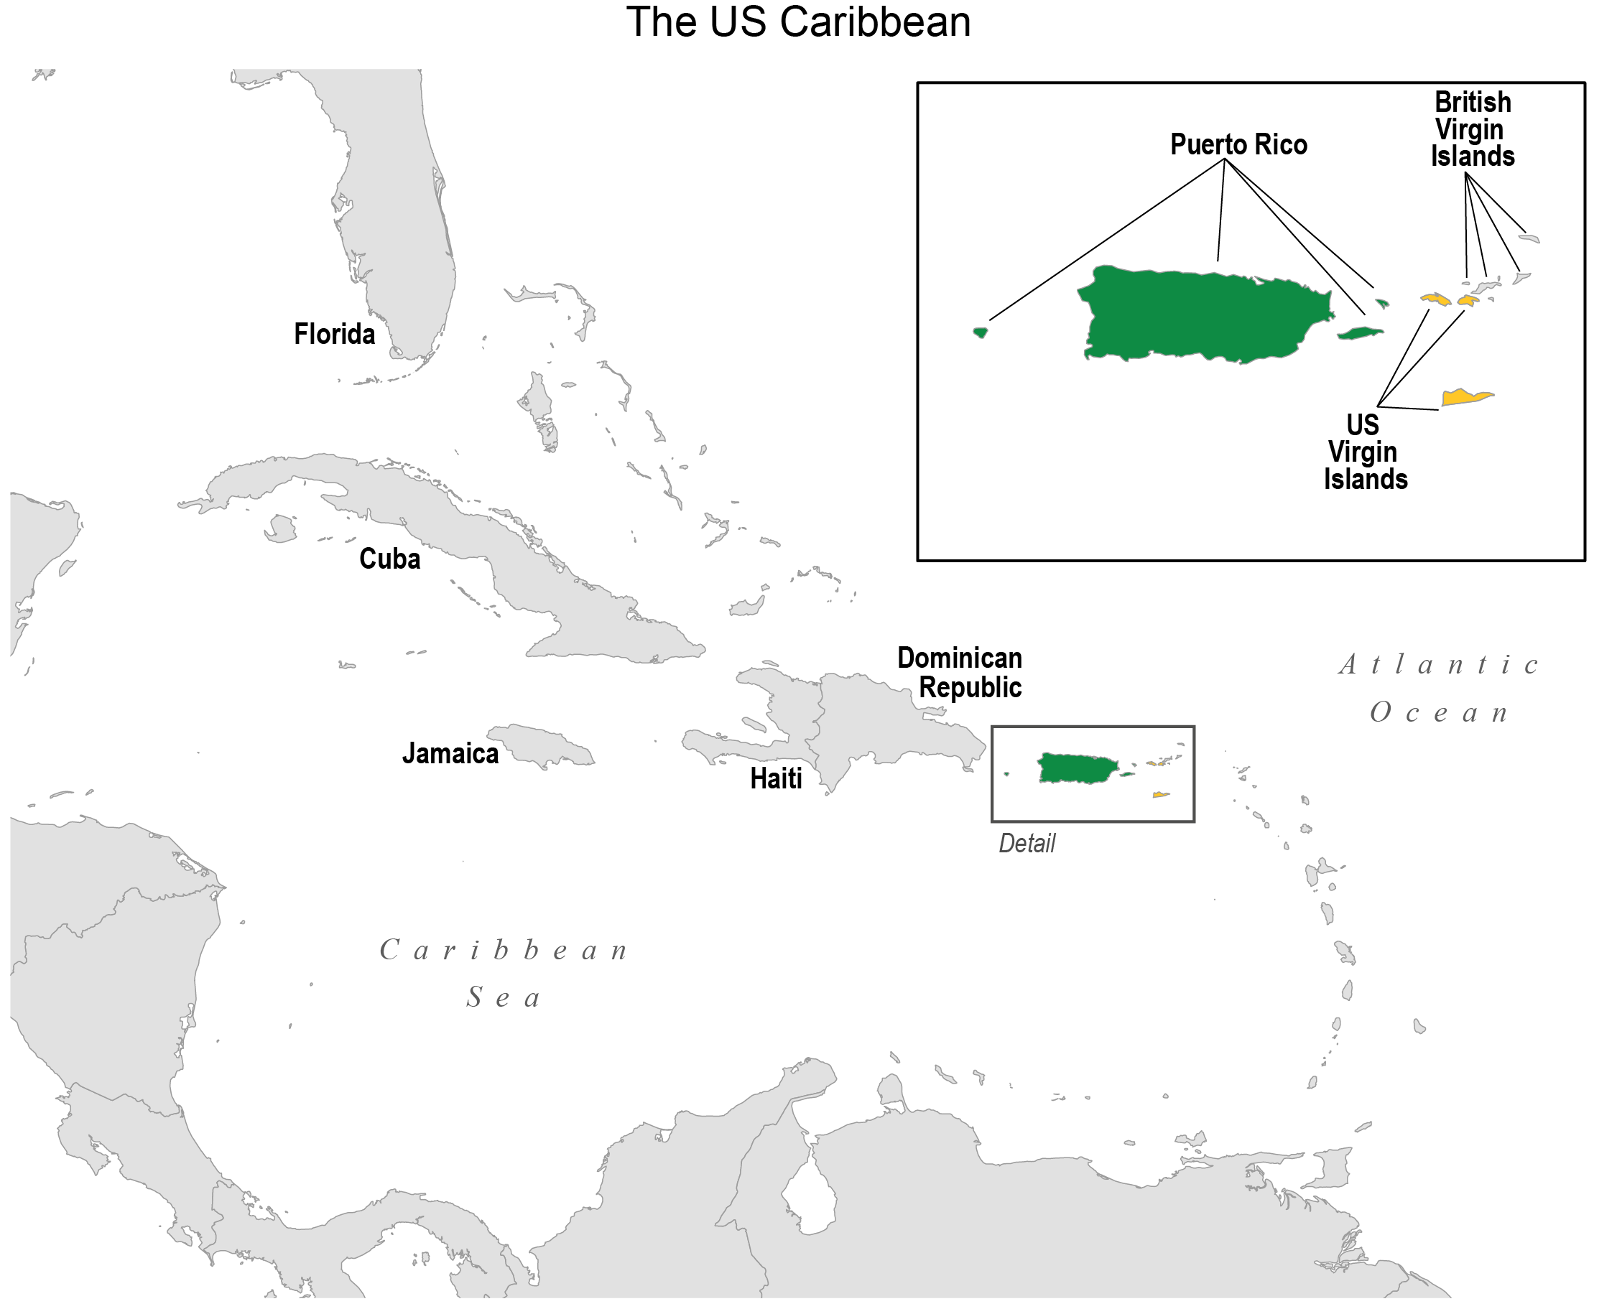
Figure 23.1. The US Caribbean region in the Fifth National Climate Assessment consists of Puerto Rico and the US Virgin Islands.
Notes:
CAPTION: The map shows the location of Puerto Rico and the US Virgin Islands in the Caribbean Basin. The inset shows the main island of Puerto Rico (green; the two municipal islands of Vieques and Culebra are shown to the east and Mona Island to the west) and the US Virgin Islands (yellow; St. Thomas and St. John to the north and St. Croix to the south). Figure credit: University of Puerto Rico, NOAA NCEI, and CISESS NC.

Slide 9
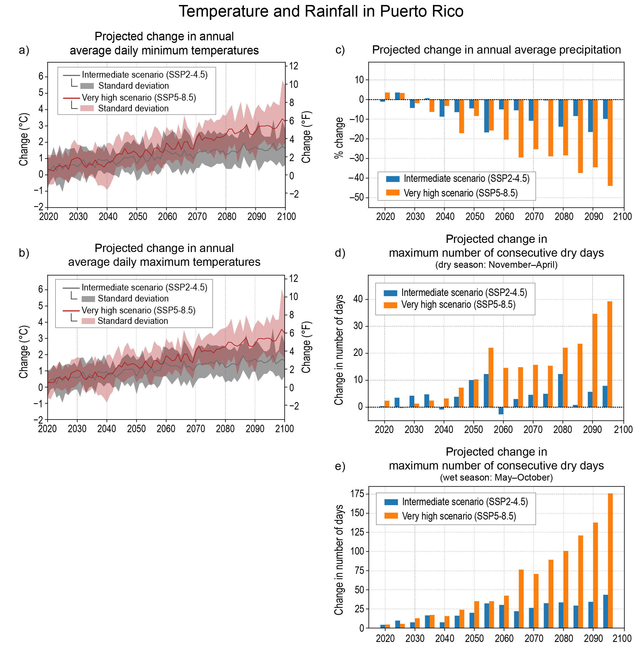
Figure 23.2. Puerto Rico is projected to become warmer and drier, with increasing uncertainty in the magnitude of change beyond midcentury; just how warm and dry depends on the scenario followed.
Notes:
CAPTION: Projected temperature and precipitation changes for Puerto Rico are shown for an intermediate scenario (SSP2-4.5) and a very high scenario (SSP5-8.5) to demonstrate the range of plausible future changes in the climate. Climate change projections are shown for annual average daily minimum (a) and maximum (b) temperatures, annual average precipitation (c), and maximum number of consecutive dry days during the dry season (d) and wet season (e). Both scenarios indicate a warmer and drier climate for Puerto Rico, but the magnitude of change for the very high scenario is alarming, especially when considering the availability of fresh water. The average maximum temperature increases for the end of the century (2071–2100) range from 2.8°F (1.5° C) for the intermediate scenario to 4.8°F (2.7° C) for the very high scenario. The increased temperatures, coupled with reductions in annual average precipitation at the end of the century of approximately 10% (intermediate scenario) to greater than 30% (very high scenario), are both indications of a significantly drier climate, with very large impacts anticipated for the very high scenario. A particular concern is the precipitation reduction during the wet season and the large increase in the number of consecutive days without rain, exceeding an increase of 115 days, on average, by the end of the century for the very high scenario. The bar plots in panels (c–e) are averages over five-year periods. All plots are differences relative to the entire period (2021–2100). Figure credit: NOAA NCEI and CISESS NC.

Slide 10
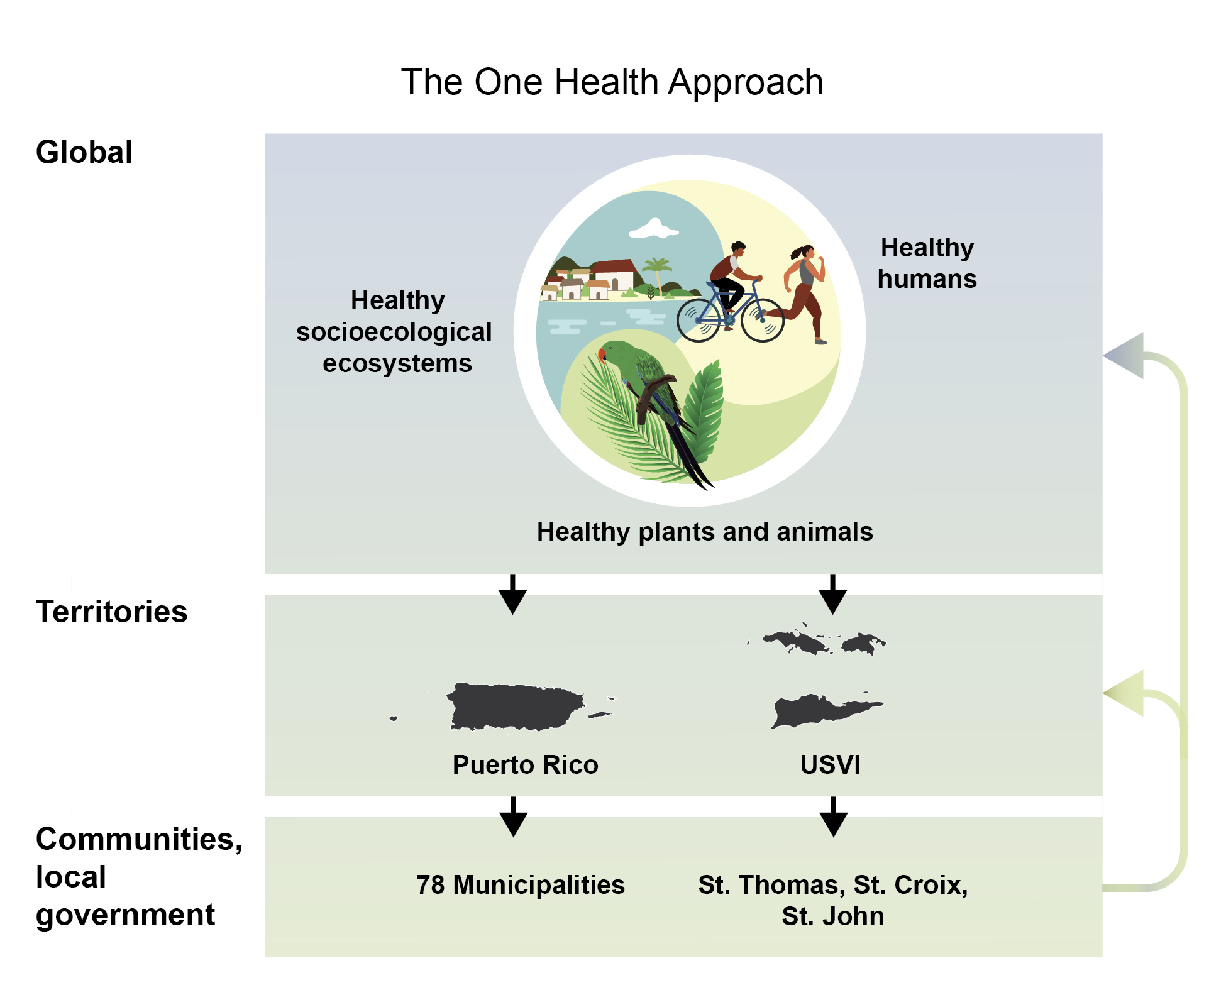
Figure 23.3. In the face of climate change, the health of Caribbean people, plants, animals, and ecosystems depends on coordination across multiple scales and boundaries.
Notes:
CAPTION: In the US Caribbean, climate change is interacting with the institutional and environmental context of the islands and the social determinants of health. Extreme weather events (e.g., powerful hurricanes, extreme heat, and droughts) are threatening access to clean air, safe drinking water, nutritious food, and safe settlements, as well as damaging infrastructure, reducing tourism, displacing vulnerable communities, promoting migration among islanders, disrupting ecosystem services, and endangering animals. The One Health approach illustrated here promotes collaborative work at local, regional, and global levels to achieve health for humans, ecosystems, and animals alike. Adapted from World Health Organization 2021⁴³ [CC BY-NC-SA 3.0 IGO].

Slide 11
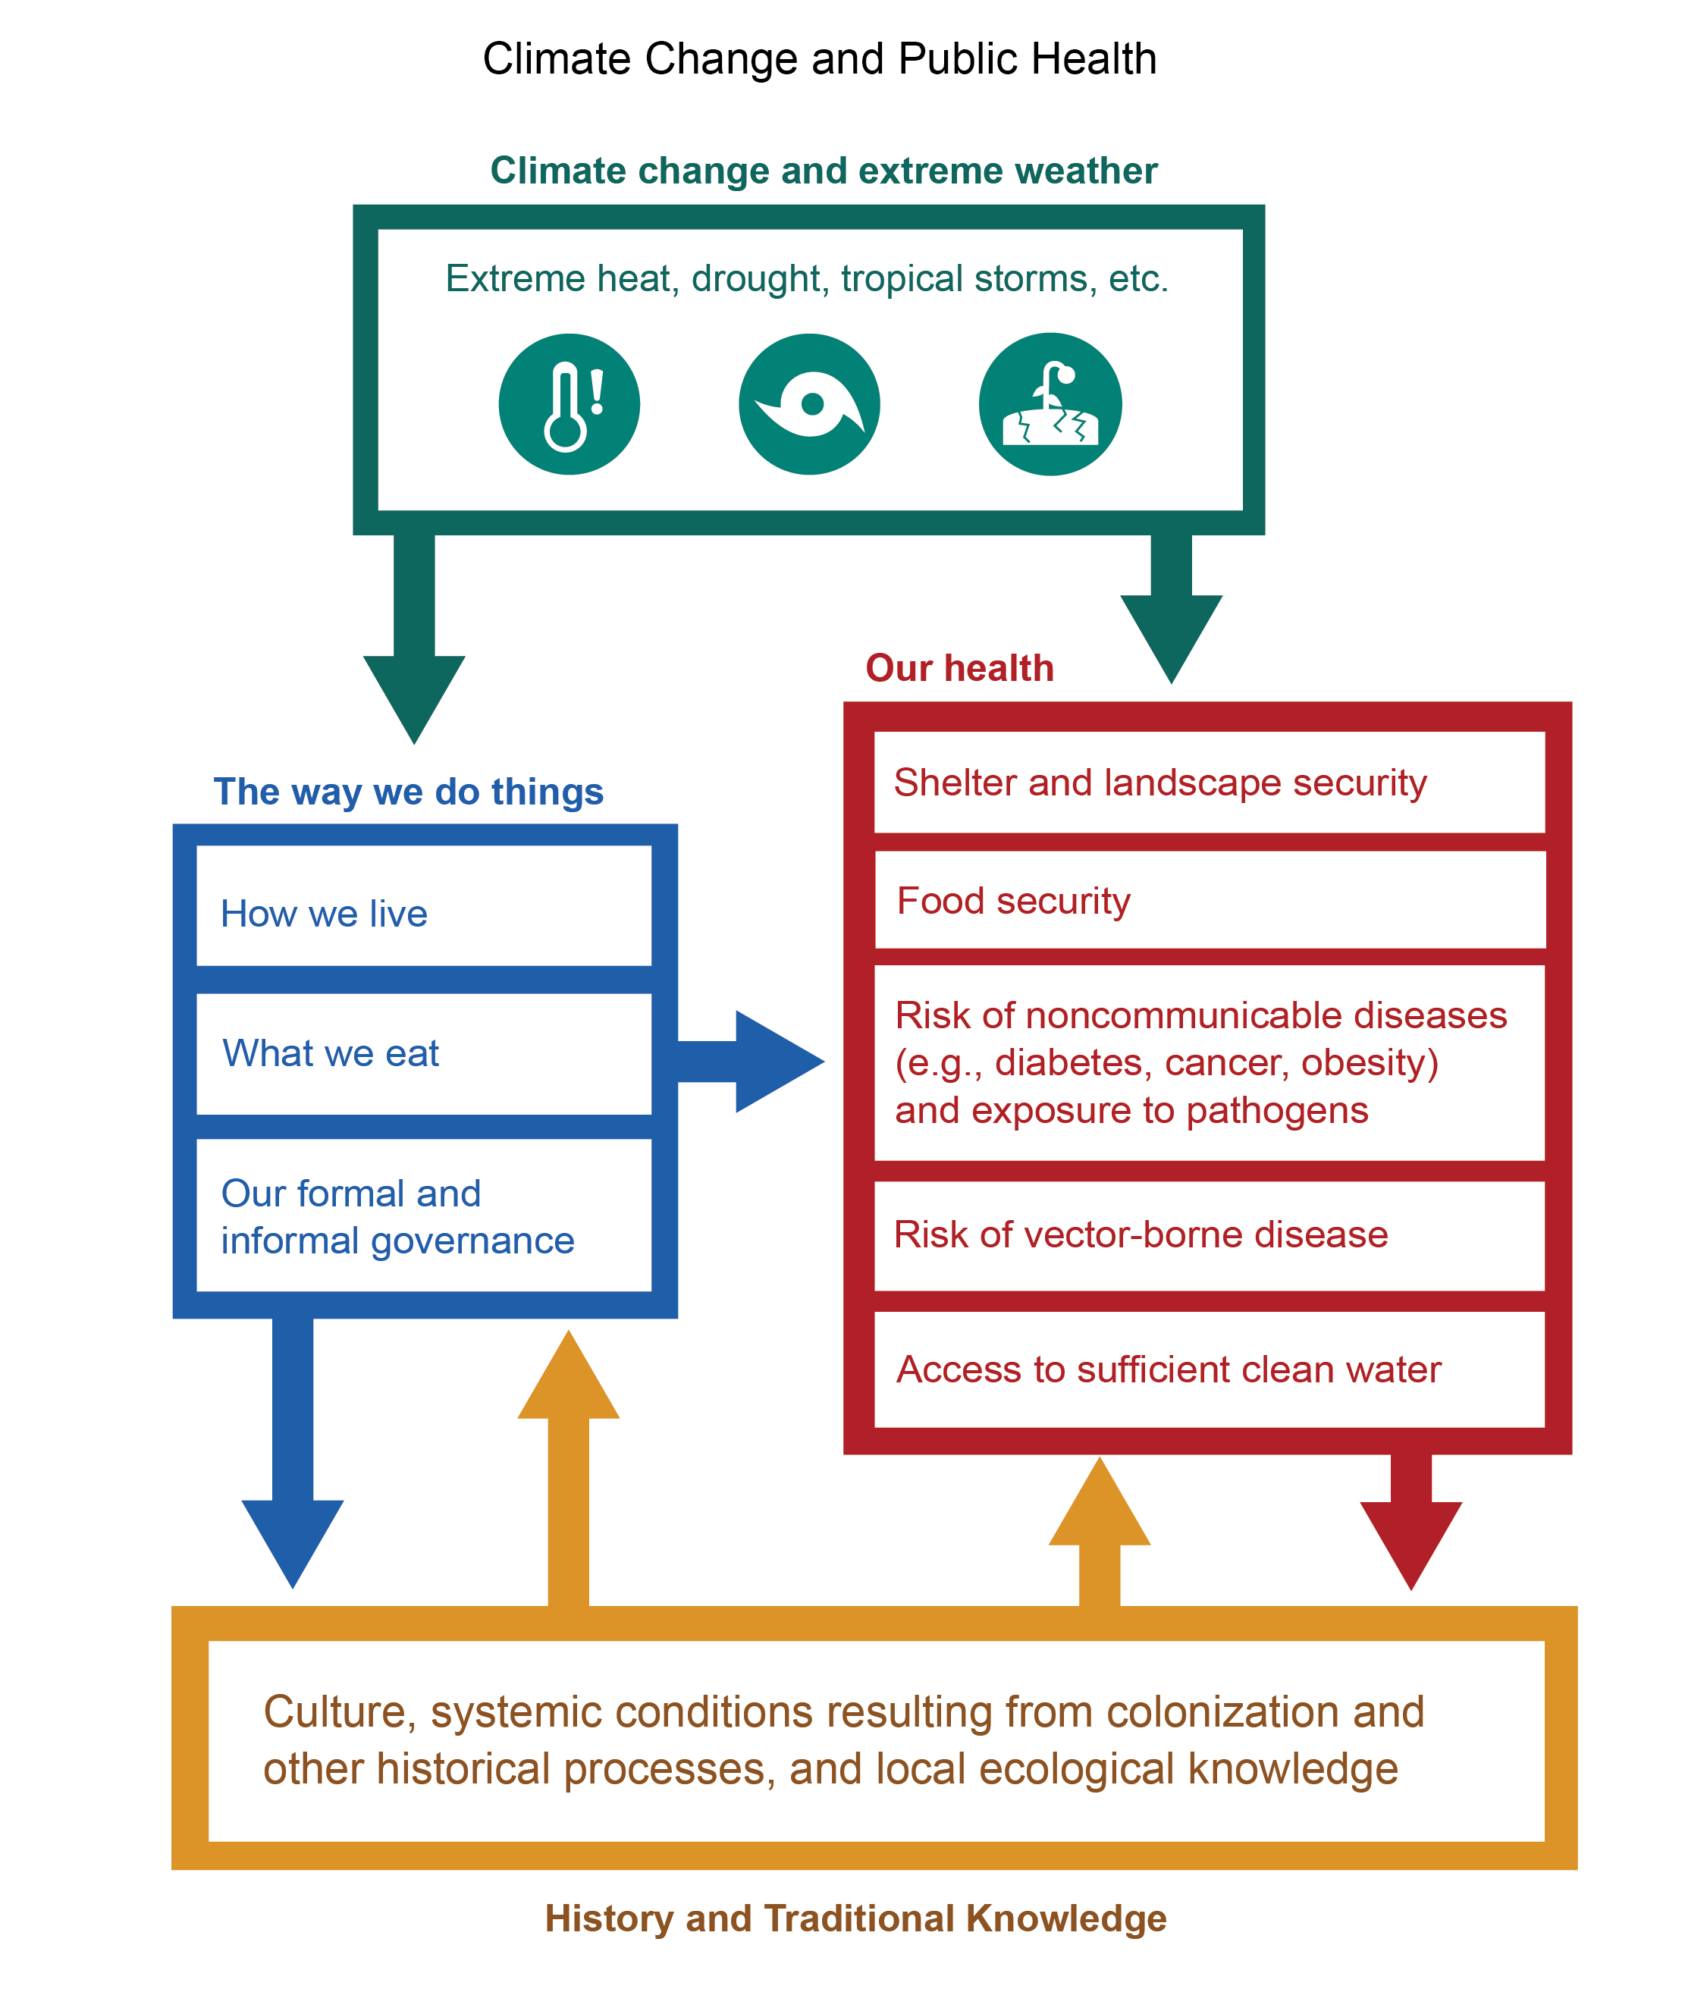
Figure 23.4. Public health is shaped by sociocultural factors and further affected by climate change.
Notes:
CAPTION: The impacts of climate change on human health in the US Caribbean must be considered in the context of the social, cultural, and historical realities of the islands. Shelter and food security, access to clean water, and communicable and noncommunicable diseases are certainly affected by climate, but they are also conditioned by culture, tradition, and historical and colonization processes. Figure credit: University of California, San Diego; University of the Virgin Islands; NOAA NCEI; and CISESS NC.

Slide 12
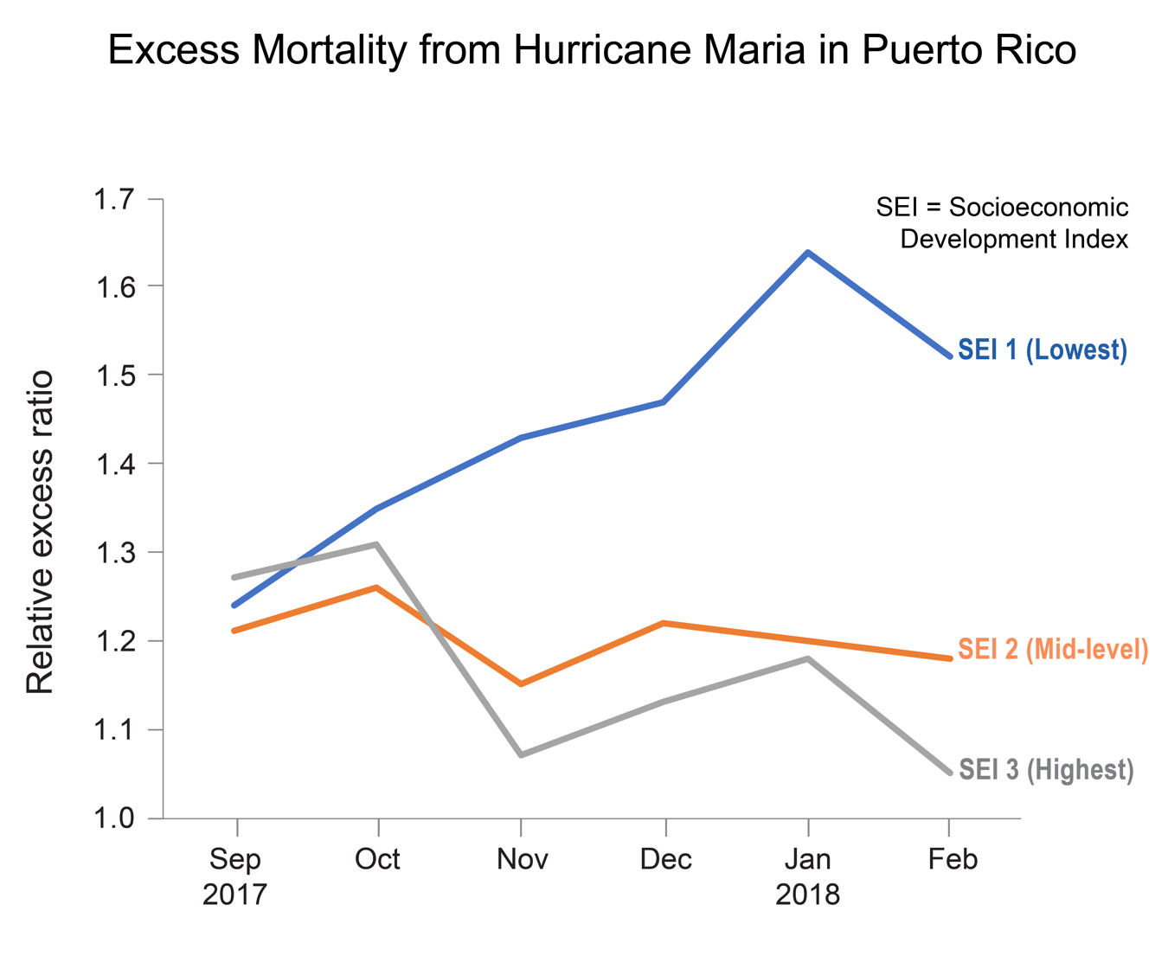
Figure 23.5. Excess mortality from Hurricane Maria was most common among Puerto Rico’s most impoverished residents.
Notes:
CAPTION: Between September 2017 and February 2018, 2,975 excess deaths—that is, above what the mortality rate would have been if the storm had not occurred—were estimated in Puerto Rico due to Hurricane Maria. Mortality was higher for individuals living in low-income municipalities, for those with the lowest scores on the Municipal Socioeconomic Development Index (SEI)—a multidimensional index of poverty developed by the Government of Puerto Rico—and for men aged 65 years or older. These results are useful to health officers, emergency preparedness personnel, and residents, as they help to prepare for and to mitigate the potential effects of hurricanes. Adapted from Santos-Burgoa et al. 2018.¹¹⁵

Slide 13
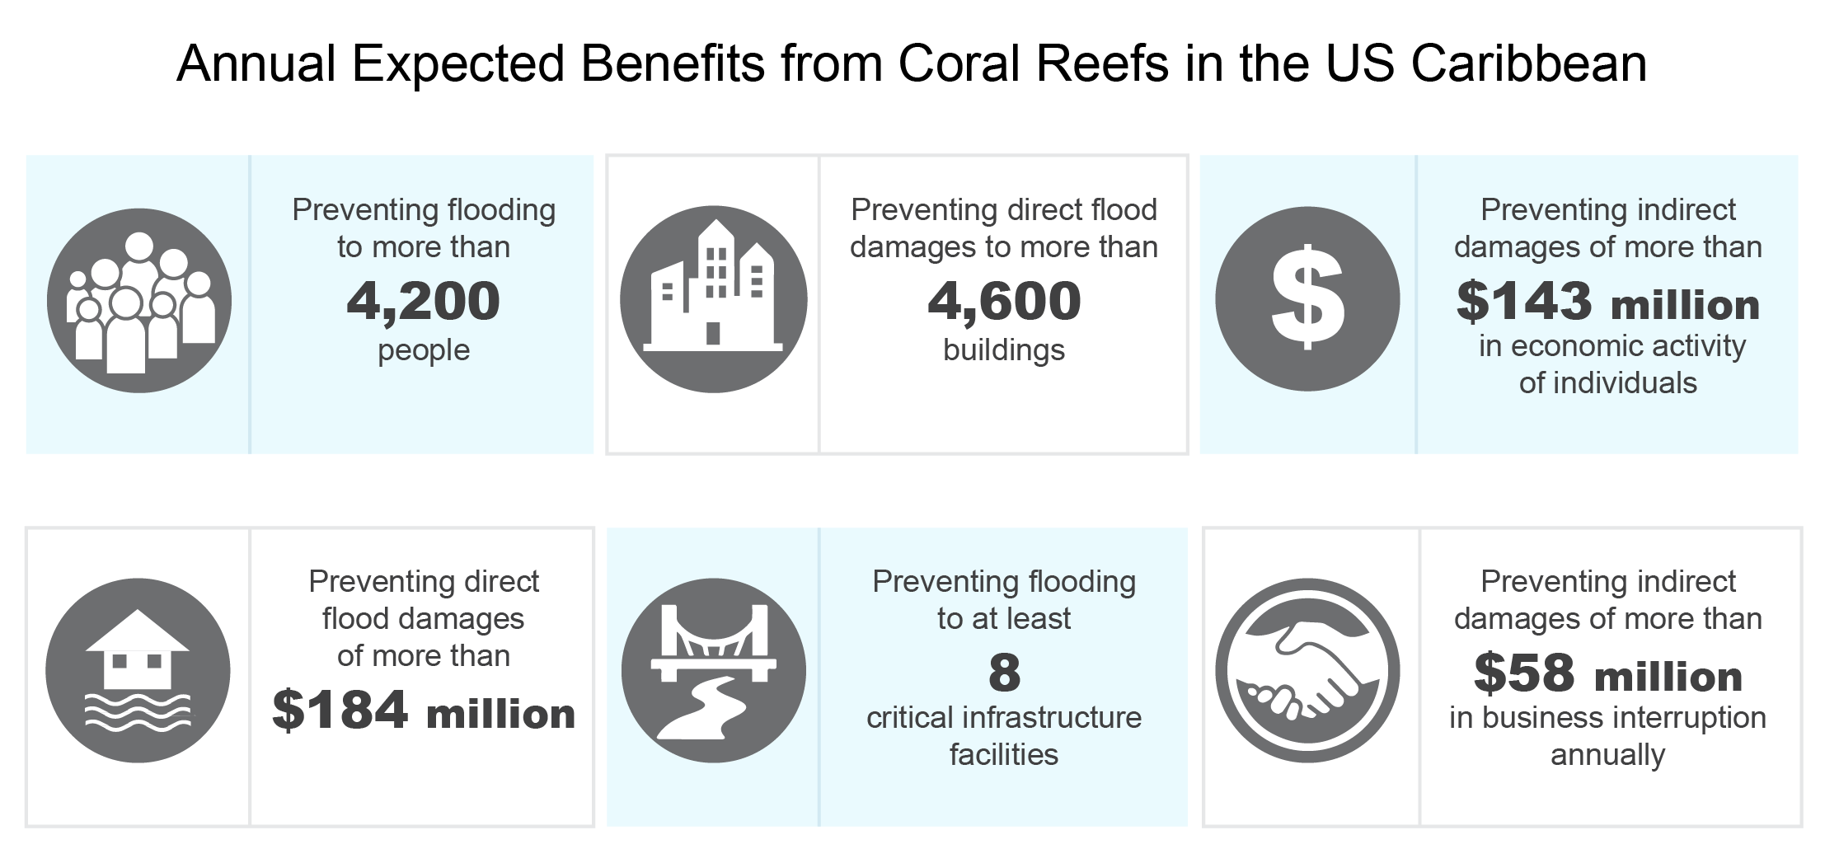
Figure 23.6. Coral reefs provide substantial coastal protection benefits to the US Caribbean each year.
Notes:
CAPTION: Coral reefs are a major component for recreational and commercial fisheries, coastal protection, and the tourism economy. Acting as a natural defense, coral reefs dissipate incident wave energy and protect coasts from erosion and flooding. Arguably, they are one of the most economically valuable ecosystems.¹³⁰ Economic estimates are in 2010 dollars. Figure credit: Caribbean Coastal Ocean Observing System.

Slide 14
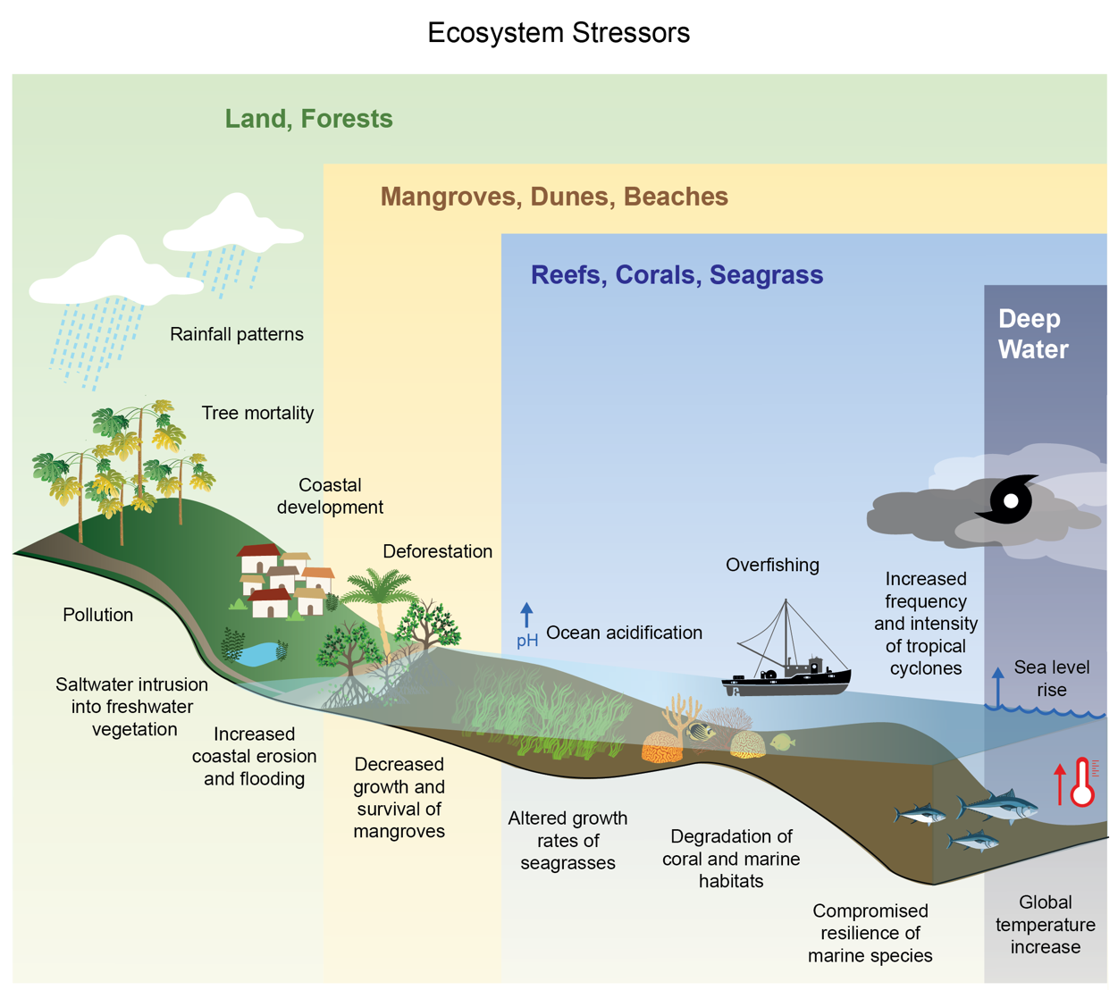
Figure 23.6. Both climate and non-climate stressors affect aquatic and terrestrial ecosystems and biodiversity in the US Caribbean.
Notes:
CAPTION: The cumulative effects of these stressors could result in the degradation of aquatic habitats, increases in coastal erosion and flooding, tree mortality, alterations in the growth of mangroves and seagrasses, and diminishment of resilience and adaptive capacity. Adapted with permission from Fitzpatrick and Giovas 2021.¹⁴²

Slide 15
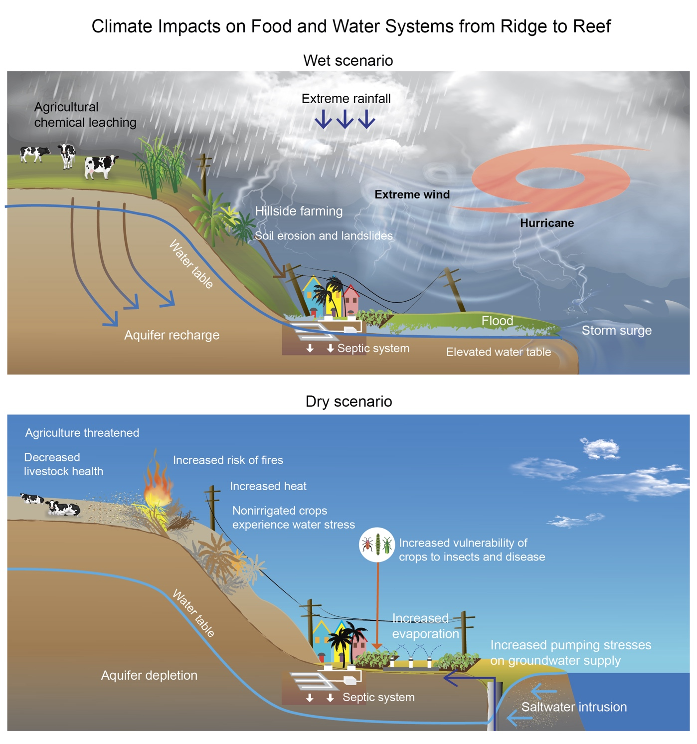
Figure 23.7. Risks to food and water systems differ under wet and dry scenarios.
Notes:
CAPTION: (top) In periods of wet conditions, saturated soils coupled with heavy rainfall from hurricanes and storms can lead to flooding and, in turn, soil erosion and vegetation and crop destruction. Strong winds and floods can also damage infrastructure needed for food and water distribution. Excessive rain combined with higher sea levels affects water quality through the leaching of agricultural chemicals and wastewater from septic systems. (bottom) Dry conditions, on the other hand, increase groundwater pumping for irrigation. When combined with sea level rise, these conditions can also lead to saltwater intrusion into coastal aquifers. Figure credit: University of Puerto Rico, North Carolina State University, USDA Forest Service, University of Arizona, and University of the Virgin Islands.

Slide 16
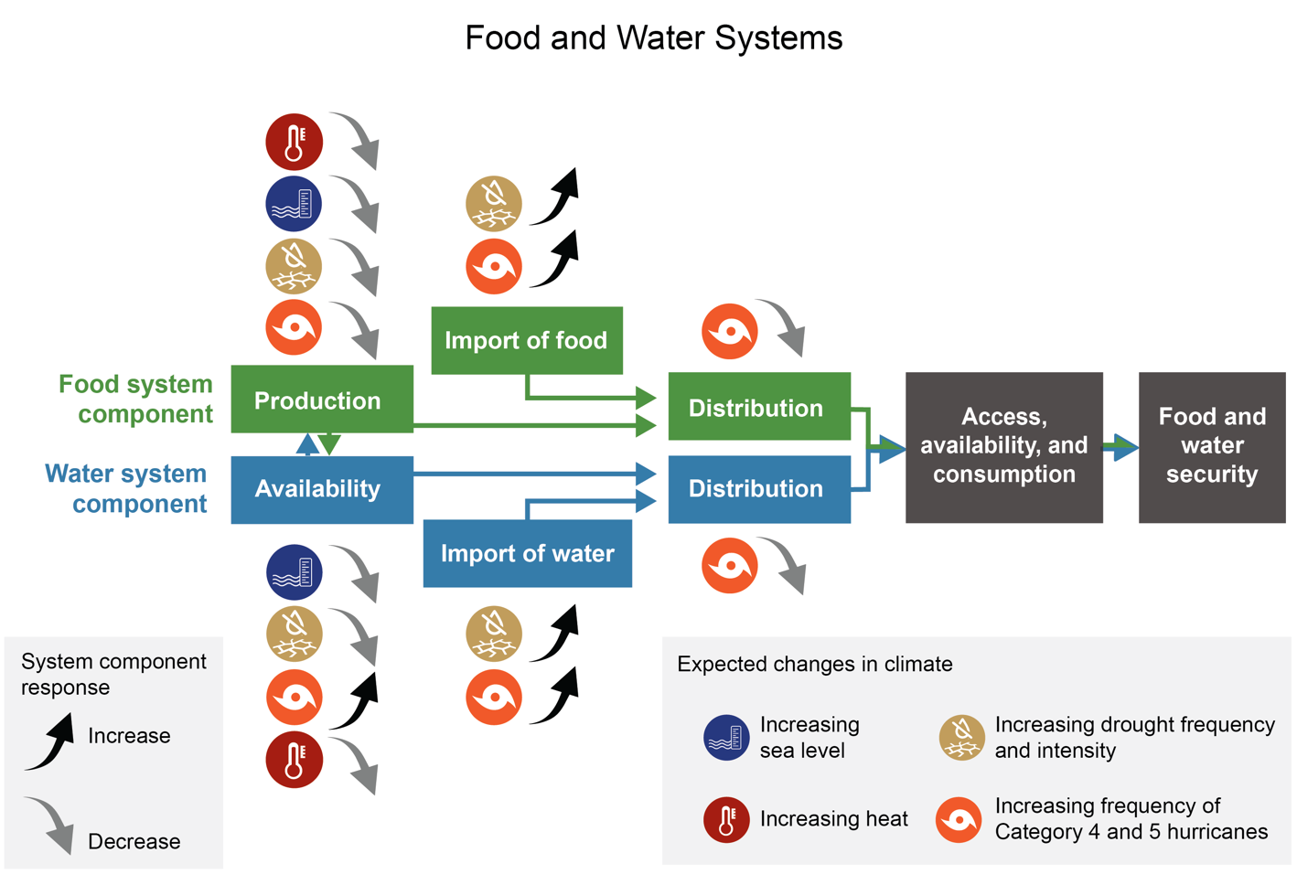
Figure 23.8. Cascading impacts of climate change affect food and water systems and security.
Notes:
CAPTION: The figure displays the effects of the main climate changes that directly affect the islands on each of the system’s components. The up and down arrows show the increasing or decreasing effect of a given climate change stressor on the food or water system components. For example, the increasing frequency of Category 4 and 5 hurricanes will cause a decrease in the distribution of food and water. The effects of climate changes are moderated by external influences such as socioeconomic changes that precondition the islands to be more or less susceptible to climate changes. Figure credit: University of Puerto Rico, USDA Forest Service, University of Arizona, North Carolina State University, and University of the Virgin Islands.

Slide 17
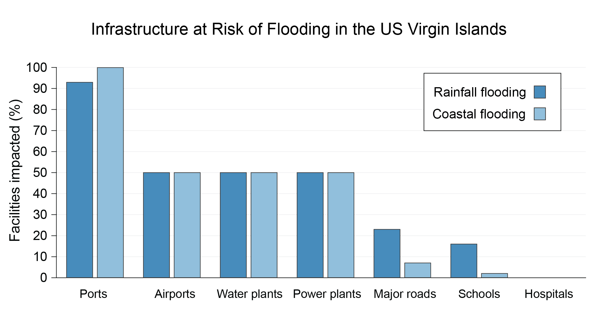
Figure 23.9. Many types of facilities in the US Virgin Islands and Puerto Rico are threatened by storm-induced flooding.
Notes:
CAPTION: The figure shows the percentage of critical infrastructure currently located in flood zones (rainfall flooding caused by rainstorms and coastal flooding caused by storm surges and waves) in the US Virgin Islands. Many similar facilities are at risk in Puerto Rico,^{215,216} but data are missing to represent the information in this report. Facilities at risk of flooding or that are flooded might not be able to provide critical services to communities when flooded, and there might not be another alternative available. The figure shows vulnerabilities under current climate conditions; additional flooding caused by sea level rise or potential future increases in intensity and duration of rainstorms is not included. Figure credit: University of the Virgin Islands, NOAA NCEI, and CISESS NC. https://www.fema.gov/locations/virgin islands

Slide 18
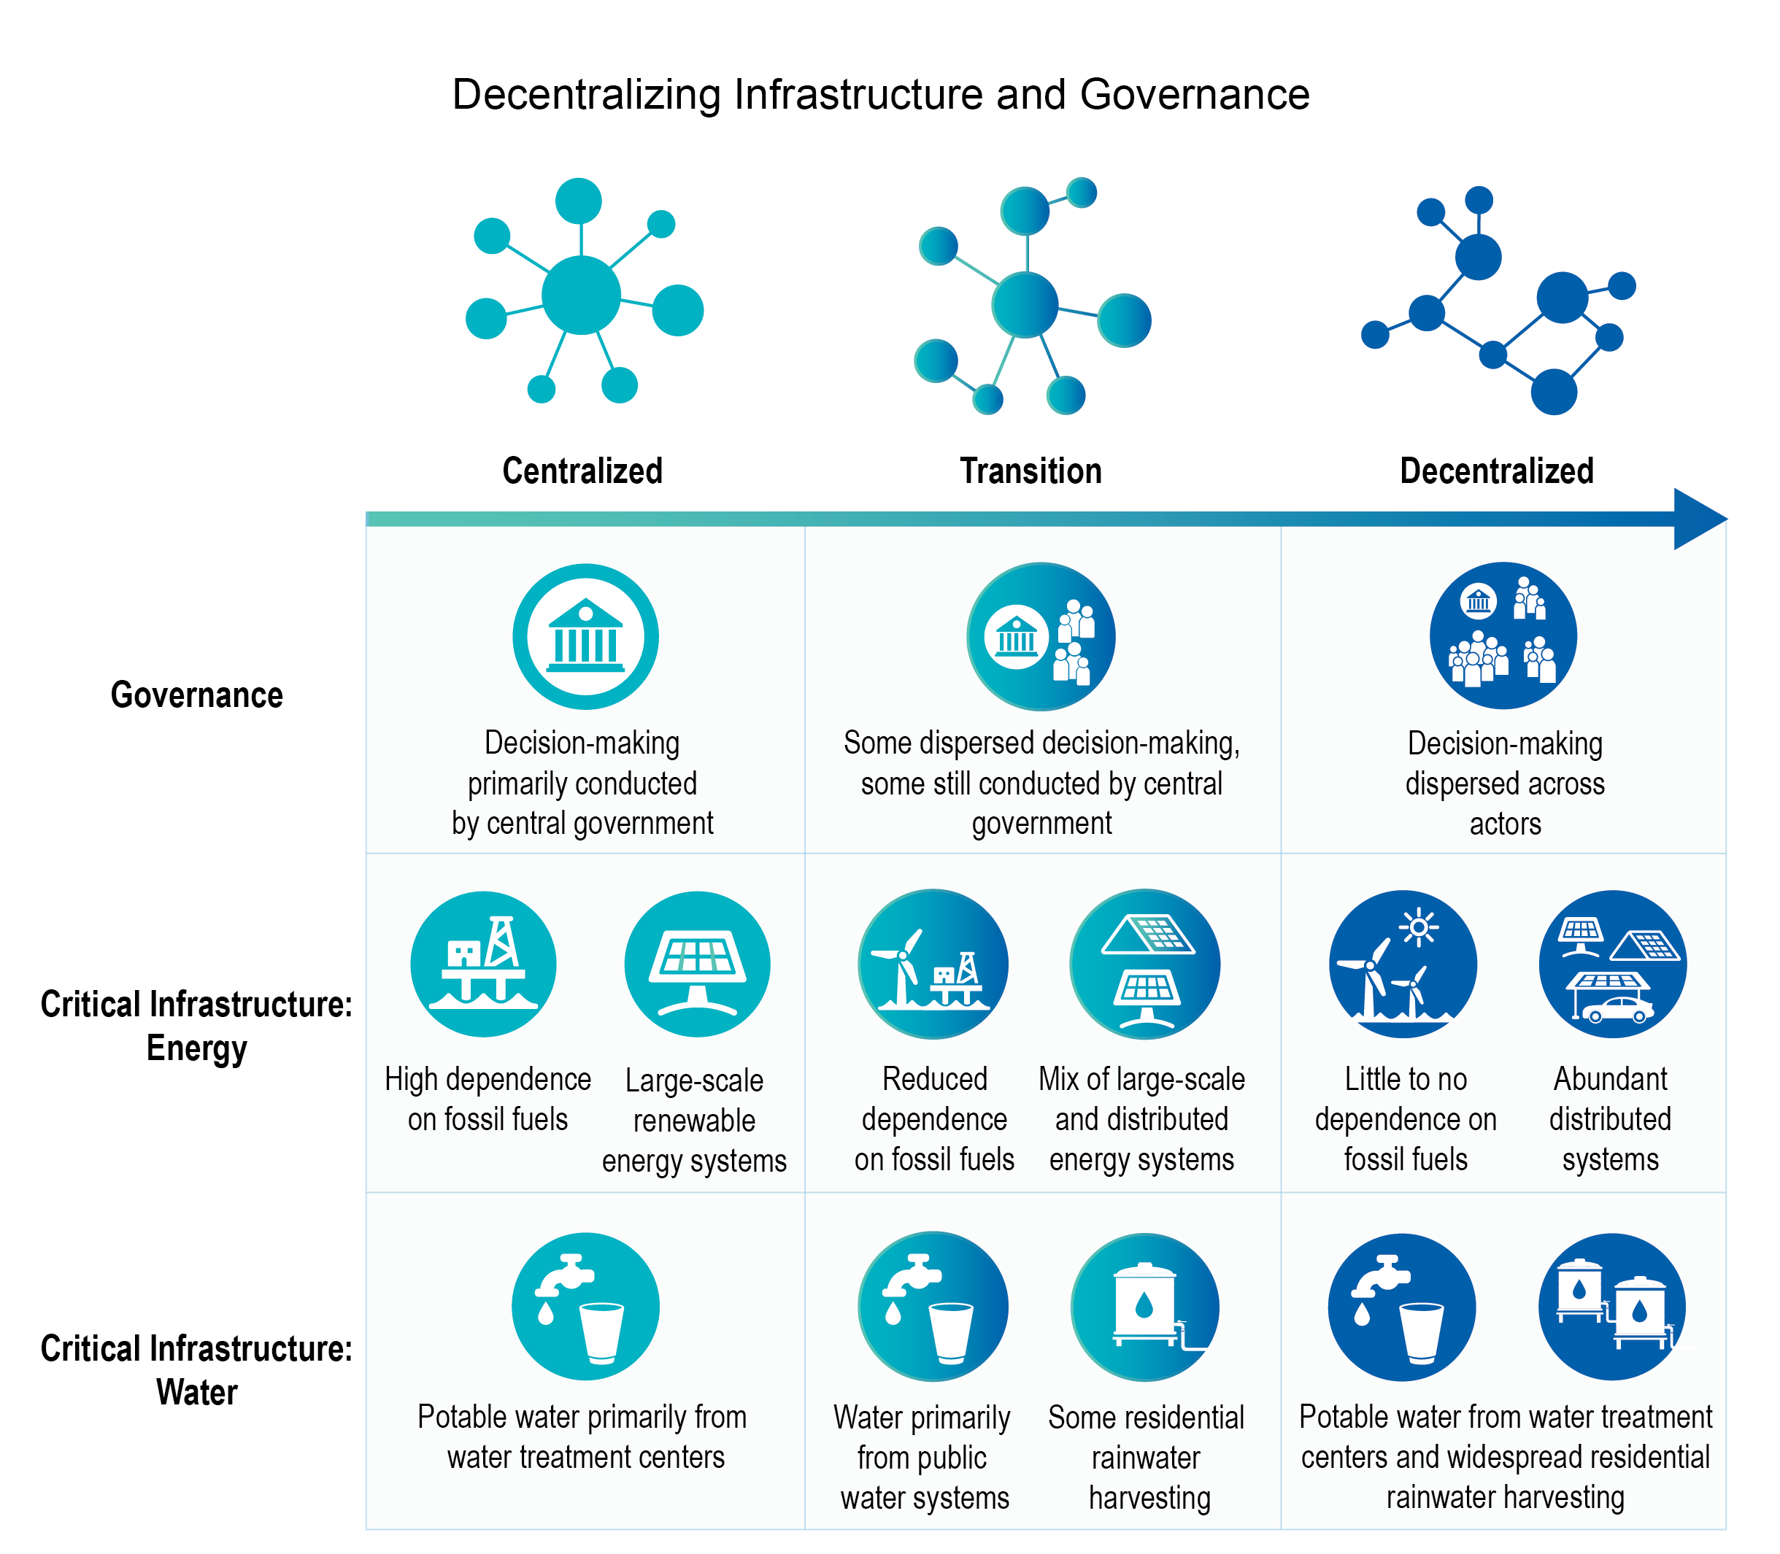
Figure 23.10. Strengthening the resilience of infrastructure will require a transition to decentralized systems as well as decentralized modes of governance.
Notes:
CAPTION: For power systems, decentralization means not only investing in more renewable energy systems managed by utilities but also increasing investments in systems managed by communities and households. For water systems, decentralization means increasing investments in water harvesting infrastructure to serve as an alternative. The improvement of governance models, by decentralizing decision-making and resource allocation, will better address climate change threats and current system frailties and problems. Figure credit: University of the Virgin Islands, NOAA NCEI, and CISESS NC.

Slide 19
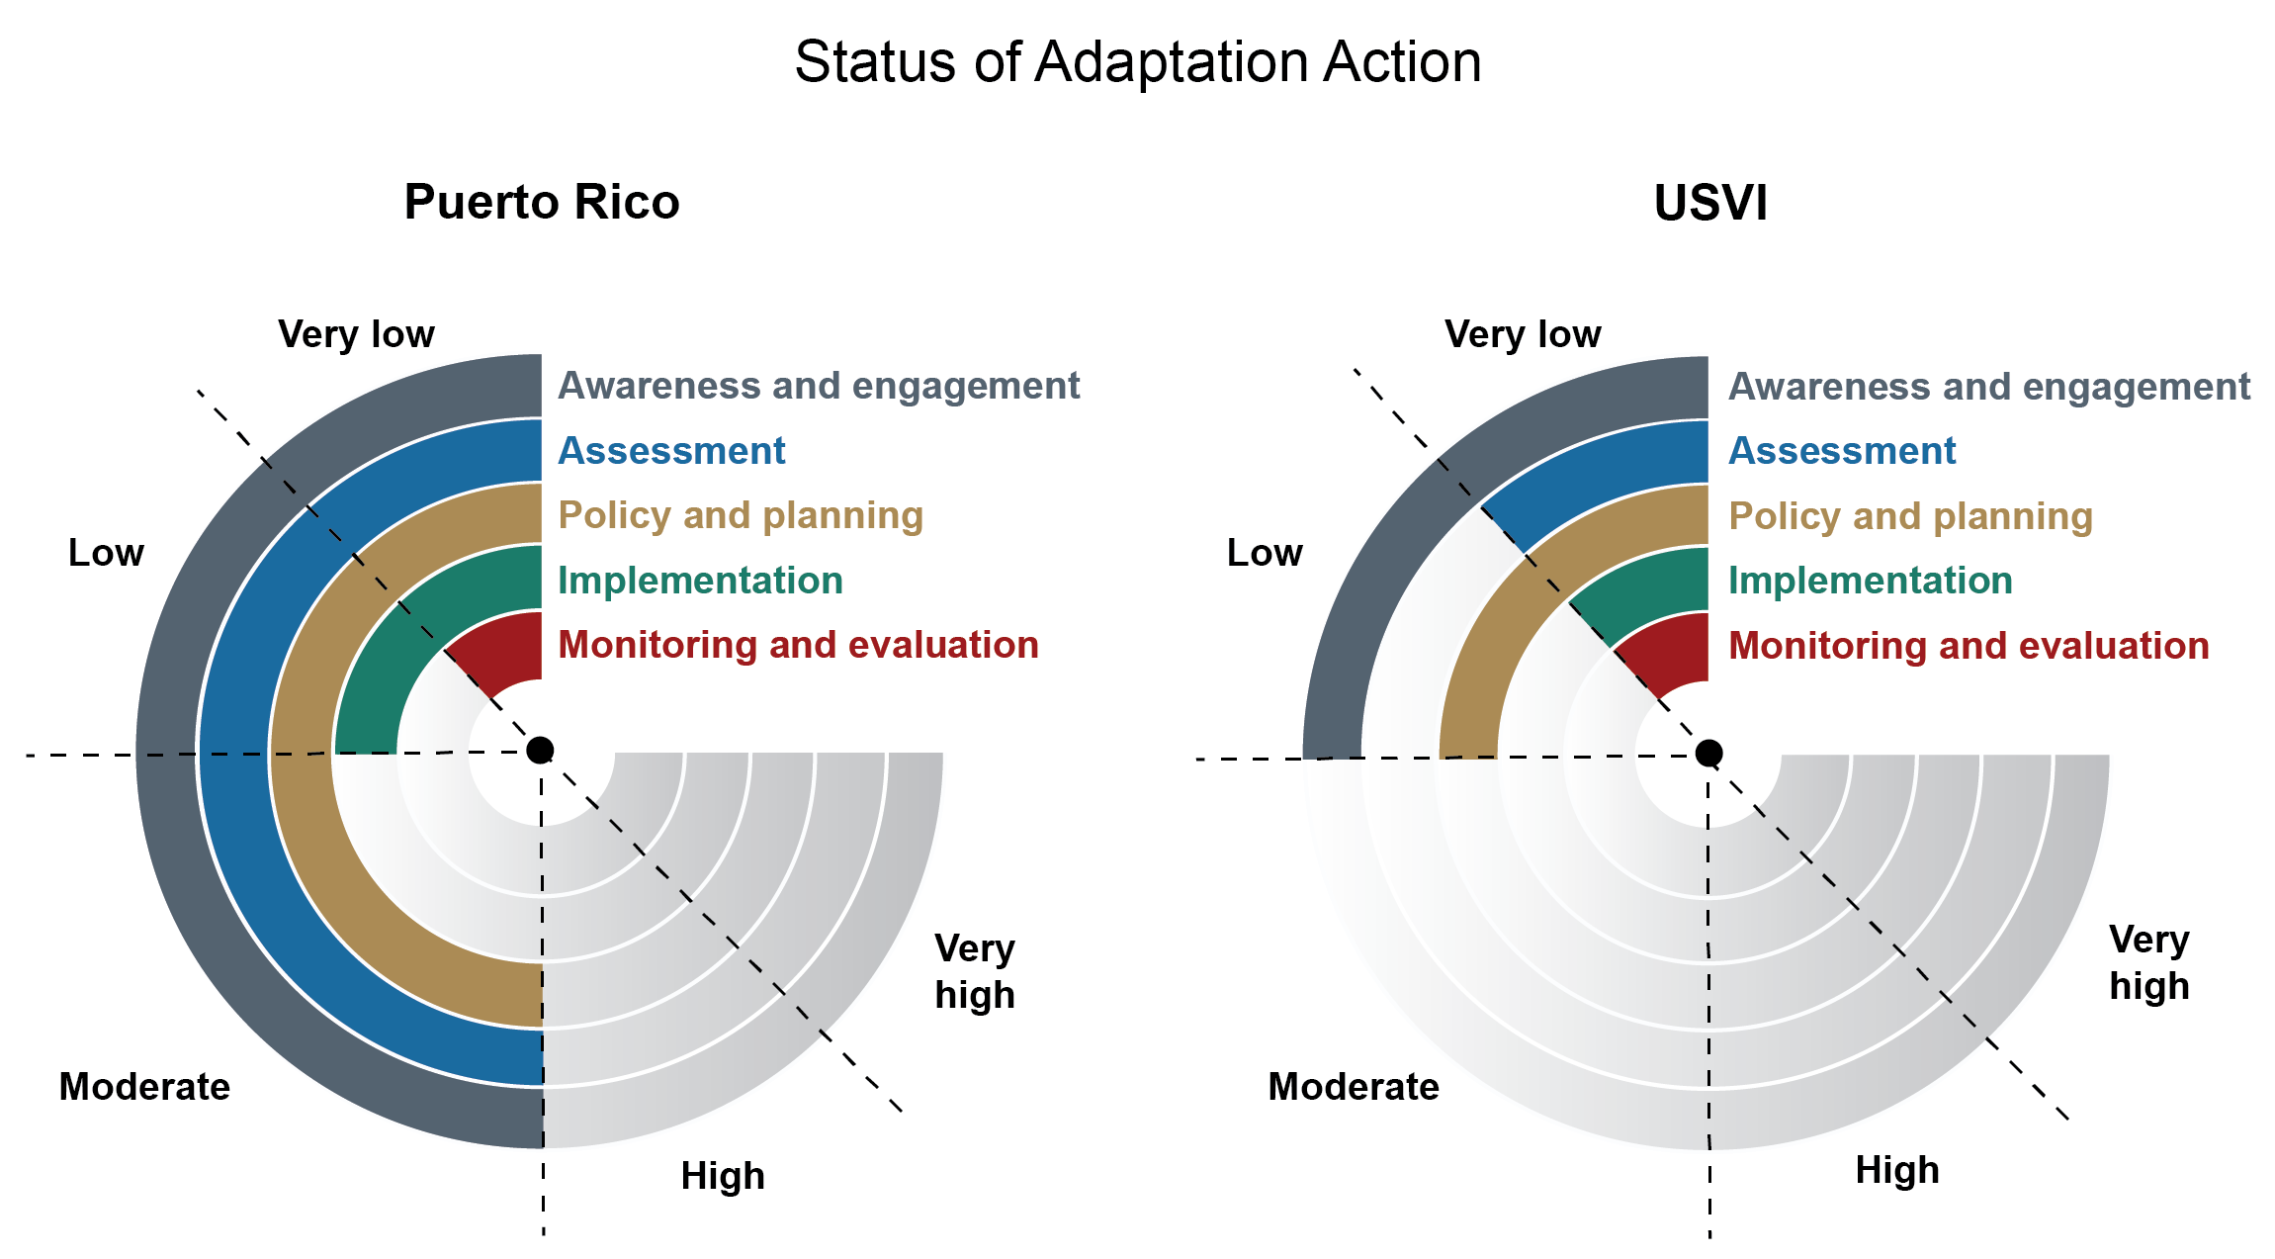
Figure 23.11. Adaptation action in Puerto Rico and the US Virgin Islands reflects different starting times and available capacity.
Notes:
CAPTION: The figure illustrates progress in adaptation action in Puerto Rico and the US Virgin Islands. The colored bars in the charts show the level of progress for each key element of climate adaptation. Adaptation is presented as a continuous process in which multiple elements may overlap or advance simultaneously. Accelerating adaptation action in both territories would reduce risk and enhance resilience. Figure credit: NOAA/Lynker and Foundation for Development Planning Inc. See figure metadata for additional contributors.

Slide 20
Federal Coordinating Lead Author
Lisamarie Carrubba, NOAA Fisheries, Office of Protected Resources
Chapter Lead
Pablo A. Méndez-Lazaro, University of Puerto Rico (June 2021–September 2022, April 2023 onward)
Patricia Chardón-Maldonado, Caribbean Coastal Ocean Observing System (September 2022–April 2023)
Chapter Authors
Nora Álvarez-Berríos, USDA Forest Service, International Institute of Tropical Forestry
Maritza Barreto, University of Puerto Rico Rio Piedras Campus, Graduate School of Planning
Jared H. Bowden, North Carolina State University
Patricia Chardón-Maldonado, Caribbean Coastal Ocean Observing System
Wanda I. Crespo-Acevedo, NOAA Climate Adaptation Partnerships Program–Puerto Rico/Lynker
Ernesto L. Diaz, Tetra Tech Inc.
Lloyd S. Gardner, Foundation for Development Planning Inc.
Grizelle Gonzalez, USDA Forest Service, International Institute of Tropical Forestry
Gregory Guannel, University of the Virgin Islands
Zack Guido, University of Arizona, Arizona Institute for Resilience
Eric W. Harmsen, University of Puerto Rico, Department of Agricultural and Biosystems Engineering
Amanda J. Leinberger, University of Arizona, Center for Climate Adaptation Science and Solutions
Kathleen McGinley, USDA Forest Service, International Institute of Tropical Forestry
Pablo A. Méndez-Lazaro, University of Puerto Rico
Ana P. Ortiz, University of Puerto Rico Comprehensive Cancer Center
Roger S. Pulwarty, National Oceanic and Atmospheric Administration
LaVerne E. Ragster, University of the Virgin Islands
Isabel C. Rivera-Collazo, University of California, San Diego
Ruth Santiago, Lawyer
Carlos Santos-Burgoa, George Washington University
Ingrid M. Vila-Biaggi, CAMBIO
Technical Contributors
Odalys Martínez-Sánchez, NOAA National Weather Service
Melissa Meléndez, University of Hawaiʻi at Mānoa, School of Ocean and Earth Science and Technology
Kim Waddell, University of the Virgin Islands
Review Editor
Edna L. Negrón-Martínez, University of Puerto Rico, Medical Sciences Campus
USGCRP Coordinators
Allyza R. Lustig, US Global Change Research Program / ICF
Fredric Lipschultz, US Global Change Research Program

Slide 21
Méndez-Lazaro, P.A., P. Chardón-Maldonado, L. Carrubba, N. Álvarez-Berríos, M. Barreto, J.H. Bowden, W.I. Crespo-Acevedo, E.L. Diaz, L.S. Gardner, G. Gonzalez, G. Guannel, Z. Guido, E.W. Harmsen, A.J. Leinberger, K. McGinley, P.A. Méndez-Lazaro, A.P. Ortiz, R.S. Pulwarty, L.E. Ragster, I.C. Rivera-Collazo, R. Santiago, C. Santos-Burgoa, and I.M. Vila-Biaggi, 2023: Ch. 23. US Caribbean. In: Fifth National Climate Assessment. Crimmins, A.R., C.W. Avery, D.R. Easterling, K.E. Kunkel, B.C. Stewart, and T.K. Maycock, Eds. U.S. Global Change Research Program, Washington, DC, USA. https://doi.org/10.7930/NCA5.2023.CH23
https://nca2023.globalchange.gov/chapter/23/

